Slide 1
Mind the Gap! Bridging academic expectations: a guide for international students
Notes:
19th – UG - 36 SS
20th – PGT - 115 SS

Slide 2
Webinar tips!
Ask
01
Ask questions and use reactions in the chat
Join in
02
Take part in the activities
Sound
03
Sound problems? Check your audio settings or leave and re-enter the room.
Listen again
04
Yes, we are recording this session!

Slide 3
Today, we will talk about
Demystify the expectations at Higher Education level.
Develop awareness of studying in UK HE is about.​
Consider what it takes to be a successful student.​

Slide 4
Which part of the campus have you discovered so far? Poll / Chat
A. St George’s Field
B. Brotherton Library
C. LUU
D. Roger Stevens Pond
Notes:
Set up polls on Zoom!! Can Zoom do multiple answers?

Slide 5
Did you attend any of the pre-arrival sessions run in August or early September? Poll / Chat

Slide 6
Academic Culture Quiz

Slide 7
Question 1. What is likely to be the biggest demand on your time for successful study?
Group-work with others
Socialising
Academic reading
Preparing for and attending classes
Notes:
SS always said Socialising, not the right answer for the Q (which is about biggest demand for a successful study) ​
Aca Reading (C) will take up most of the study time. Spending far more time reading, than writing. [link to Q2] ​
(D) Preparing for class – SS often overestimate the importance of tutorials and lectures (but lectures/seminars are only to provide an introductory to topics/resources)​

Slide 8
Question 2. What kind of texts will you be reading?
Books
Academic journal articles
Government reports and papers
Websites and other internet resources
Notes:
Each of your module leader will provide you a reading list with recommended materials such as books and articles. These are to read as an introductory set of info. You are also expected to go on doing your own research and reading too – so journal articles (and not just to read passively, but need to take active approach to evaluate info presented) ​
​
Stress: the importance of being cautious in using internet info - No Wiki. No online Oxford dictionaries.

Slide 9
Question 3. What is the likely ratio of independent study to classroom study?
1:2
3:1
1:3
2:1
Notes:
Correct Ans – B ​
35 hours working week on average – 6-8 hours in class + then indv study! ​
​
You all have access to the module catalogue online which tells them how many hours are 'contact hours' and how many are 'independent study'. They can work out how many hours they should be spending on their work overall by using the rule of thumb that 10 credits is approx 100h of work. ​
Therefore, your 180 credit course should be about 1,800 h of work, which equates to around 35h per week, give or take, which is much less time than a full-time job...​
​
Time in the classroom might be less than anticipated as independent learning is fundamental in studying in uni esp for PGT. ​
----​

Slide 10
Question 4. What activities are considered as ‘independent study’? (multiple choices)
Reading & Writing assignments
Meeting module leaders in office hours
Discussions with fellow students
Meeting a Learning Advisor from Skills@Library
Notes:
Stress: take the responsibility of your own workload; being motivated to learn; managing your time; and reflecting on your own progress.​

Slide 11
Question 5. What is the most important skill to develop for good marks in assignments?
Referencing
Critical analysis
Research skills (ie finding information)
Academic writing
Notes:
Correct Ans – B - Critical analysis – debrief in slides 11-12

Slide 12
Critical Analysis
Being critical involves more than simply agreeing or disagreeing. It involves making connections, considering limitations and different approaches, suggesting areas of additional research, noting generalisations or assumptions, and demonstrating how different ideas link together.
Notes:
Being critical involves responding to ideas we read (or hear in the lecture theatre for instance). It does not mean simply agreeing/disagreeing but there are a whole range of fine-tuned responses that we do every day but need to develop further and be more conscious about. These responses emerge when reading a text and after careful consideration, will be later on showing in our writing.

Slide 13
Critical Thinking/Curiosity
Not just an academic skill, also a professional skill
Organisations/Recruiters want curious graduates:
Why do we do things like that? Is there a better way?
How do you know that, where is the evidence?
You are keen to learn and explore
You can articulate credible, evidenced and logical communications (oral and written)
You can explore different perspectives
https://studentcircus.com/blog/curiosity-an-underrated-soft-skill-to-supercharge-your-job-hunt#section1

Slide 14
Good study practices
Finding and using appropriate information
Reading and note making
Thinking and analysing
Creating and writing to express your understanding
Citing and referencing
Working collaboratively as well as independently
Notes:
as a way to round-up the quiz – So what does it take to be a successful student? developing good study habits/practices
​
Academic study involves a lot of independent research. Often required you to find and use information. How you keep track of this information has a big impact on your academic integrity when you come to write and present your work. Effective note making is part of good academic practice and can help you avoid accidental plagiarism – so you need to keep a record of the sources of info when using those info in your work. ​
4-5 Good study practice helps you to make clear the difference between information you find and your own ideas. You can be transparent about when you use other people's work at the same time as demonstrating your own understanding of the topic. 5- One of the key aspects of academic integrity is acknowledging other people’s contributions to your work. ​
​
6- It is natural to want to support each other on your course and within friend groups. There are times when this can be very beneficial, for example, reminding each other about deadlines, or explaining where to find something on Minerva. It’s important to remember that when you start working on assignments, you need to make sure that you are working as an individual.

Slide 15
Library blog post
Notes:
Transitioning from Undergraduate to Masters – Leeds University Libraries Blog (wordpress.com)

Slide 16
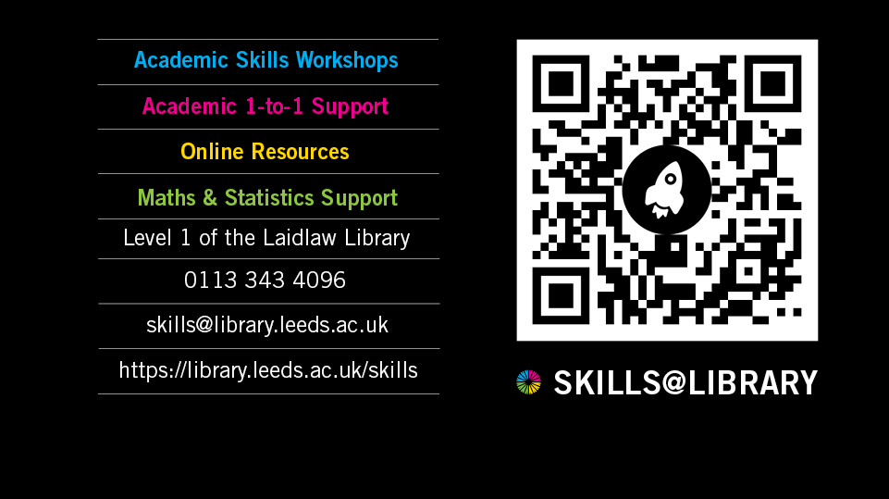
Notes:
Skills@Library offers a range of free workshops to all taught students, which you can attend alongside your study. Workshops are on many diff topics, from academic reading, to note taking, writing and doing your research projects. These are offered throughout the year.
1-1 apt - useful tailored support for whatever you’d like to discuss.
QR code to access and explore the support from Skills@LIbrary.

Slide 17
Flying Start Fair - 26th September, 11.00 - 14.00
Drop in to the Skills@Library in LaidLaw Library
Get a headstart developing your academic skills!
Get to know our Library Makerspace resources and try something new!
Treasure Hunt with a chance to win a prize.
Notes:
Flying Start fair: Drop-in to the Skills@Library Flying Start Fair on 26th September,11-2pm and get a headstart developing your academic skills for the year ahead. Find out about the help and resources we offer to all Undergraduate and Taught Postgraduate students. You can chat to staff and writing mentors from the Skills@Library team about academic and digital skills (including data skills), maths and stats. You can also find out about our Library Makerspace and have a go at trying something new! There will be a a Skills@Library Treasure Hunt with a chance to win a prize and refreshments available!

Slide 18
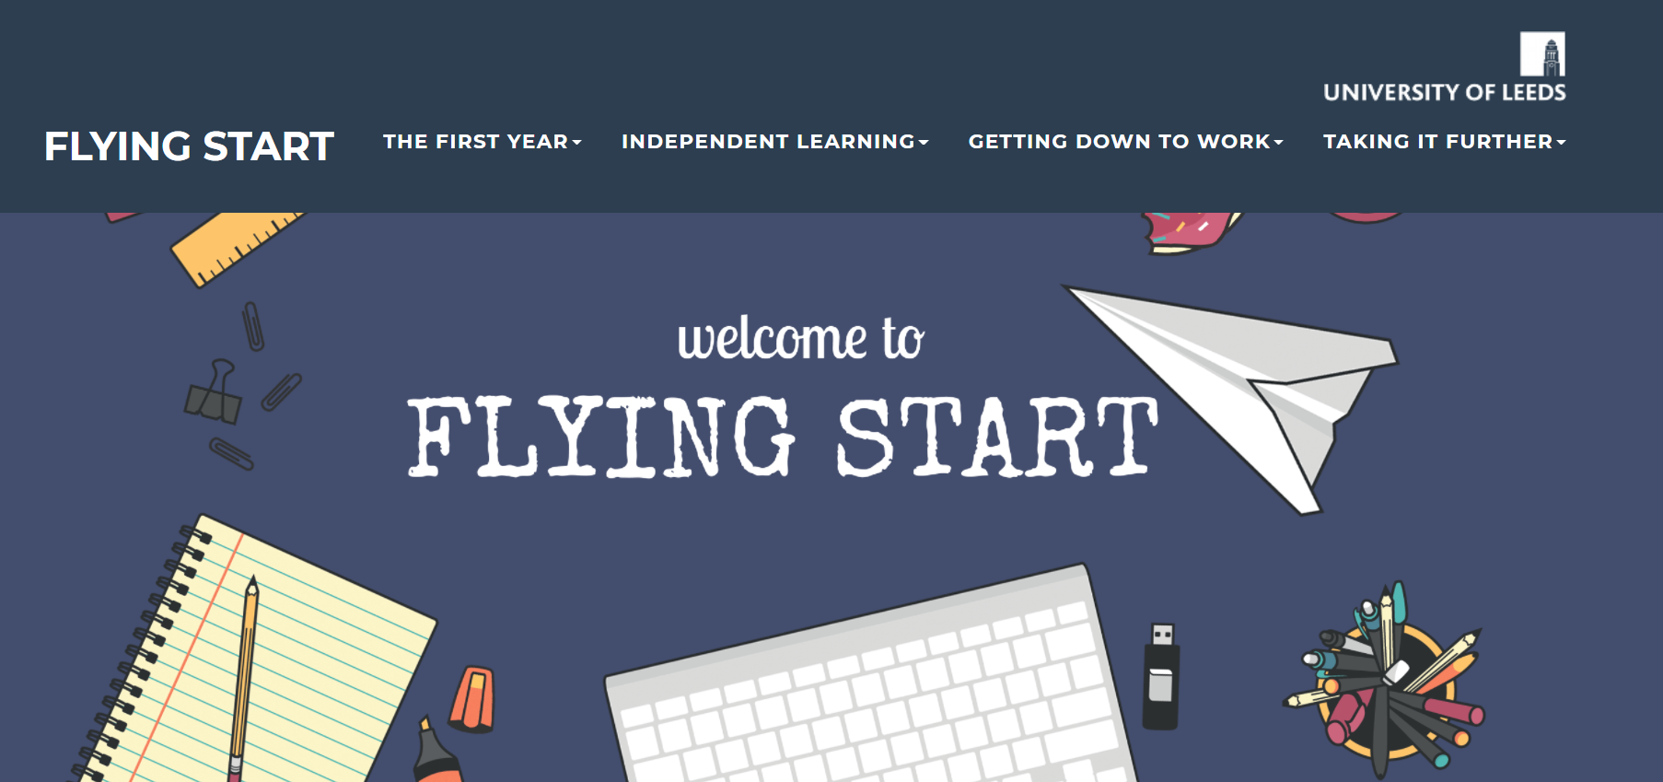
Flying Start https://resources.library.leeds.ac.uk/flyingstart/

Slide 19
PGT students
https://resources.library.leeds.ac.uk/step-up-to-masters/
Notes:
[Do not demo. Just say]
There are also some other resources that may be useful for you, such as Flying Start. It is developed for people like you, who are just starting the university study. It is broken into different sections and you can work through these in one go, or dip in and out, or just look at key relevant sections.

Slide 20
Academic English courses & workshops
The Language Centre provides opportunities for students to become more confident in using academic language in their discipline. Your School may offer these workshops and academic English support specific to your area of study.
Weekly classes
1:1 and/or small group consultations
Online resources for modules
Find out about workshops and learning opportunities you can access from your School
Notes:
The Language Centre at Leeds provides a range of learning opportunities for students to become more confident in using academic language in their discipline. These may take the form of: Weekly classes, 1:1 and/or small group consultations, online resources for modules.
If you'd like to develop your confidence in using academic language, there are workshops and advice appointments that can help you to do this.
For Students | English for Academic Purposes: Insessional (leeds.ac.uk)

Slide 21
Language Zone
A dedicated space and resource centre for language learning.
Workshops
Activities
And many more....
Language Zone | University of Leeds
Notes:
Independent English language learning support is also available at the Language Zone, which has free resources and activities to help you develop your language skills.
The Language Zone - A dedicated study space and resource centre for language learning. Workshops + Activities to help you practise and improve your skills.

Slide 22
Research show that it is important to use English in social contexts. This is because practising English socially can have positive impacts on using English in an academic context. Get involved!
Notes:
Some students will have had lots of experience of using English before and others less.
Stress the importance of using English in social contexts, recognising that going out and practising English socially can also have positive impacts on using English in an academic context.
The more engaged you are with the university and in social contexts, more successful you can be academically.
Lots of opps to get involved: S@L workshops, LUU events and activities, being a school/course rep, joining sports and societies, coming along to the Language Zone, as well as taking part in events organsied by your local school and progs.

Slide 23
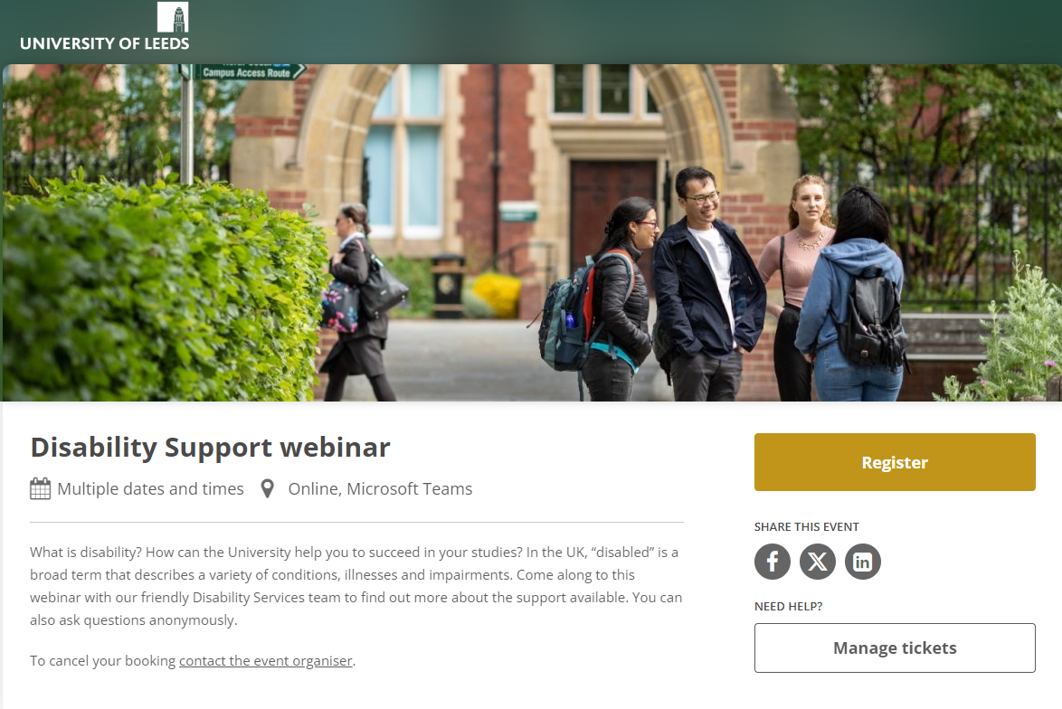
Scan the QR code to register
Notes:
Finally, a shout out for the Disability Support Webinar run by our friendly Disability Services team.
In the UK, “disabled” is a broad term that describes a variety of conditions, illnesses and impairments. Some of these conditions are diagnosed by health professionals, and some are self-diagnosed. In this webinar, you can find out more about the support available in the context of developing academic skills as well as asking questions anonymously.
Scan QR to register.
Register – Disability Support webinar – Microsoft Teams (tickettailor.com)

Slide 24
Useful sites for information Student Information Service https://students.leeds.ac.uk/askingforhelp International Orientation programme https://students.leeds.ac.uk/orientation
Upcoming talks, sessions and events
Orientation resources and links from today's session

Slide 25
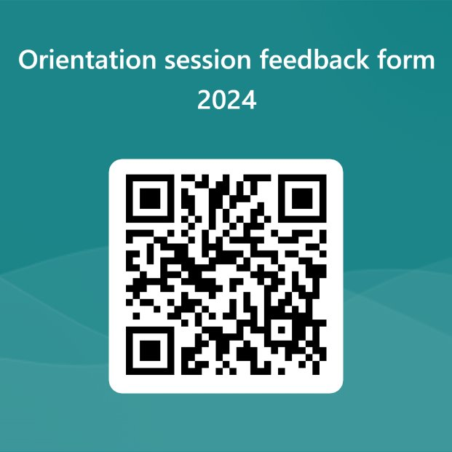
Have your say!
Evaluation QR code / link

