Slide 1
Misconceptions about reporting or getting support (1)
It is serious enough to book an appointment with us
We take disclosures very seriously and will support you however feels right to you
I won't be believed or taken seriously...
Notes:
We have been specialist advisors for years now and have noticed some students have misconceptions about reporting an incident or accessing support. These are real comments we have received from students:
"I won't be believed or taken seriously"
I want to reassure you -
It is serious enough to book an appointment with us – you can disclose anything that has made you feel uncomfortable or unsafe during your time at Leeds or before you arrived.
We take disclosures very seriously and will support you however feels right to you. We can explore different options about what to do next together.

Slide 2
Misconceptions about reporting or getting support (2)
If I make a report, it could impact my studies or Visa...
Seeking support won't impact your studies
Accessing our service is confidential.
Making a report to the police does not affect your Visa.
Notes:
If I make a report, it could impact my studies or Visa...
Seeking support won't impact your studies – accessing our service is confidential. This means.... With your permission we can contact your school to apply for mitigating circumstances or look for extra support.
Making a report to the police does not affect your Visa. In an appointment we can talk about this and reduce any concerns you may have. We have a police campus officer – PC Laura Beaton who you can also talk to.

Slide 3
Misconceptions about reporting or getting support (3)
What if I want to speak to a specific person or request a translator/require any additional requirements?
We'll make the space and our support as inclusive as possible
Notes:
What if I want to speak to a specific person or request a translator/require any additional requirements?
We'll make the space and our support as inclusive as possible – we can make adjustments to the room, arrange a translator, offer sensory devices and more to ensure you're comfortable speaking to us.

Slide 4
Misconceptions about reporting or getting support (4)
If I talk to someone in the team, they will go against my wishes and force me into a reporting service.
We'll always make sure you are in control over what you decide to do next.
Notes:
If I talk to someone in the team, they will go against my wishes and force me into a reporting service.
We'll always make sure you are in control over what you decide to do next. We will assess risk and make sure you are safe. If we ever needed to escalate anything, we would let you know if we are doing this. The majority of the time, you are in control over what you would like to happen next as we are a student-led service. Our main aim is for you to understand your options around reporting processes and support.

Slide 5
“Her support, kindness and going above and beyond gave me the strength and confidence to proceed with my report.”
3rd year undergraduate student
''All your advice and concern have helped me as a student in a foreign country, you made me feel supported and not alone. Without your help, I probably would not have known how to work through this at all.''
1st year international student
No question is too big or too small – please email us at:
reportandsupport@leeds.ac.uk
Notes:
Here is some feedback from international students who used our services

Slide 6
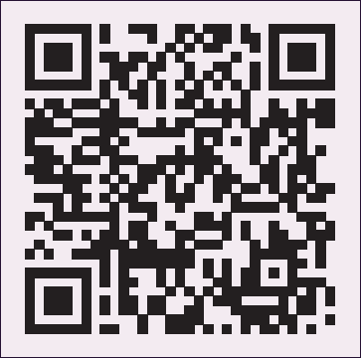
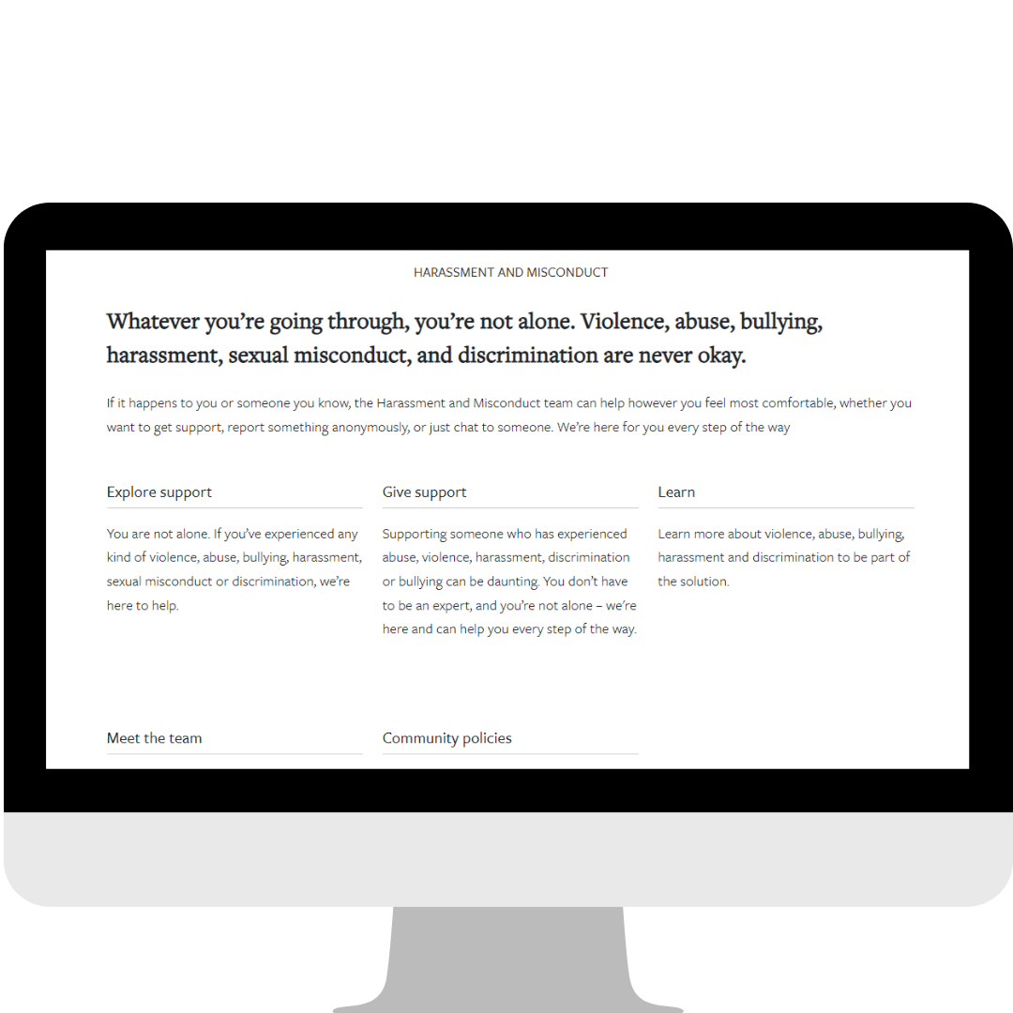
How to contact our service
Report and Support webpage:
Tell us anonymously
Complete the 'Speak to An Advisor' form
Email the team directly on reportandsupport@leeds.ac.uk
For Students Webpages: information about how what support is available, how to give support and what you can do to be part of the solution to change the culture.
"You are not alone."
Notes:
There are several ways to access our service: You can tell us anonymously or you can provide your contact details using the report and support webpage
Anonymous disclosures are important as they allow us to have an understanding of what is happening within our community. The information you share here supports us in monitoring trends which we use to inform preventative work across the university.
If you make a disclosure giving us your contact details via the Report + Support webpage, the information you give us will not go anywhere else. Making a disclosure is not the same as a formal report. We are not a formal reporting place but can help you make a report if you want to.
You can also email us at our email address. This is monitored Mon – Fri 9am – 5pm and we will respond to you within 1 working day.
For Students Webpages: You can find lots of information on our webpages about how what support is available, how to give support and you can do to be part of the solution to change the culture.

Slide 7
Three takeaways
Reassurance – you can contact our team for confidential, judgement-free support.
You take the lead – we will not tell you what to do.
Nothing too big or too small
You are not alone; let's take the next steps together.
"You are not alone."
Notes:
Here are the three most important things I want you to take away from my presentation:
Reassurance – we hope you feel confident about reporting and reassured you that you can contact our team for confidential, judgement-free support.
You take the lead – by contacting our team, there is no pressure or expectation for you to make any decisions about anything. We will work with you to create a space for you to have access to information to make informed choices about any next steps you might want to take. We will not tell you what to do.
Nothing too big or too small – if something has happened that didn't feel ok, whether during your time at university or before, you can contact us. You don't have to fit into a specific definition to tell us that something has happened. If we realise that another team would be better placed to support you, we can refer you to the right people.

Slide 8
Questions and feedback
Notes:
ISO facilitator: Thank you Carys, and thank you to everyone for coming along to this session
I hope everyone has found it useful and reassuring
Remember, there’s lots of support on offer to help you feel safe and people who can help you understand UK rules and ways of doing things. It’s important to take precautions to minimise the chance of problems arising, and seek advice if you’re unsure, but try not to let safety worries or general uncertainty about how things are done stop you from asking questions, taking part and enjoying yourself! And if anything doesn’t feel right or is making you worried or uncertain, reach out for support.
(Webinar) STOP RECORDING
Now we have some time for questions and feedback about today's session
Webinar Q&A only If you have any questions, please feel free to type them in the chat or let us know if you prefer to ask your question in person and we can switch on your microphone.
For in person vevox Q&A move to next slide

Slide 9
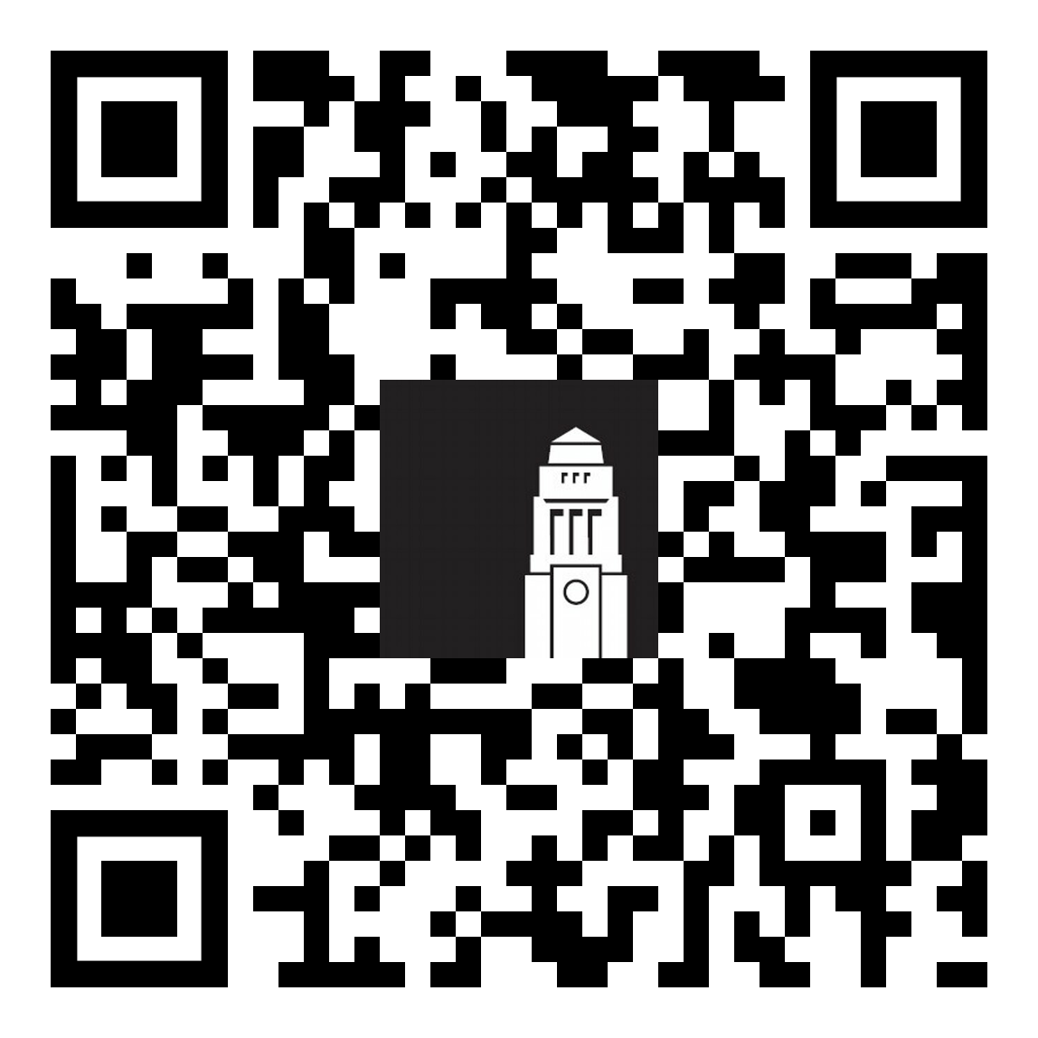
Questions:
Webinars and resources:
Money and Banking
Healthcare and Wellbeing
Staying Safe in Leeds
Working in the UK during and after studies
Embracing (Culture) Change (interactive workshop)
Disability Support
Preparing to Study; Bridging Academic Expectations
House Hunting in Leeds (finding private accommodation)
Sign up for live sessions this week and next week
Recordings and slides also available to catch up
students.leeds.ac.uk/orientation
Contact the Student Information Service
Student Information Service
Notes:
Just a reminder that if you still have questions, you can contact the Student Information Service in person at an information point, by phone or by email.
You can also find all of the links mentioned in this presentation, and our other sessions, on our Orientation Resources page, and we will be posting slides and videos from this presentation
You can also still sign up for live sessions this week and next week

Slide 10
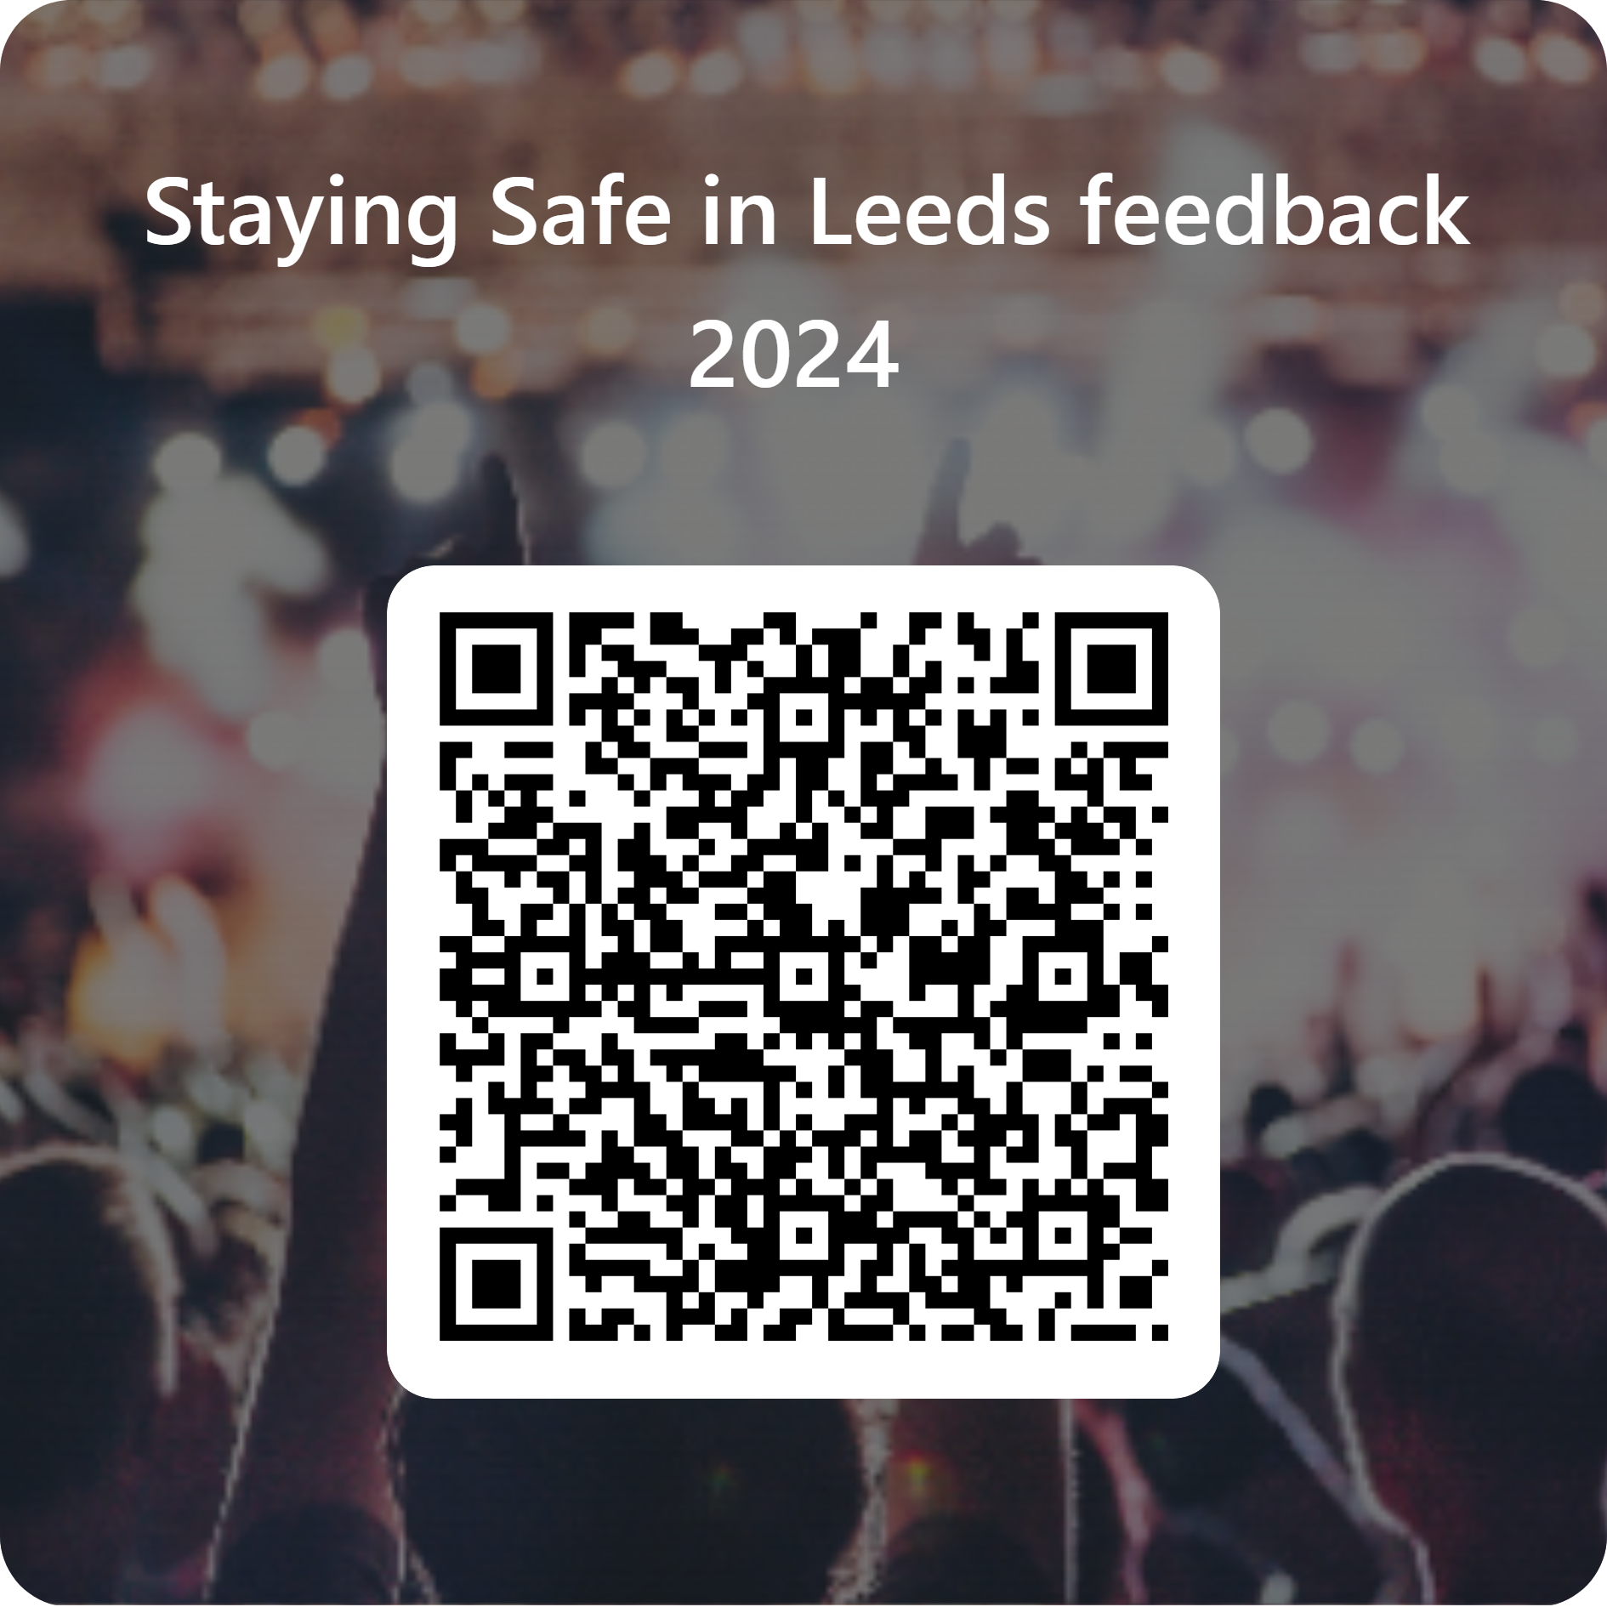
Your feedback matters!
Please tell us what you thought about today's talk
Prize draw!
Win one of four £30 "Love2Shop" vouchers
Scan the QR code or visit
tinyurl.com/SSinL24
Notes:
Finally, Before you leave today, please use the QR code or on the slide to complete a short feedback form to tell us what was useful, what worked well and what could be improved. Your feedback is really valuable and will help us to improve the session in future.
After the session:
Facilitator 1 (ISO team member) to export the poll results and attendance report and save in the relevant folder in the Webinar feedback folder
Download feedback from MS Form and save
To save attendance report, either go to the Attendance tab and download, or a tile labelled Attendance report will pop into the chat about five minutes after your meeting ends. Select it to download the CSV file.
Check attendance report and add total number to headcount column of the Orientation facilitator schedule 24.xlsx
Record any feedback/comments in the feedback column of the Orientation facilitator schedule 24.xlsx and share with colleagues anything that needs updating before the next webinar.

