Slide 1
Support from your Harassment and Misconduct Team
Notes:
ISO facilitator: Now we are going to handover to Carys to tell you more about how the Harassment and Misconduct team supports students

Slide 2
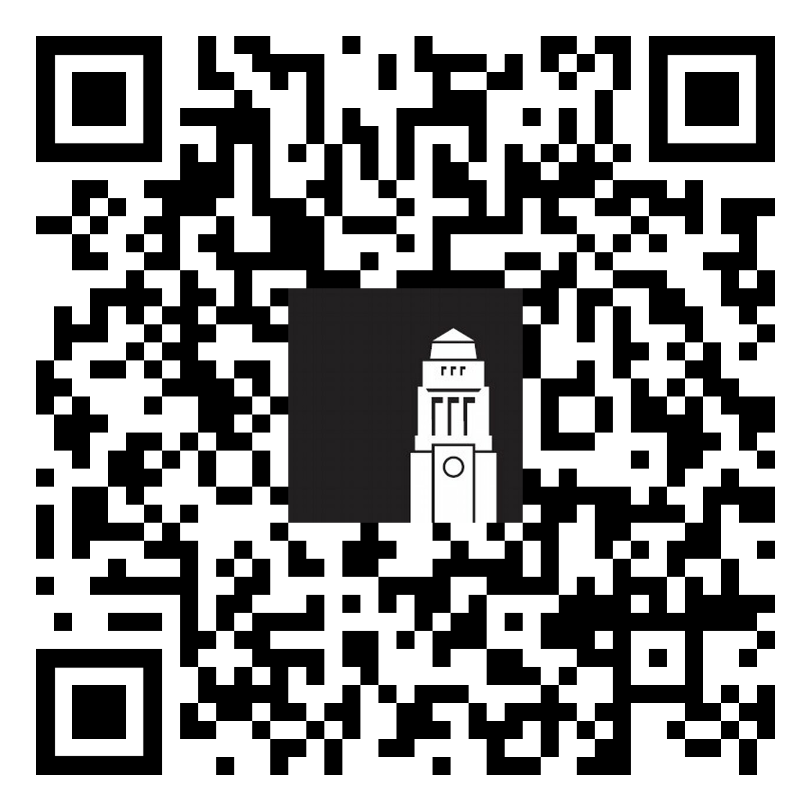
Harassment and Misconduct
Violence, abuse, bullying, harassment, sexual misconduct, and discrimination are never okay.
If it happens to you or someone you know, the Harassment and Misconduct team can help however you feel most comfortable.
We’re here for you every step of the way.
Notes:
Hi everyone I am Carys, a specialist adviser from the Harassment and Misconduct team at the University. We offer emotional and practical support to all students and postgraduate researchers if they experience or witness any incidents of concern. Today I will provide some examples of different incidents we have supported students with and show you how to get in contact with our service, and the different ways we can help. I'll also talk through some misconceptions that previous international students have had about contacting our service. I want to reassure you that our team is here to support you. I hope my talk will remove any misconceptions or barriers for you so that you feel comfortable to contact our team, if you need us.
This presentation is not to worry you, as most of you here today may not need to access our support. However, it is really important that everyone is aware of some of the types of behaviour and incidents that we support with, so you know that you can contact us if you ever experience or witness an incident that makes you feel uncomfortable or unsafe. This could include things happening at the University or in the wider community. Or it may have happened to you before you have even arrived in Leeds but you may still be feeling the impacts and we can help with that.
The University wants to create a community that is free from harassment and discrimination.
Any form of violence, abuse, harassment, bullying or discrimination is never okay, and it is not your fault if it happens to you.
We have a trained, specialist team that support students who have experienced a range of different behaviours and situations.
Here are some examples of the type of situations we can help with. What you experienced may not fall under one of these examples, however you can still contact us. If we aren't the right team to support you, then we will find the team who will support you.

Slide 3
Example situations 1
Sexual Harassment: A student has received multiple messages on WeChat from another student at the university. She has asked him to stop, and he continues to message and ask her out for a coffee. She has blocked his number but now he has started messaging via her university email address. ​
Bullying: A student is feeling left out of the group with their flat mates. They arrange their own nights out and don’t include him. When he goes to cook in the kitchen, the group go silent and ignore him. This doesn't feel okay to the student and it's making his living situation uncomfortable.
Notes:
<click>
Sexual Harassment: A student has received multiple messages on WeChat from another student at the university. She has asked him to stop, and he continues to message and ask her out for a coffee. She has blocked his number but now he has started messaging via her university email address.
<click>
Bullying: A student is feeling left out of the group with their flat mates. They arrange their own nights out and don’t include him. When he goes to cook in the kitchen, the group go silent and ignore him. This doesn't feel okay to the student and it's making his living situation uncomfortable.

Slide 4
Example situations 2
Hate crime or incident: A student is on a bus in Leeds when a stranger on the bus makes a racial comment towards them. Nobody else on the bus intervenes and the student feels very upset and uncomfortable about this experience. They don't know who to report this to and if anyone will listen.
Coercive control/domestic abuse: A student has just started a new relationship. At first things were going well but now their partner wants them to only spend time with them and not their friends. They also track their location frequently and get annoyed when they don't update them on where they are.
Notes:
<click>
Hate crime or incident: A student is on a bus in Leeds when a stranger on the bus makes a racial comment towards them. Nobody else on the bus intervenes and the student feels very upset and uncomfortable about this experience. They don't know who to report this to and if anyone will listen.
<click>
Coercive control/domestic abuse: A student has just started a new relationship. At first things were going well but now their partner wants them to only spend time with them and not their friends. They also track their location frequently and get annoyed when they don't update them on where they are.

Slide 5
Example situations 3
Honour based abuse: A student started a new relationship but haven't told their family due to religious or cultural reasons. Their family have now found out and are angry and they are threatening the student. The student is now worried to come to campus in case something happens to them or their new partner. They are thinking of reporting this for their safety but are worried about the police and don't want their family to get into trouble.
Spiking: A student is out in Leeds and notices another student has added alcohol to their drink without asking them first. They aren't sure who to tell and it has made them feel anxious about socialising again, so they are spending a lot of time on their own and feeling quite isolated.
Notes:
<click>
Honour based abuse: A student started a new relationship but haven't told their family due to religious or cultural reasons. Their family have now found out and are angry and they are threatening the student. The student is now worried to come to campus in case something happens to them or their new partner. They are thinking of reporting this for their safety but are worried about the police and don't want their family to get into trouble.
<click>
Spiking: A student is out in Leeds and notices another student has added alcohol to their drink without asking them first. They aren't sure who to tell and it has made them feel anxious about socialising again, so they are spending a lot of time on their own and feeling quite isolated.

Slide 6
Example situations 4
Blackmail / Fraud: A student has met someone online and has been messaging them. They have sent an intimate picture of themselves to this person. This person is now blackmailing them and demanding they transfer them a sum of money otherwise this person will share the image with their friends/family/online.
Notes:
Blackmail / Fraud: A student has met someone online and has been messaging them. They have sent an intimate picture of themselves to this person. This person is now blackmailing them and demanding they transfer them a sum of money otherwise this person will share the image with their friends/family/online.
Now I will explain some of the ways we can help.

Slide 7
Harassment and Misconduct Team
Experienced and specialist advisers with skills and knowledge to support people after sexual assault, harassment or abuse
By providing a non-judgemental, empowering space to talk after experiencing or witnessing an incident
To understand options for formal reporting
To get help with practical support such as any impacts on academic studies, finances, accommodation
Referrals to therapeutic and emotional support
Charlotte Webster, Harassment and Misconduct Manager Lorna de Fenzi, Harassment and Misconduct Advisor Carys Corkhill, Harassment and Misconduct Advisor
Notes:
We are a specialist team who have skills and knowledge to support you.
<click> We have a private space on campus where you can have an appointment with us and talk confidentially about what has happened. In the appointment we assess risk and talk to you about your options. You never have to make a decision about the next steps in that appointment and we give you time to think about what you would like to do next.
<click> You might have options for reporting the incident to the police or to the university if the incident involves another student, but there is no pressure to report.
<click> We look at practical support, for example, do you need us to help you get academic support from your school? We can write a supporting statement for you to use as evidence to apply for an extension. Or you may need emergency accommodation as you aren't feeling safe or the incident involved a flatmate. We can work with the university accommodation team to arrange options.
<click> We help with emotional support and are here to listen and offer advice. We aren't counsellors so we would help you with accessing counselling or therapeutic support from the student counselling and wellbeing team or with an external service in Leeds.

