Slide 1
Staying Safe in Leeds
International Orientation
Brought to you by the International Student Office
Slides and links to all resources mentioned can be found on
students.leeds.ac.uk/orientationresources
Notes:
Welcome to today's session about staying safe in Leeds.
Leeds is a generally safe place to live, but as in any big city it’s important to do things that keep you safe. We understand you might feel worried about recent unrest in some UK cities, but the situation is much calmer now. In this session we will give you lots of information to help you feel safer.
We’re going to give you some key information and advice about important rules you need to be aware of, and some risks you need to consider during your time at Leeds. We’ll also tell you how to get support if you need it.

Slide 2
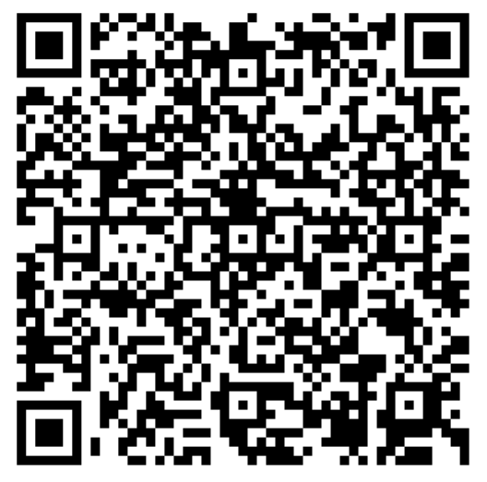
Introduction
Aims
Topics
Reassure you about simple steps you can take to stay safe and avoid problems
Highlight key UK laws and rules you need to know about
Share useful information and resources
Encourage you to use support if you have any worries or problems
Helpful contacts
Student Visa Advice
Transport and travel
Protecting your belongings
Fraud and scams
Alcohol safety in the UK
Support from the Harassment and Misconduct team
Questions
Orientation Resources
Notes:
The aims of today’s session are to
<click>Reassure you about simple steps you can take to stay safe and avoid problems
<click>Highlight key UK laws and rules you need to know about
<click>Share useful information and resources
<click>Encourage you to use support if you have any worries or problems
Topics today’s session will cover safety on and off campus, including <click>:
Helpful contacts
Student Visa Advice
Transport and travel
Protecting Your belongings
Fraud and scams
Alcohol safety in the UK
Support from your Harassment and Misconduct team
Links for all resources and web pages mentioned in this session are on the Orientation resources page [QR code] / link
[webinar version] If you have questions at the end you can write them in the chat or ask them on the microphone

Slide 3
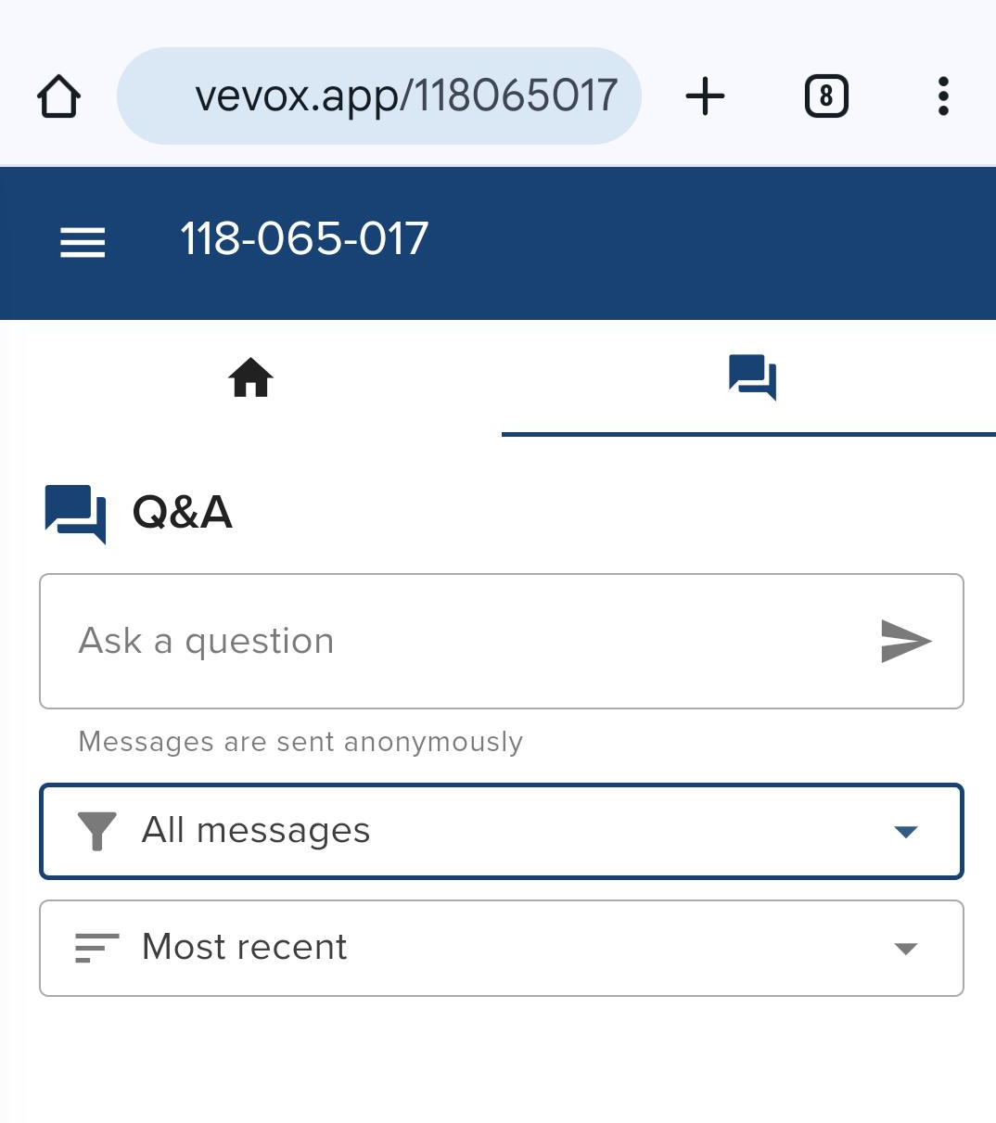
Any questions?
Ask a question or vote for other people's questions
Questions are moderated so they may not appear immediately
Go to vevox.app on your device and enter the session ID:
192-426-102
Or scan the QR code

Slide 4
Helpful contacts
​Contacts | EMERGENCIES​ | NON EMERGENCIES​
Student Information Service​ | ​ | +44 (0)113 343 7000 ​(International) 0800 915 0402 ​(UK sim card) studentinfo@leeds.ac.uk
Harassment and Misconduct Team | ​ | reportandsupport@leeds.ac.uk
University Security Office​ | +44 (0)113 343 2222 ​ (or the SafeZone app) ​ | +44 (0)113 343 5494 ​ +44 (0)7876 866747 ​
Police​ | 999​ | 101​
Campus Police officer: PC Laura Beaton​ | ​ | +44 (0)7719417879 ​ (8am-4pm, Mon–Fri)​​
Notes:
There are lots of ways to get advice and help with questions about safety and UK rules. Also, if you experience or witness a crime, or any situation that makes you feel worried. You can contact the Student Information Service and University Security Services. They can put you in touch with our Campus Police Officer if needed. You can also contact the Police directly using the emergency or non-emergency numbers shown here.
We also have a team of specialist Harassment and Misconduct advisers who can offer confidential support if you experience or witness any kind of harassment, discrimination, bullying, violence or abuse. You will hear more about how this team supports students later in this session.

Slide 5
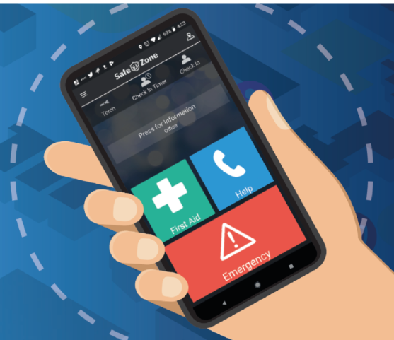
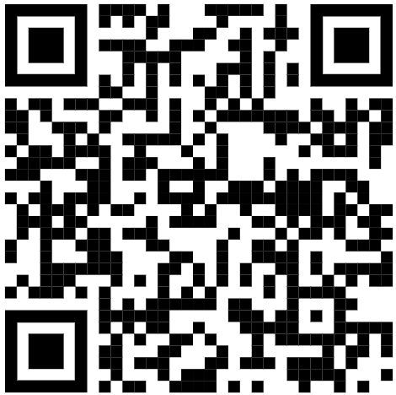
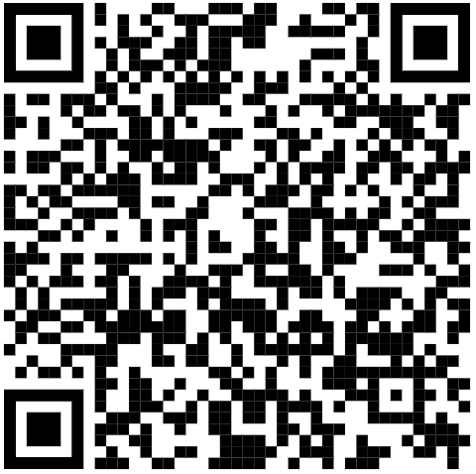
Safe Zone App
For help with a physical or mental health incident
Non-emergency situations
(you’re locked out of a building or you're lost)
Download the SafeZone app
Immediate danger
Iphone
Android
https://estates.leeds.ac.uk/our-services/security-services/#safezone
Notes:
SafeZone is an app that everyone on campus can use to ask for help. It’s there to give you extra peace of mind in addition to the other support offered by the University. It is linked to the University’s Security team who are always on call to help you.
The app has three buttons
<click> Use the green First Aid button if you’ve had a physical incident or if you’re struggling with your mental health.
<click> Press the blue ‘Non-Urgent’ button to get connected to Security in a non-emergency situation, for example, if you are locked out of a building or you're lost.
<click> Use the red button only in case of emergencies, if you are in immediate danger.
The app can track where you are so that University of Leeds Security Services can contact you or come to help as soon as you raise an alert.

Slide 6
Student Visa Advice
Our Student Visa Advice Team can help with advice including:
Correcting errors with your visa/BRP
Student / Tier 4 Visa extensions
Inviting your family
Working during and after your studies
Visa scams
Important things to do
If you don’t have an eVisa, create a UKVI account and access your eVisa once you have your BRP.
Check your student visa responsibilities and the conditions of your student visa so you protect your student status
If you’re thinking of making changes to your study plans, find out whether there will be any impact on your visa
Student Visa Advisers are the only staff in the University that can legally give you immigration advice
Seek help early, and don't leave visa issues to the last minute!
students.leeds.ac.uk/visa

Slide 7
Transport, travel and protecting your belongings
Notes:
Now we are going to give you some information about transport, travel and protecting your belongings

Slide 8
Transport and travel: Walking
We drive on the left – be careful when you cross the road. Some areas of campus are not just for pedestrians
Avoid taking shortcuts through badly lit areas like alleys or parks, and don't walk home with strangers.
Stick to well lit, busy areas and stay with other people you know, or use transport – buses or taxis.
Notes:
Walking is one of the easiest and healthiest ways to get around Leeds and it’s good for saving money too.
<click> Remember when you cross the road that we drive on the left in the UK, and watch out for traffic on campus as many areas are not only for pedestrians.
<click> If you’re walking around the city at night, avoid taking shortcuts through badly lit areas like alleys or parks, and don’t walk home with strangers.
<click> Stick to well lit, busy areas and stay with other people you know, or use transport – buses or taxis.

Slide 9
Transport and travel: Buses
Download the First Bus app for journey planning and cheaper tickets
It’s usual to queue at bus stops and to put your arm out to signal for the bus to stop
LUU's night bus is free, safe and convenient
Notes:
You can plan bus journeys using the First Bus app which also has useful maps and timetables. Tickets are cheaper if you buy them on the app. You can also pay on the bus in cash (close to correct money is best) or by using contactless on your bank card.
<click> To avoid any difficulties when you’re catching a bus, remember to queue at the bus stop, and put your arm out as the bus is approaching so the bus driver knows they need to stop for you.
<click> There’s also a Night Bus that will take you from Leeds University Union building to your door in the evenings during term time.

Slide 10
Transport and travel: Taxis
Use a licensed taxi company or a pre-booked car service like Uber or local taxi firm, Veezu.
Veezu can take you home in exchange for your Student ID card.
Don’t accept lifts or share taxis with people you don’t know
Notes:
If you’re taking a taxi, use a licensed taxi company or a pre-booked car service like Uber or local taxi firm, Veezu. You can download apps for both.
Veezu have a scheme where they can take you home in exchange for your student card if it’s after dark and you have no money. You collect your student card and pay the fare at the Cash Office in Leeds University Union 3 days later.
Don’t accept lifts or share taxis with people you don’t know

Slide 11
Transport and travel: Bikes
Stay safe and know the rules
You can get cycle safety advice at the Bike Hub on campus and there are also free adult cycle training courses in Leeds
Check the UK Highway code on the GOV.UK website for rules and advice for cyclists
Don't ride through red traffic lights or on pavements. Use cycle paths
Wear a helmet, hi-visibility clothing and use lights
Hire a bicycle at the bike hub on campus or rent an e-bike using the Beryl app
If you buy a bike, get it registered and marked with the BikeRegister scheme
Always lock up your bike using a good quality D-lock and lock it to a cycle rack
Notes:
Many people choose to cycle in Leeds but traffic can get busy so it’s important to take cycle safety advice, especially as you get used to new rules and situations
<click> You can get cycle safety advice at the Bike Hub on campus and there are also free adults cycle training courses in Leeds
<click> Check the Highway Code for rules and advice cyclists should follow
<click> Don’t ride through red traffic lights or on the pavement/sidewal. Use cycle paths when you can.
<click> Wear a helmet and hi-visibility or reflective clothing to help you be seen, and use lights in bad weather or at night.
<click> You can hire a good quality bike from the campus Bike Hub which offers bike hire for 3 months. These bikes are very popular so apply early.
Leeds also has a bike share scheme. You can rent an e-bike when you need one by downloading the Beryl Bikes app and collecting a bike from one of the docking stations around the city.
<click> If you buy a bike, get it registered and marked with the BikeRegister scheme. The University covers the cost. Look out for BikeRegister events, stop a member of the Security team on campus, or contact Security Services to make an appointment.
<click> Always lock up your bike using a good quality D-lock. You can buy D-Locks from the Security team. Lock your bike frame to a cycle rack.

Slide 12
Transport and travel: Driving
If you have your own car or motorbike you must have a driving licence, road tax and vehicle insurance.
You must also have your car or motorbike checked every year by a mechanic to make sure it is safe to drive – this compulsory check is called an M.O.T.
Find out about the legal requirements for using a car or motorbike on the road on the GOV.UK website
Notes:
If you have your own car or motorbike you must have a driving licence, road tax and vehicle insurance.
You must also have your car or motorbike checked every year by a mechanic to make sure it is safe to drive – this compulsory check is called an M.O.T.
Find out about the legal requirements for using a car or motorbike on the road on the GOV.UK website

Slide 13
Your belongings
Don’t leave laptops/mobile phones or wallets/purses out of your sight.
Keep doors locked all the time and lock windows when you go out.
When entering your accommodation, don't hold the door for other people so that they can get in the building
Keep valuable items hidden when you are walking around, especially at night
Security Services operate a lost property system on campus
Register your possessions for free with Immobilise.com.com so that the Police can return any stolen items, if found
Check if your accommodation includes contents insurance
Notes:
Now we’re going to move onto sharing some key advice to help keep your belongings safe during your daily life in Leeds.
Don’t leave laptops/mobile phones or wallets/purses where you can’t see them, not even in places on campus like the libraries or cafés.
<Click> At home, keep doors locked all the time and lock windows when you go out. When you enter your accommodation, don’t hold the door for anyone behind you. They might be strangers trying to get in the building.
<Click> Keep valuable items hidden when you are walking around, especially at night
And here are some useful tips and resources:
<Click> Security Services operate a lost property system on campus
<Click> Register your possessions for free with Immobilise so that the Police can return any stolen items, if found
<Click> Check if your accommodation includes contents insurance

Slide 14
Fraud and Scams
Notes:
It's really important to be aware of the risk of fraud and scams.
But what are they?

Slide 15
Fraud and Scams: What to look out for
A CRIME
FAKE IDENTITIES
ASKING TO PAY MONEY
A national trend in fraud and scams targeting international students
Does it look too good to be true?
Does it seem real?
Do they speak your native language or contact you through specific channels (ie. WeChat)?
Whether big or small never pay any money, especially in advance.
If you're pressured into paying, it's probably a scam
If you experience a fraud or scam our Harassment and Misconduct Team can help
Notes:
<click> Fraud is a crime where a person uses a <click> fake identity to trick another person to <click> pay large amounts of money to them.
<click> Unfortunately there is a national and global trend in frauds and scams specifically targeting international students.
Fraudsters may pretend to be from an official organisation (such as the UK Home Office, the University, an Accommodation service, or an authority in your home country).
<click> They try to make themselves seem very genuine and may use language that sounds official or false documents that look real. They may seem to know something about you, such as your name and address, or that you have applied for a visa. They may try to seem trustworthy by speaking to you in your native language or contacting you through specific channels such as WeChat.
<click> They may demand money (for example a "fine" for an immigration problem that doesn’t exist) or ask for your personal information, and threaten that if you don't pay them quickly there will be consequences (for example, arrest by the police, deportation or cancelling your visa). Or they may offer to save you money on your accommodation or fees. Whether big or small never pay any money, especially in advance. If you feel pressured into paying, or it seems too good to be true, it's probably a scam.
If you think you have been scammed, contact your bank straight away, and also contact the Harassment and Misconduct team for support

Slide 16
Fraud and Scams: Things to remember
It’s always OK to end the call and ignore a message, even if the person claims to be from an official organisation. Checking will never cost you anything!
Organisations including banks, the police, the Home Office and the University will NEVER contact you to demand payment via phone, text or any other platform.
Banks will NEVER contact you to ask you to open new accounts and transfer current funds.
The University will NEVER send you a payment link through a message. Only use official University payment portals
For more information about spotting fraud and scams, register to attend our Money and Banking webinar
Notes:
Scams are becoming increasingly sophisticated and there are lots of different kinds, but there are some common principles to remember:
<click> It’s always OK to end the call and ignore a message, even if the person claims to be from an official organisation. Checking will never cost you anything!
<click> Organisations including banks, the police, the Home Office and the University will NEVER contact you to demand payment via phone, text or any other platform.
<click> Banks will NEVER contact you to ask you to open new accounts and transfer current funds.
<click> The University will NEVER send you a payment link through a message. Only use official University payment portals
We have more information about spotting fraud and scams in our Money and Banking webinar, so we really recommend that you attend this session if you haven’t already.
If you want to check if something is a scam, you can contact the Student Visa Advice team if it’s something to do with immigration or your visa, and for anything else contact the Harassment and Misconduct team. Someone will contact you within one working day, and often faster.

Slide 17
Alcohol safety in the UK
Notes:
Becky / Amy introduce themselves and where they work
Many people in the UK may choose to drink alcohol as part of their social activities, and there are also many people who don’t drink alcohol at all.
While you’re here you’re likely to see local people and students who’ve had too much alcohol to drink and we understand that this may feel shocking or scary, depending on where you’ve lived before.
You shouldn’t feel pressured to drink alcohol if it’s not something that you feel comfortable doing, even if people you want to be friends with are offering. It’s normal to say you don’t drink alcohol, or you’d prefer a coke or other non-alcoholic drink.

Slide 18
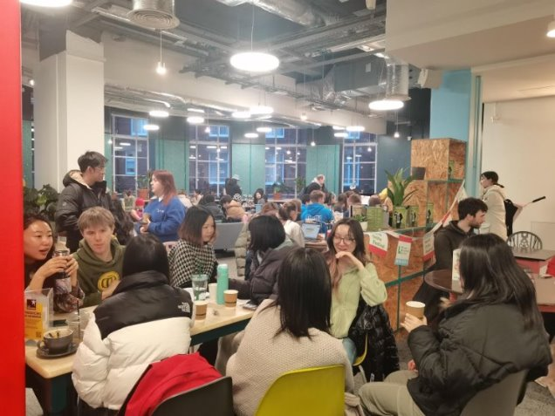
Alcohol free spaces and University support
Common Ground
Global Cafe
Crossroads
LUU Engage – Alcohol Free
We're a harm reduction University
Notes:
You can buy non-alcoholic drinks in all social venues, including pubs. Non-alcoholic drinks are also called “soft” drinks. There are also lots of alcohol-free social spaces and social activities on campus and in the city. At the university, these include
Common Ground: Located at the heart of the Union building, Common Ground is a vibrant and cosy cafe space. This is where Global Cafe takes place every Monday
Crossroads, right next to Common Ground is LUU’s student entertainment lounge. It has gaming computers, board games, cards and comics, and a cosy reading area.
LUU Engage – Engage is how you find out what's happening on campus - from joining in with our 350+ clubs and societies and the amazing activities and events they do to finding a wellbeing event to help you relax. You can use the ‘alcohol free’ filter to find something you’d like to do LUU Engage
Unlike some other countries, many coffee shops and cafes in the UK don’t stay open later into the evening and places that are open later often serve alcohol. But you can find cafes and dessert restaurants in the City Centre and places like Hyde Park that open later and don’t serve alcohol.
If you do drink alcohol, the next section gives some information to help you keep safe.
The University takes a harm reduction approach to alcohol and helps students to get the support, resources and education they need to feel safe and make informed choices.

Slide 19
Alcohol rules in the UK
The legal age for buying and drinking alcohol in the UK is 18
You must not buy alcohol for anybody who is under 18
Valid photo identification is needed to buy alcohol/enter evening venues which serve alcohol: Citizen Card, Passport, Driver’s License, BRP
You must not drink alcohol in a designated public place
Notes:
<click> In the UK, the legal age for buying and drinking alcohol is 18.
<click> You must not buy alcohol for anyone who is under the age of 18.
<click> You may be asked to show photo identification to buy alcohol, or to enter licensed venues, such as bars, pubs or clubs. This includes Leeds University Union evening events which serve alcohol.
Examples of valid photo ID are:
Proof of Age scheme cards with a PASS logo, like a Citizen Card
Passports / BRP
UK Driving License
Be very careful about taking important documents like your passport or BRP on nights out. We recommend you apply for a proof of age card such as a Citizen Card as soon as possible. You don’t need to be a UK citizen to apply for the card.
<click> There are also some public places where signs will tell you that you must not drink alcohol (including streets in the City Centre). You risk having to pay a fine if you fail to stop drinking alcohol in a public place when a police or council officer tells you to.

Slide 20
Safety on social nights out
Be aware of health advice and how much alcohol you’re drinking
Drink water or soft drinks between alcoholic drinks
Avoid binge drinking
Always keep your drink where you can see it
If you feel unsafe or are worried about someone else, ask for help:
On campus - Use the SafeZone App
Off campus - speak to a member of staff at the venue, or call 999 in an emergency
Harassment and Misconduct team can provide support if something has happened on a night out that you're not comfortable with
Notes:
Many students drink alcohol as part of social events and nights out. Alcohol can have a variety of different effects, and not everyone experiences the same things when they drink alcohol. Some people on a night out might find that they don’t have to drink much alcohol to start feeling its effects – which can include sickness, loss of control, and lowered inhibitions.
Because drinking alcohol can have risks for your safety and health, it’s good to remember the things you can do to keep safe when you’re drinking.
<click> Be aware of health advice and how much alcohol you’re drinking - we have some information to help with this on the next slides
<click> Take safety precautions like drinking water or soft drinks in between alcoholic drinks.
<click> Avoid drinking too much alcohol at once, or in a short period of time, because this can be damaging to your health. This is known as ‘binge drinking.’
<click> Always keep your drink where you can see it, so no-one can add anything you don’t know about. If a stranger buys you a drink, make sure you can see it being poured and that you take it straight from the bartender.
<click> If you feel unsafe or if you’re worried about someone else when you are on a night out, there are things you can do:
On campus – you can contact University Security Services using the Safezone App we told you about earlier
Off campus – speak to a member of staff at the venue, or call 999 in an emergency
<click> Also, if something happens to you on a night out that you’re not comfortable with, you can ask for support from the Harassment and Misconduct team, who you’ll hear from later in this talk.

Slide 21
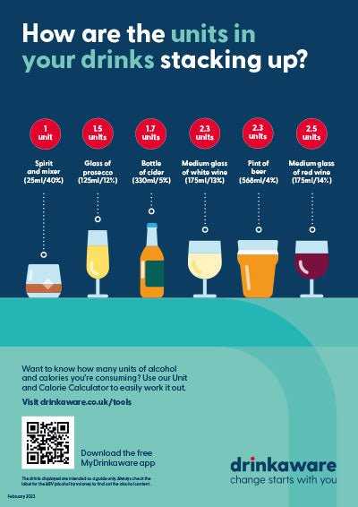
Alcohol units
Notes:
Here’s some information to help make sure you’re aware of health advice and how to know how much you’re drinking
The UK government recommends that if you choose to drink alcohol, you should drink no more than 14 units of alcohol per week. This includes having several days where you don’t drink alcohol at all. In the UK, units might look like this: [refer to visuals.]

Slide 22
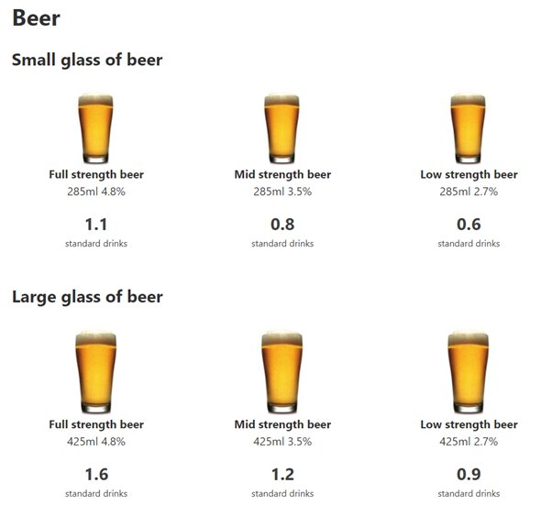
Alcohol strength
Notes:
When you’re checking how much alcohol you’re drinking, remember the strength of the alcohol varies in different drinks, [refer to visuals] and the strength can also vary from country to country so what you’re used to at home may be quite different in the UK.

Slide 23
Advice, guidance and support
Access support, address concerns, and receive proactive harm reduction advice and information
📅 When: Every Friday
🕐 Time: 1:00 PM - 4:00 PM
📍 Location: Room 3 - Orange, Leeds University Union
Notes:
We want you to know that there are people you can speak to if you have any worries about alcohol use, or if you want to understand more about alcohol.
Forward Leeds is a local drug and alcohol service that is independent from the University, but they work with us to provide advice and support to students. They have a drop-in service at the Leeds University Union building every week during term time.
You can go and speak to them if you have any questions about alcohol use - it isn’t just for students who are concerned about their own drinking. It can be for anyone who has questions about alcohol, is feeling uncomfortable about alcohol use around them, or is worried about somebody else.
Drugs
Forward Leeds can also provide advice and support about drug use. The safest way to do drugs is not to do drugs at all, and we do not condone drug use at the University. This doesn’t mean that you can’t speak to us about it if you are worried or need advice and support.
You may find that some students engage in illegal drug use, and you may be worried about this or even feel pressure to join in. If you have any questions or concerns about drug use, you can speak to Forward Leeds at their drop-in service on Fridays.

