Slide 1
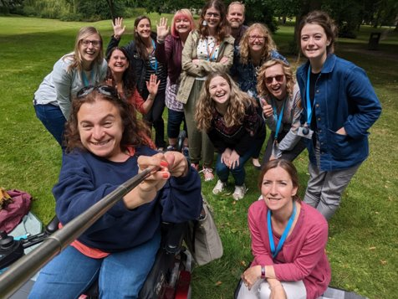
Welcome to Disability Services
disability@leeds.ac.uk
Notes:
Will share contact details again at the end of presentation

Slide 2
Can we help you?
We’re a friendly service for the University’s disabled students
We provide academic related support & guidance to students, University Schools and Services.
We recommend academic reasonable adjustments for students’ learning, teaching & assessments.
We are the University experts and contribute to making the University a more inclusive space
We work with over 8000 students at Leeds – you are not alone!
Notes:
Did you have exam arrangements at school, or additional support as an undergraduate?
Do you have a disability or condition that may affect your studies?

Slide 3
Who qualifies for disability support?
In the UK the Equality Act 2010 defines a disabled person as someone who:
“has a physical or mental impairment that has a substantial and long-term adverse effect on his or her ability to carry out normal day-to-day activities.”
‘Long term’: has lasted, or is likely to last, 12 months or more
Notes:
You don’t have to think of yourself as disabled to qualify for support, it is about whether you meet the legal definition.
More than 7,500 students registered with Disability Services.
Impact on academic studies only.

Slide 4
We support disabled applicants and students who…
Are D/deaf or hearing impaired
Are blind or visually impaired
Have physical disabilities and/or mobility difficulties
Have specific learning difficulties (e.g. dyslexia, dyspraxia, AD(H)D)
Are autistic
Have a diagnosed long-term mental health condition
Have a diagnosed long-term medical condition
Have a combination of these
This list is not exhaustive. If you’re not sure whether you qualify for support please contact us for more advice and information
Notes:
Are D/deaf, hearing impaired or hard of hearing
Are blind, visually impaired or partially-sighted
Have a physical disability, and/or mobility difficulties
Have a specific learning difficulty (e.g. dyslexia or dyspraxia)
Have ADHD
Are autistic
Have a long-term mental health condition
Have a long-term medical condition (e.g. chronic fatigue syndrome, diabetes, epilepsy)
Have a combination of these

Slide 5
Things to think about
You may not have previously considered yourself disabled so some things to think about are: ​
Are you on medication for a health issue?​
Do you have specific learning needs?​
Have you been diagnosed with a medical condition?​
If the answer is yes to then contact Disability Services to discuss further. Have a combination of these
You can also learn more by visiting our webpage for disabled international students
Notes:
Are D/deaf, hearing impaired or hard of hearing
Are blind, visually impaired or partially-sighted
Have a physical disability, and/or mobility difficulties
Have a specific learning difficulty (e.g. dyslexia or dyspraxia)
Have ADHD
Are autistic
Have a long-term mental health condition
Have a long-term medical condition (e.g. chronic fatigue syndrome, diabetes, epilepsy)
Have a combination of these

Slide 6
Examples of adjustments that we may recommend
For Exams:
Rest breaks or extra time
For Study Support:
Directed reading lists
Timetabling
Use of a computer
Scribes & readers
Smaller room
Equipment
Feedback consideration
Lecture capture
Private study spaces
Slides & resources in advance
Support advice for Schools
Notes:
What kind of reasonable adjustments could you access? In short – it depends. Every student is different, and we’ll work out which adjustments you would benefit from when you register with us based on your requirements.

Slide 7
Funded Support
Examples of funded support include:
Equipment: laptops, printers, recording devices
Assistive technology: voice recognition, screen-readers
1:1 support: Specialist Mentors, Study Skills Tutors
General allowances: printing, travel costs
Contact disability@leeds.ac.uk to arrange an appointment with your Disability Coordinator to discuss funded support.
Notes:
Funding available to pay for support, e.g., ergonomic equipment, taxi travel, printing. Evidence of disability-related need required to access funded support.
Communication might be a barrier for some disabled students, support for this includes disability services and in some cases a specialist mentor. Funded support is available, either through your funding body or the University. If you’re unsure, register with us and speak to us and we will advise.

Slide 8
What next?
1
Complete our online Sign Up form
2
Send us appropriate supporting information
3
Contact Disability Services to discuss funded support
How does disability impact you? Previous exam arrangements? Consent to share?
At peak times it may take 10-12 weeks to hear from us
Notes:
If you need help come to a drop-in or contact Disability Services. Don’t delay!
Can sign up with DS at any time but there are key points in the year when we need you to register by a deadline (usually Week 4), so that adjustments are in place for the next exam period.
Disability-related funding – speak to Disability Services if you’re not sure what you’re eligible for.

Slide 9
Contacting Disability Services
In person drop-ins (no appointment needed):
Monday, Tuesday, & Wednesday 1:30pm-4pm
Thursday & Friday 10am-12:30pm
Online Appointments: must be booked in advance
Contact:
0113 343 3927
disability@leeds.ac.uk
Ground floor, Chemistry West Building
UoLDisabilityTeam
@UoLDisability
@uoldisability

Slide 10
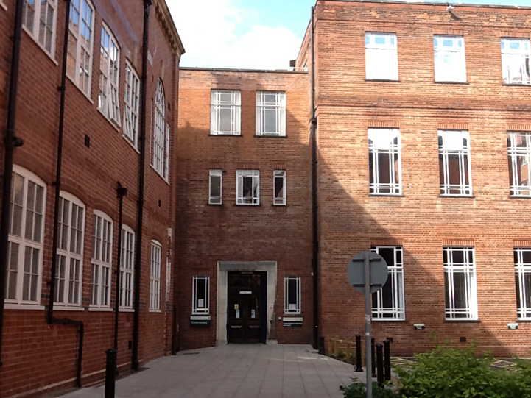
How to find us?
With your back to the Students’ Union building, walk towards the Great Hall and the Clothworkers Arch​
​2. Pass through the arch and continue through the courtyard
3. Continue straight with the School of Media and Communication on your left​
4. Disability Services is in the Chemistry West building at the end of the path (press silver button on right side of door to enter building)
AccessAble guide: detailed access guide for Chemistry West building
Notes:
Acknowledge that new students may not know campus that well yet so may not be familiar with buildings referenced in directions.

Slide 11
Questions?
Any Questions?

