Slide 1
Educational Engagement
Student Worker
Roles
Meghan Clamp & Chloe Robinson

Slide 2
Educational Engagement
Purpose
To recruit and support high quality students to the University of Leeds, regardless of background
To raise aspirations and awareness of higher education (in particular, research-intensive universities)
This is supported by:
Outreach activities delivered:
On-campus – Campus Visits, Higher Education Experience Days, Summer Schools, Residentials
Off-campus – Workshops, HE events and Presentations in schools, UCAS Exhibitions
Online – videos, teacher & student resources

Slide 3
Educational Engagement
2 Core Areas - Access & Student Success
Access
Education Outreach Team
Contextual Outreach Team (RfE, RO, TTP, Linacre Institute, Tutor Trust & Brilliant Club) & Contextual Admissions Team (Access to Leeds)
Academic Cluster Teams (Arts, Social Sciences, Health Sciences & STEM)
Monitoring & Evaluation Team

Slide 4
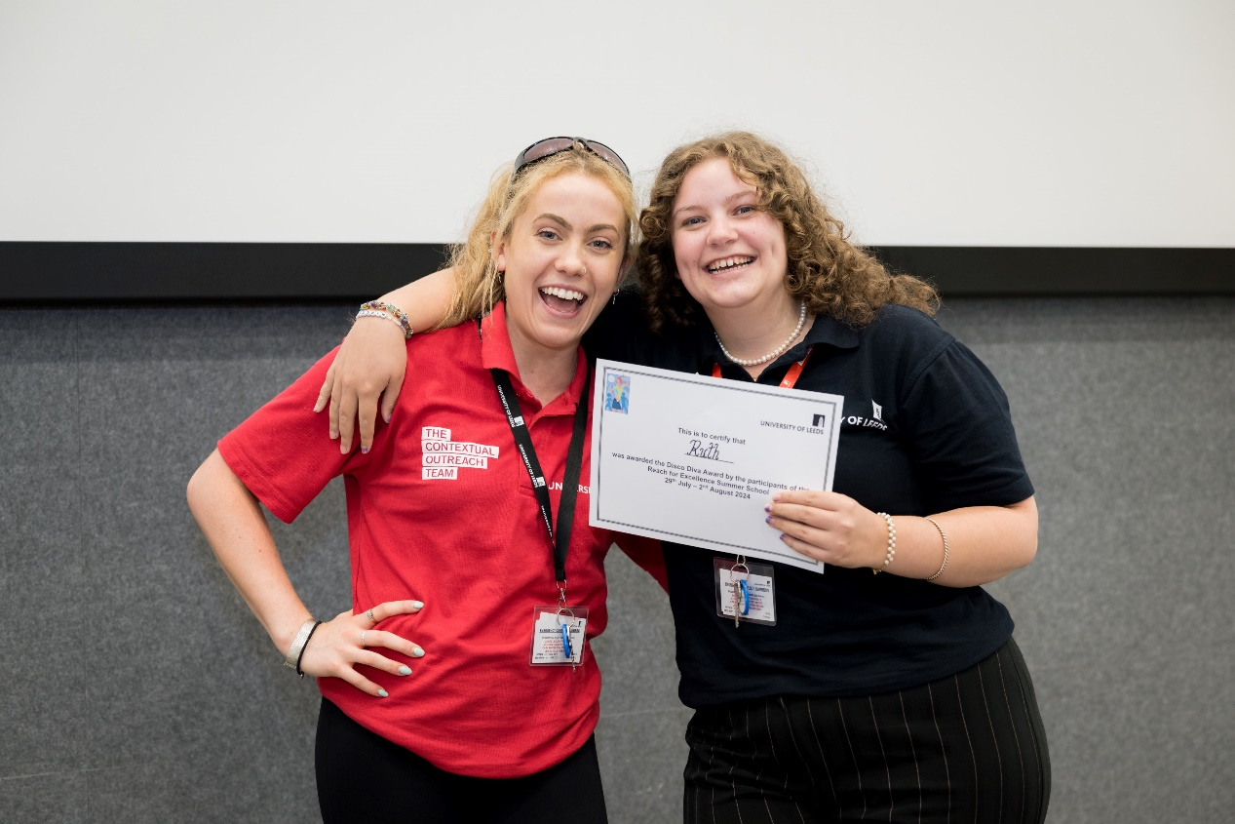
Educational Engagement
2 Core Areas - Access & Student Success
Student Success
Plus Programme Team (Plus Programme, Finance & Scholarships)
PGR Diversity Team
Student Success Team (Faculty SSOs/Engagement Callers)
Sense of Belonging Team
Monitoring & Evaluation Team

Slide 5
Educational Engagement
Schools & Colleges
Recruitment & Widening Participation (WP)
Students, Teachers, Parents.
What is WP?
A drive to increase access to learning, providing opportunities for success and progression to higher education (HE) to a much wider cross section of the population than at present.
Hard to reach groups, those who may be discouraged by social, cultural, economic, or institutional balance.

Slide 6
The Student Ambassador Role
Developing and delivering face to face presentations introducing young people to university and to your subject area;
Visiting a range of schools and colleges to inspire young learners, promoting progression to university and encouraging interest in your area of study;
Supporting on campus and online events for school pupils and teachers interested in learning more about HE and your subject area.
Chaperoning students and their teachers on taster events, higher education experience days and hosting campus tours.
Working in groups with young people exploring all aspects of higher education and your subject specialism
Supporting on campus residential events, including summer schools
Assisting in the preparation of resources and setting up of events

Slide 7
The Education Outreach Fellow Role
Developing talks and interactive workshops which offer young learners a taster of your subject area in order to generate subject interest and raise aspirations towards higher education
Delivering workshops in schools and colleges across the country, as part of our on-campus taster days and as part of our online outreach programmes
Liaising with school/college or university staff prior to an event to confirm arrangements;
Working collaboratively with other Education Outreach Fellows, Student Ambassadors and the wider Educational Engagement team, as necessary, to prepare resources and deliver sessions;
Evaluating the sessions delivered, using feedback from students and teachers/staff, to develop and improve delivery method and content;
Representing the University, including attending recruitment and outreach events and exhibitions both face to face and online

Slide 8
How to Apply
12.46 per hour – Student Ambassadors
17.25 per hour – Education Outreach Fellows

Slide 9
Any Questions?
Please don’t hesitate to direct any queries to EEworkers@leeds.ac.uk

Slide 10
