Slide 1
What will you do after your studies?
Graduate route visa
Go overseas
Skilled Worker visa
Student visa
Return home
Other work visa
Further study

Slide 2
Working with a Student visa after your course is over
You can work full-time during the time remaining on your visa after your course end date if you have completed all work for your course;
Check the course end date on the CAS you used to obtain your Student visa
If you complete your course early, the University must notify the Home Office that you have completed early before you can start working full-time. Please be aware that this may result in your Student visa being shortened
If you are required to take resits, you should not work full-time until after these have all been completed
Can’t fill a full-time permanent vacancy unless you have submitted valid application for the Graduate visa
Notes:
Work, volunteering and your visa: https://students.leeds.ac.uk/info/1000099/work_volunteering_and_your_visa
UKCISA: https://www.ukcisa.org.uk/Information--Advice/Working/Student-work
2

Slide 3
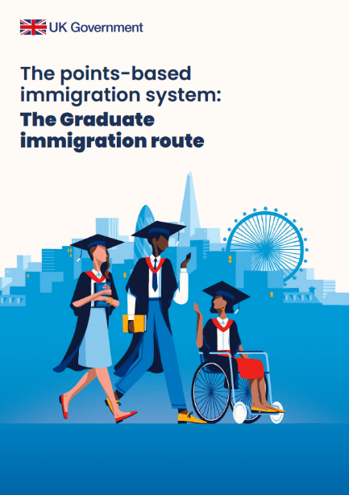
Graduate route visa
Visa to stay in the UK after your studies and look for work and work in most jobs at any skill/salary level,
No job offer required
Only dependants that are already in the UK as your Student visa dependant can apply as a dependant under the Graduate route,
Lasts for 2 years (3 years if PhD or other doctoral qualification),
Cannot be extended
Can only get it once
Cannot do any study that could be studied with a Student visa
Does not lead to settlement
Notes:
Sometimes called the ‘Post-Study Work’ (PSW) visa
Introduced in July 2021
Gov.uk guide: https://www.gov.uk/graduate-visa
Our webpage: https://students.leeds.ac.uk/graduatevisa
UK Council for International Student Affairs (UKCISA): https://www.ukcisa.org.uk/Information--Advice/Working/Graduate-route
Case studies: https://ukcisa.org.uk/Research--Policy/Resource-bank/Experiencing-the-UK-Graduate-route
3

Slide 4
Graduate route – Conditions
What you can do
What you cannot do
Look for work
Work in most jobs at any skill level/salary
Be self-employed
Do voluntary work
Travel abroad and return to UK
Study courses that would not be eligible for a Student visa
Continue to live with any dependants that were previously granted permission as a dependant of a Student, and any children born inside UK
Access public funds
Work as a professional sportsperson
Any study that could be studied under the Student visa route
Bring new dependants to live with you in the UK

Slide 5
Graduate route visa – Requirements
You must apply inside the UK and before your Student visa expires
Must have successfully completed your degree
If your course is 12 months or longer, you must have studied in the UK with your Student visa for at least 12 months (excluding permitted study abroad)
If your fees and living costs have been financially sponsored by a Government or international scholarship agency, you will need their permission to apply. (You do not need permission from University of Leeds if we have awarded you a scholarship).
Your permission to stay in the UK is extended while you wait for your decision
You should not travel outside Common Travel Area while your application is pending
Visa Application Fee – £822 per year
Immigration Health Surcharge - £1,035 per year
Total cost:
2 years: £2,892
3 years (PhD): £3,927
Notes:
You’re expected to stay in UK for duration of your course, including the dissertation period if you are a Masters student. Remote study is not permitted for Student visa holders so leaving UK early to complete your dissertation at home could affect your Student visa status and therefore your eligibility to apply for a Graduate visa (unless you are doing approved overseas fieldwork/data collection).
Leaving an integrated master’s programme with the lower level qualification counts as successfully completing it (e.g. leaving an integrated master’s programme a year early with a bachelor’s qualification). Most other types of ‘fallback’ awards do not count.
You must have been awarded the qualification for the course listed on your most recent CAS, unless you were permitted to change course without applying for a new visa
Your Graduate visa will start on the date your application is granted
Application usually processed within 8 weeks
There are no financial or language requirements.
5

Slide 6
Graduate route visa – Timeline
You successfully complete your course
Final results are released
University reports course completion to UKVI
University tells you by email that report has been made
You can now apply (before your Student visa expires)
Please see this page for details of all the requirements and other important information:
https://students.leeds.ac.uk/graduatevisa
Notes:
UG final results normally released in July, PGT final results in late November. If PGR… after your research degree has been awarded and you have been added to pass list. This is after your viva, corrections, and submission of final ethesis.
You must not apply until after you receive email from the University confirming we have notified UKVI about your successful completion.
The Graduate will start on the day it is granted.
Results dates: https://students.leeds.ac.uk/info/10121/marking_results_and_resits/826/results
PGR Research Degree Awards and Graduation deadlines: https://students.leeds.ac.uk/info/10125/research_degree_assessment/916/award_of_your_research_degree_and_graduation
Visa application processing times: https://www.gov.uk/guidance/visa-processing-times-applications-inside-the-uk
6

Slide 7
Graduate route visa – Potential problems
The Graduate visa is not guaranteed. You need to successfully complete your course and meet the other requirements to be eligible.
If your final results are not confirmed before your Student visa expires you might run out of time to apply for the Graduate visa
Reasons why results may be delayed: Re-sits, repeats, deadline extensions, academic appeals, overdue tuition fee debts
If you are concerned about potential issues that may stop you from successfully completing in time, please discuss these with your school early
The University can only issue new CAS to allow you to extend your Student visa in very limited circumstances - if you will be an internal student and there is academic need for you to be on campus.
Notes:
Leaving an integrated master’s programme with the lower level qualification counts as successfully completing it (e.g. leaving an integrated master’s programme a year early with a bachelor’s qualification). Most other types of ‘fallback’ awards (e.g. PG Diploma) do not count.
7

Slide 8
Skilled Worker visa
Replaced the Tier 2 visa route in December 2020
Need to be sponsored by a UK-based employer with a sponsor licence, or an employer willing to get one
Allows work in a specific job, tied to specific employer
Visa can be granted for up to 5 years, can be extended
Can lead to settlement in the UK after 5 years
Changes of employment require a new visa
Can switch to SW from Graduate visa or Student visa (after completing course), or apply for SW visa from overseas
Dependant partner and children can join you (unless working as care worker or senior care worker)
Must pay IHS and Visa application fee depends on type of job, length of visa, where you are applying
Employer can help with costs
Notes:
Gov.uk guide: www.gov.uk/skilled-worker-visa
Register of licensed sponsors: https://www.gov.uk/government/publications/register-of-licensed-sponsors-workers

Slide 9
Skilled Worker visa – Requirements
Valid Certificate of Sponsorship from a licenced sponsor
Job at appropriate skill level - job must be in an eligible occupation code listed in Appendix Skilled Occupations or Appendix Immigration Salary List
English language skills – evidence not needed if met in previous visa application, or if have degree-level qualification
Minimum salary
General minimum salary threshold of £38,700 per year (previously £26,200) or the going rate specific to the occupation (whichever is highest)
Minimum salary requirement reduced if certain conditions met, e.g.
PhD in subject relevant to job - £34,830 or 90% of going rate, or £30,960/80% if in STEM subject
Job on Immigration Salary List - £30,960/going rate
You are a ‘new entrant’ – salary requirement is reduced to £30,960/70% of going rate
Lower salary requirements for NHS staff and education workers based on national pay scales
Lower salary for social care workers - £23,200
Visa application fees and requirements can vary depending on type of job and length of job. For full details, go to: www.gov.uk/skilled-worker-visa
Notes:
Register of licensed sponsors: https://www.gov.uk/government/publications/register-of-licensed-sponsors-workers
Skilled Worker – ‘New entrant’ requirements
Multiple ways to qualify as a ‘new entrant to the labour market’, including:
you are under 26 when you apply, or
your last visa was a Student visa or Graduate visa
you will be working towards a recognised professional qualification or moving directly into a postdoctoral position
Lower minimum salary requirement - £30,960/70% of occupation's going rate (whichever highest)
Can apply as new entrant up to 3 months before expected course end date (or after 12 months of PhD study)
New entrant eligibility lasts for 2 years after Student/Graduate visa expiry, and can be used when applying for visa from overseas as well
You cannot apply as a new entrant to stay in the UK for more than 4 years. This includes any time you've already spent in the UK on a Graduate or Skilled Worker visa. If your visa would take you over this limit, you will need to meet one of the other minimum salary rates
9

Slide 10
Skilled Worker visa – When can you switch?
If you want to switch from a Student visa to a Skilled Worker visa inside the UK, you must meet one of following conditions:
You must have finished your course.
You are studying at degree level and your Skilled Worker job will start after your course completion date.
You are studying a full-time PhD course and your Skilled Worker job will start no earlier than 24 months after the start date of that course.
You cannot switch to a Skilled Worker visa inside the UK before you meet one of above conditions.
Notes:
You can’t leave your course early to switch to a Skilled Worker visa in the UK.
10

Slide 11
Summary – Graduate visa vs Skilled Worker visa
Skilled Worker visa is best if you can get an eligible job offer from an employer that is willing and able to sponsor you
If you already know who you want to work for and what you want to do
Can apply for Skilled Worker visa from overseas
Skilled Worker visa is path to permanent residence in UK
Can bring dependants
Unfortunately, the April 2024 changes to the salary requirements have made it much more difficult
Graduate route visa is best if you need time to job search, explore your options, build work experience
Graduate visa is flexible – you can more easily switch jobs and do whatever type of work you want to do
Graduate visa allows you to be self-employed
Can use the time on the Graduate route to find and secure Skilled Worker sponsorship
There are other work visas, such as the Health and Care Worker visa, Innovator Founder visa, Global Talent visa, etc. You can find full list of UK work visas at www.gov.uk/browse/visas-immigration/work-visas
The Student Visa Advice team cannot provide advice regarding work visas. For further advice, please consult your employer or a regulated immigration lawyer.
Notes:
Other UK work visas
Health and Care Worker visa
A type of SW visa with different requirements, for medical professionals to work with NHS or in adult social care – but care workers and senior care works cannot bring dependants
Innovator Founder visa
For entrepreneurs with innovative business ideas
Replaced the ‘Innovator’ and ‘Start Up’ routes
Global Talent visa
For leaders/potential leaders in academia, research, arts and culture, or technology
Requires eligible award or endorsement from approved endorsing body
Government Authorised Exchange visa (Temporary Work)
Work experience, training, fellowship, internship schemes
Youth Mobility Scheme
2-year ‘working holiday’ visa for 18-30 year olds from certain countries
India Young Professionals Scheme
Similar to Youth Mobility Scheme, 2-year visa for Indian citizens between 18-30 years old with a degree (limited spaces)

Slide 12
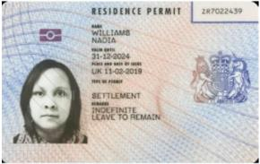
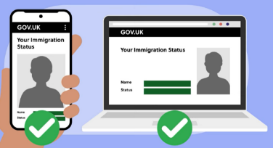
Reminder: Replace your BRP with an eVisa
If you have a BRP expiring 31/12/2024…
Remember to set up your UKVI account and get access to your eVisa before the end of this year
eVisa should be linked to your passport (must update your UKVI account if passport or other personal details change)
Find out more:
www.gov.uk/evisa
https://students.leeds.ac.uk/info/21506/your-visa/1920/changing-your-brp-to-evisa

Slide 13
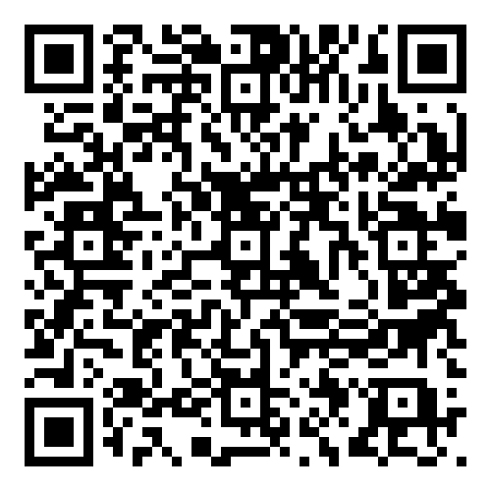
Further information
University of Leeds
Visa information: https://students.leeds.ac.uk/visa
Student Visa Advice: https://students.leeds.ac.uk/info/21506/your-visa/2008/student-visa-advice-service
External sources
Gov.uk: www.gov.uk/browse/visas-immigration
Gov.uk: www.gov.uk/browse/working
UK Council for International Student Affairs (UKCISA): https://www.ukcisa.org.uk/Information--Advice
Immigration advisers & lawyers
Office of the Immigration Services Commissioner (OISC) regulated immigration advisers: https://www.gov.uk/find-an-immigration-adviser
Immigration solicitors: http://www.lawsociety.org.uk/find-a-solicitor/
Student Visa Advice service
Be careful when looking online for visa advice (Youtube, TikTok, Facebook, Reddit, etc.) – there is a lot of false and out-of-date information
Notes:
https://ukcisa.org.uk/Research--Policy/Resource-bank/Experiencing-the-UK-Graduate-route
https://www.ukcisa.org.uk/blog/7093/Navigating-work-and-study-with-a-Student-visa

