Slide 1
Student visas: Working in the UK During and After Studies
9 September 2024
Notes:
Webinar to be recorded.

Slide 2
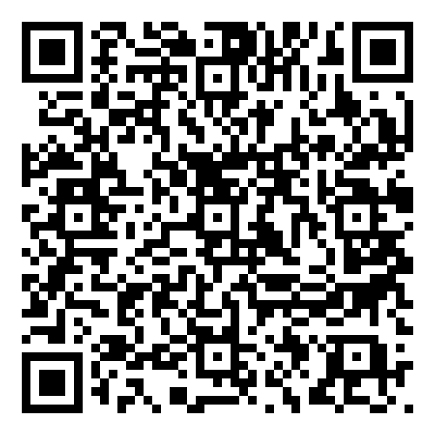
Introduction
The Student Visa Advice team
We provide international students at University of Leeds with free visa & immigration advice relating to their study at the University
Contact us: https://students.leeds.ac.uk/info/21506/your-visa/2008/student-visa-advice-service
We do not provide support with applications for work visas
This presentation is intended for international students who are studying at the University of Leeds with a Student visa
The information provided is an overview and introduction. This is not a complete guide, and we do not have the time to list every rule and requirement. We will tell you where you can find further information.
The information in this presentation is up-to-date as of 09/09/2024
Student Visa Advice service
Notes:
Student Visa Advice service: https://www.leeds.ac.uk/international-visas-immigration/doc/immigration-advice-service

Slide 3
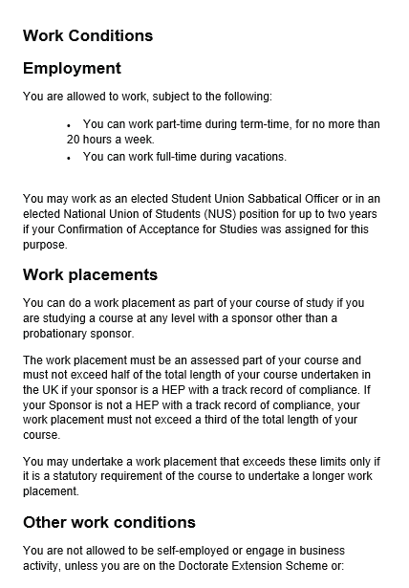
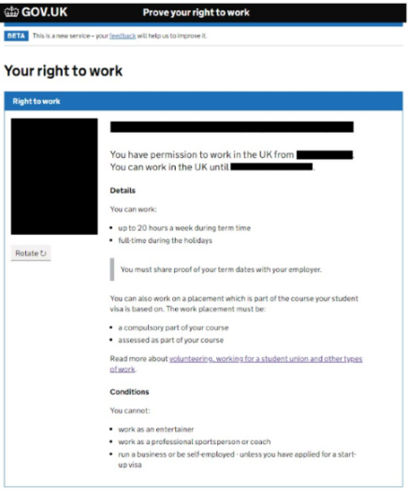
Student visa Work Conditions
Check your Work Conditions:
Entry clearance vignette in passport
Biometric Residence Permit (BRP)
Visa decision email
View your Right to Work status online
Student visa holders studying full-time at degree level or above are allowed to work, subject to the following restrictions:
You can work part-time during term-time, for no more than 20 hours a week.
You can work full-time during vacations.
However – there are some types of work that you cannot do with a Student visa…
Notes:
Work, volunteering and your visa: https://students.leeds.ac.uk/info/1000099/work_volunteering_and_your_visa
UKCISA: https://www.ukcisa.org.uk/Information--Advice/Working/Student-work
32

Slide 4
Prohibited Work for Students
You cannot do any of the following while on a Student visa:
be self-employed or engage in business activity
work as a professional sportsperson (including as a sports coach)
work as an entertainer
work in a position which would fill a full-time permanent vacancy (unless you have submitted a valid application to switch to the Skilled Worker or Graduate route)
Notes:
https://www.ukcisa.org.uk/blog/7093/Navigating-work-and-study-with-a-Student-visa
https://www.ukcisa.org.uk/blog/6257/a-working-definition
Being self-employed normally means you manage your own workload, pay, and tax. If you are going to be working for an employer as a freelancer, contractor or consultant you are highly likely to be self-employed. Some gig economy workers like Uber delivery drivers are classed as self-employed contractors. If you are selling things online or trading in stocks or cryptocurrency, and making a profit, this is likely to be considered self-employment or business activity.
You cannot set up your own business or work as a director of a company. You can participate in amateur sports or entertainment as a hobby. You cannot be paid for playing sport or as an entertainer.
Entertainer is not defined in immigration rules. This would be things like singer, actor, dancer, comedian
A permanent vacancy is one with no end date on your contract. You can do a permanent part-time job, but not a full-time one. A temporary full-time job outside term-time is fine.

Slide 5
Work Conditions – what does it mean?
Work – includes paid and unpaid employment, voluntary work, and working remotely for an overseas employer, while you are in the UK
20 hours – this is the maximum total number of hours of work per week
Week – a period of 7 days beginning with a Monday
Term-time – when you are studying your course. Vacation periods, when the University is closed, or the time after your course has ended, do not count as ‘term-time.’
Find our term dates online at: www.leeds.ac.uk/term-dates
For Masters students, the summer period is still considered term-time as you are expected to be working on your dissertation during this time.
You can work part-time during term-time, for no more than 20 hours a week
Notes:
Work, volunteering and your visa: https://students.leeds.ac.uk/info/1000099/work_volunteering_and_your_visa
UKCISA: https://www.ukcisa.org.uk/Information--Advice/Working/Student-work
You will need to keep track of your own working hours, especially if you are working for multiple employers or are doing unpaid voluntary work alongside a part-time job.
Working in the 4 months wrap-up IF submitted all work and course end date has passed, can then work full-time (but not filling a permanent vacancy)
Term-time for PhD – whenever you are not using your annual leave How many hours you work is separate from your pay. Receiving holiday pay, bonus payments, etc. does not change how many hours you have actually worked

Slide 6
Volunteering vs Voluntary work
You are allowed to volunteer while you’re studying, but…
There is a difference between volunteering and voluntary work. Voluntary work counts towards your 20 hours per week limit.
It is likely to be voluntary work if:
there is an obligation on you to carry out the work (e.g. an expectation to attend at particular times and carry out specific tasks) – this doesn’t need to be in a written contract
you are rewarded for the work, either through money or payments in kind
Volunteers don’t have a contract, are not a substitute for a paid employee, and don’t receive payment in kind (although they can be reimbursed for reasonable travel/subsistence expenses).
Notes:
Volunteers usually help a charity, voluntary organisation or public sector organisation

Slide 7
Consequences of Illegal Working
There are serious consequences if you are found to have breached your work conditions.
For employer – Civil penalties up to £60,000 per ‘‘illegal’’ worker
Employee – your Student visa can be cancelled and you can be detained and removed from the UK, and may be banned from applying for a new visa

Slide 8
Avoid breaching your work conditions
Keep your own record of how many hours you are working each week (Monday-Sunday), and include unpaid work and voluntary work
Make sure you know your term dates
Don’t work more than 20 hours per week during term-time
Avoid doing anything that could be seen as self-employment or business activity
If you are not sure if a job would count as freelance or self-employment, ask the employer or seek advice before you start the job
If you’re studying a Masters programme, remember that the dissertation period counts as term-time.

Slide 9
If you think you have breached your work conditions
The University of Leeds has an obligation to notify the Home Office if we learn that one of our sponsored students has been working illegally
Therefore, if you think you may have breached your work conditions, we recommend that you seek independent immigration advice outside the University.
OISC immigration adviser finder: https://www.gov.uk/find-an-immigration-adviser
Notes:
https://ilpa.org.uk/members-directory/
https://www.gov.uk/find-an-immigration-adviser UKCISA Student advice line

Slide 10
Work Placements
You can also work on a placement which part of the course your Student visa is based on. The work placement must:
be agreed with and approved by your school
be a compulsory part of your course
be assessed as part of your course
not exceed half of the total length of your course (unless it is a statutory requirement of the course to undertake a longer work placement)
You can work full-time on a placement that meets the above requirements. Work that is part of the work placement does not count towards your 20 hours per week limit.

Slide 11
Work Placements
What is a work placement? | Work Conditions | Who can apply? | What is required
• Must be included as part of the course • Approved by University • Cannot be longer than half of total length of course • Usually taken in third year of UG degree • Placement can be taken inside the UK or overseas | • Full time on Student visa whilst on work placement • Can also work part time elsewhere up to 20 hours per week | • Degree level course • Assessed and integral part of your course • Subject to UKVI 5 year study limits | • New CAS – must complete a CAS request form • Visa extension application to cover the additional year • New ATAS (if required)
Weblinks to:
Change of programme form: https://students.leeds.ac.uk/info/10104/making-changes/650/transfer-to-a-new-programme
Visa extension application: https://www.gov.uk/student-visa/extend-your-visa
ATAS: https://www.gov.uk/guidance/academic-technology-approval-scheme
Notes:
Work, volunteering and your visa: https://students.leeds.ac.uk/info/1000099/work_volunteering_and_your_visa
UKCISA: https://www.ukcisa.org.uk/Information--Advice/Working/Student-work
40

Slide 12
Extending visa for a Work Placement
When to apply? | Where to apply? | Costs?
• Up to 3 months before commencing work placement • After completing work placement and within 3 months of resuming studies. • Cannot apply during work placement. • Employer may require visa extension before commencing work placement • Check visa covers full duration of placement before you start | • Inside UK– visa application can take up to 8 weeks for a decision no international travel permitted until new visa is received. • Outside UK– visa application can take 3 weeks for a decision and passport retained during this period. | • New visa application fee - £490 • Immigration Health Surcharge – est. £1,164 • If apply before work placement will need to pay IHS for 2 years
Weblinks to:
Guidance on work placements: https://students.leeds.ac.uk/info/21506/your-visa/1009/work-placements-and-extending-your-tier-4student-visa
Visa extension inside the UK: https://students.leeds.ac.uk/info/21506/your-visa/701/extending-your-visa-in-the-uk
Visa extension outside the UK: https://students.leeds.ac.uk/info/21506/your-visa/855/applying-for-your-visa-outside-the-uk
Notes:
Work, volunteering and your visa: https://students.leeds.ac.uk/info/1000099/work_volunteering_and_your_visa
UKCISA: https://www.ukcisa.org.uk/Information--Advice/Working/Student-work
41

Slide 13
Right to Work Checks
Employers must check your immigration status to confirm you can legally work.
If you have a BRP or eVisa – you must use https://www.gov.uk/prove-right-to-work so employer can do an online check
Generate share code
Send share code and your date of birth to the employer
This will let your employer verify your right to work on the UK Government website
If you don’t have a BRP or eVisa – may be able to provide alternative evidence so employer can do a manual check
If you haven’t collected your BRP yet - Visa in your Passport (if it is still valid)
If you have a pending application – employers can use the Home Office’s Employer Checking Service (https://www.gov.uk/employee-immigration-employment-status)
You must also give your employer a copy of your academic term and vacation times – these are on our website: https://www.l.uk/term-dates
If you need aletter with your course details and term dates, you can request a Student Registration Status Certificate: https://students.leeds.ac.uk/info/21519/official-documentation-and-regulations/849/student-registration-status-certificate
Problems viewing your right to work or generating share code?: Contact UKVI to ask about problems ‘Viewing and proving your immigration status, right to work, or right to rent’: https://www.gov.uk/contact-ukvi-inside-outside-uk
Employers will keep a record of when your visa expires, and will need to follow up with you to make sure that you still have the right to work after it expires – they will need to check your new visa, or confirm you have submitted a new immigration application
Notes:
Employers who fail to carry out right to work checks are committing a criminal offence
Employers must not discriminate when conducting right to work checks.
https://www.gov.uk/government/publications/right-to-work-checks-employers-guide
42

