Slide 1
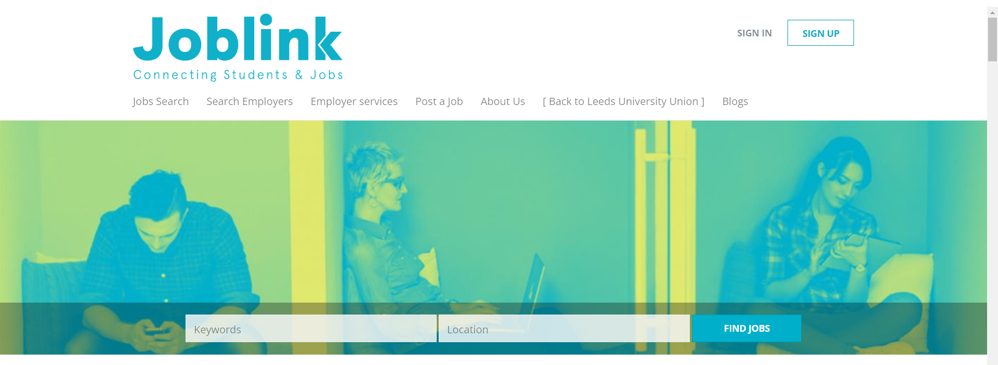
Also, downstairs in the Student Union
Part-time work

Slide 2
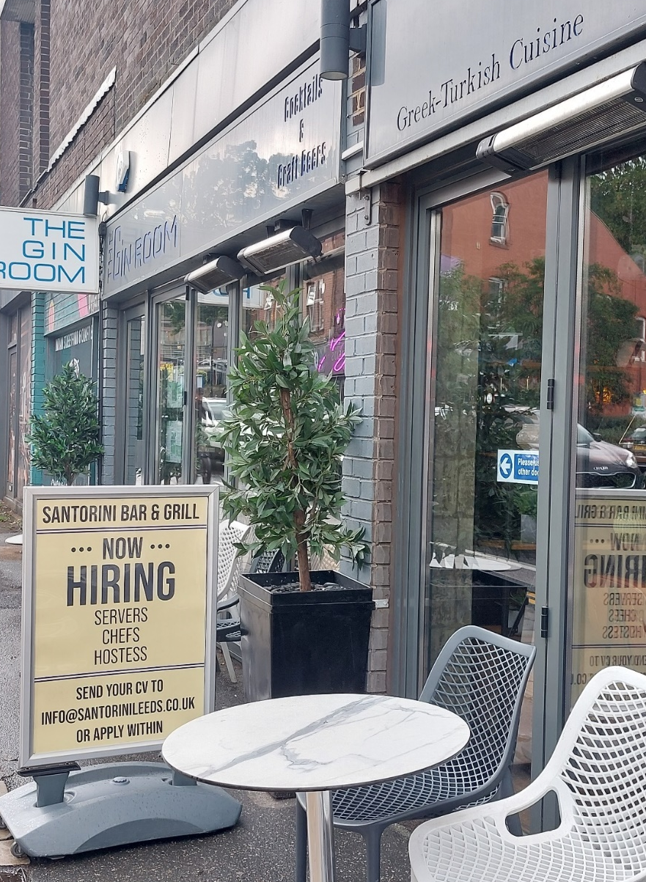
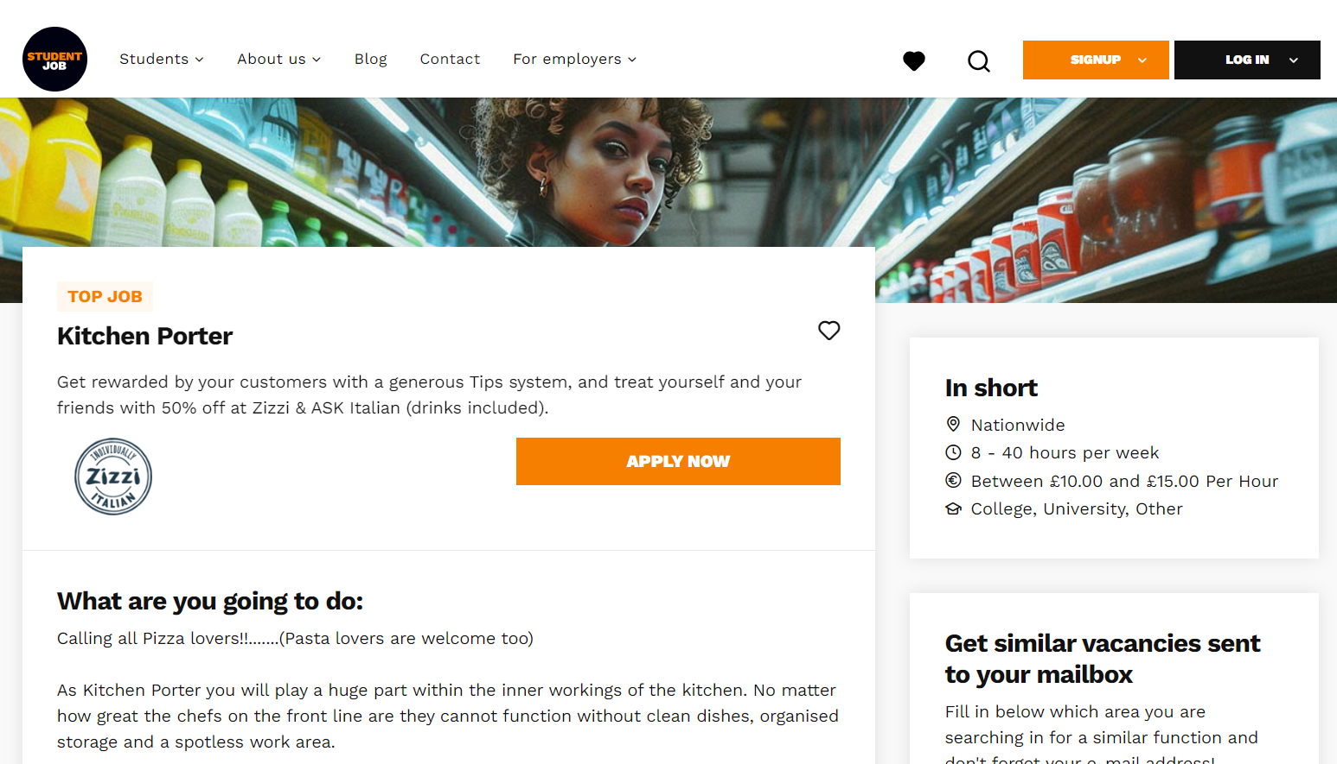

Slide 3
Student Tip
My friends would always ask me, how did I find out about all these great opportunities, like taking part in the Universities Business Challenge, going on a LUBS Study Tour to Italy, and becoming the Leeds:Connections intern in the Careers Service. My answer? I read my emails!
Purvi R- MA Corporate Communications, Marketing and Public Relations 2023
Notes:
MyCareer daily/weekly updates of new opportunities including volunteering or for your sectors
Faculty team newsletters

Slide 4
Action: Come to the Careers Fairs
Autumn Careers Fair- Tuesday 8th October / STEM Careers Fair – Tuesday 22nd October
11am- 3pm -The Edge Sports Centre
Look at MyCareer-Events for more details

Slide 5
PGT Careers Support
You are welcome to join all events, please come along.
All Careers staff can help you.
AND some specific "PGT Careers Support" workshops/webinars
One-stop: PGT Sway
Need to keep in mind your workload…
But try to make time for other activities!
Be aware of recruitment and on-boarding timelines:
graduate schemes often start in the summer.
http://bit.ly/PGTSway

Slide 6
PGR Careers Support
You are welcome to join all events, please come along!
All Careers staff can help you.
PGR Careers Fair
https://researchersupport.leeds.ac.uk/
Recruiters at other careers events may not understand as much about what you do- do you have an “elevator pitch”?
Think of yourself as a package of skills and experiences that you can transfer to many areas.
Check out https://phd-careers.co.uk/

Slide 7
International Student Support
You are welcome to join all events, please come along.
All Careers staff can help you.
AND some specific “International student" workshops/webinars
One-stop: International Student Sway
If you want to work in the UK, be aware of when
Graduate schemes open
Also, excellent communication skills will be required –
Use the Language Zone and Skills@Library

Slide 8
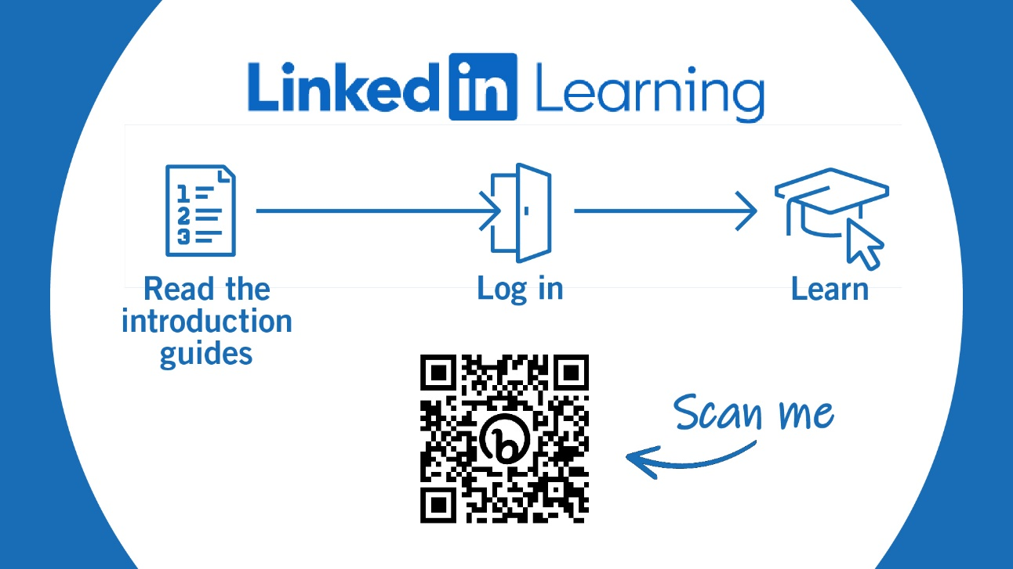
Notes:
All students have free access to LinkedIn Learning during your time here at the University of Leeds.
Use the QR code to access our student guide with the details of how to activate your account, content recommendations and how you create a LinkedIn Profile.
To activate your account simply log in with your University of Leeds credentials (Username /password)
CALL TO ACTION: activate their account now!

Slide 9
Some other useful resources
Prospects.ac.uk
Job Profiles and What Can I Do With My Degree?
TargetJobs.co.uk
Careers advice- CV examples, how to answer interview questions, identifying your skills
LinkedIn
Show off your experience, make connections, find opportunities, increase commercial awareness.
Use it effectively by following organisations and people you find interesting.
Student Circus (also on LinkedIn)
Job opportunities with visa sponsorship, and careers advice for international students
Gradcracker
STEM jobs- but also Banking, FinTech, Education opportunities.

