Slide 1
International Orientation:
Working in the UK During and After Studies
September 2024

Slide 2
Today’s talk
11.30 – 11.55: Introduction to Careers support and opportunities
(Marc, Jo & Jordan)
11.55-12.35: Student Visa Advice related to working and volunteering during and after studies
(Student Visa Advice team)
12.35-12.45: Educational Engagement promoting EE Student Ambassador role
(Meghan and Chloe)
12.45-1.00: Q&A

Slide 3
Who Am I?
Marc Steward
Careers Consultant
International Student focus

Slide 4
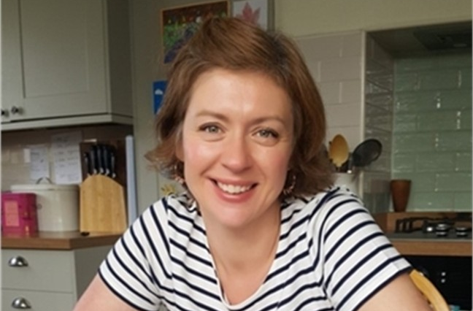
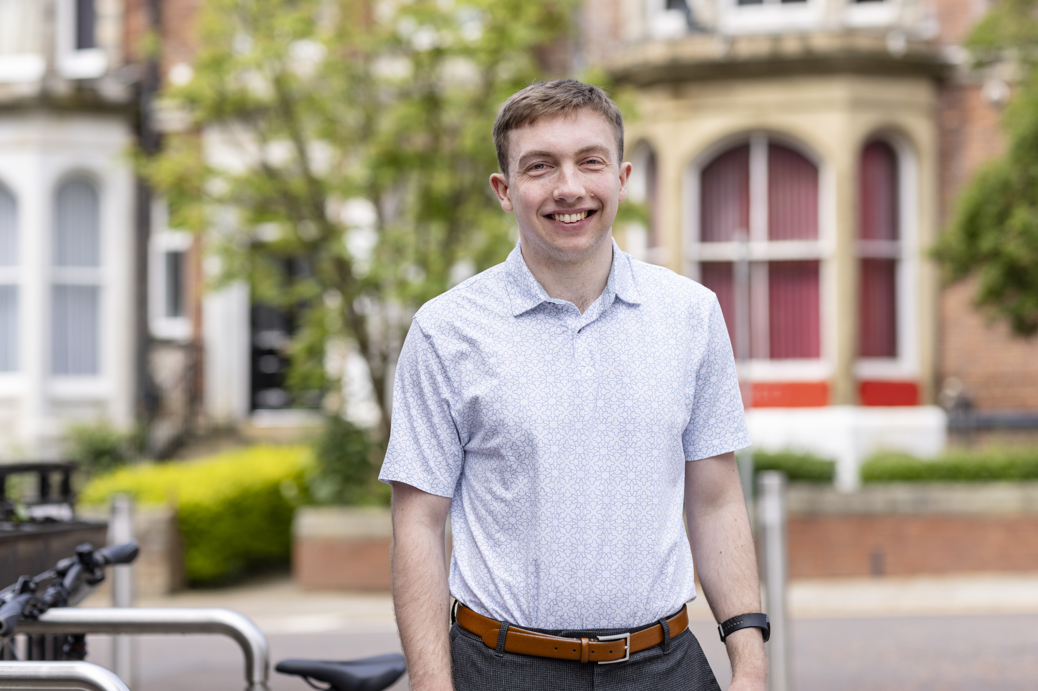
Volunteering team
Jo Hargreaves and Jordan Nugent
Helping UoL students to volunteer during their time in Leeds
Helping charities in Leeds connect with our students

Slide 5
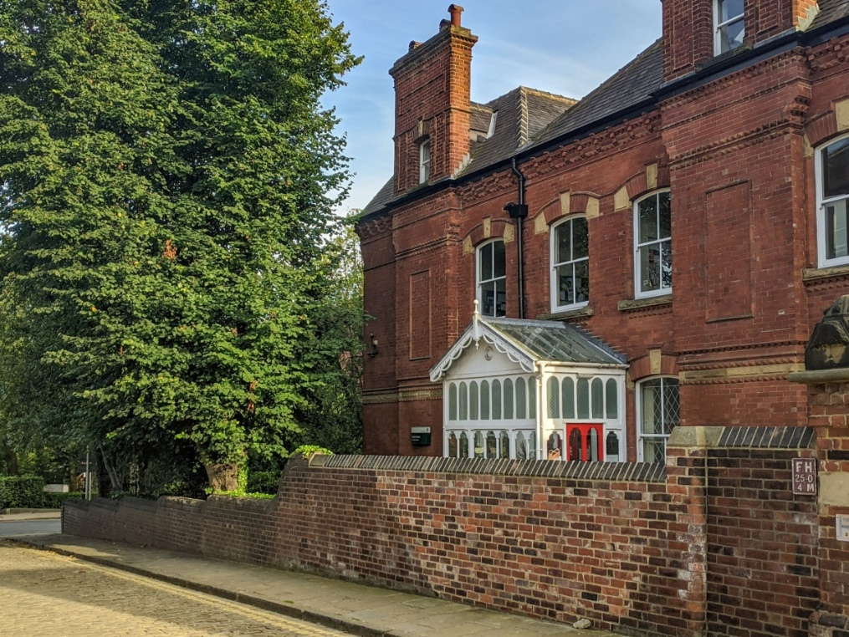
What is the Careers Service?
We're here to help you:
Access new experiences such as work, volunteering and projects- locally and internationally.
Identify and develop the skills you need for employment and further study.
Create meaningful connections.
Make decisions about what you want to try next.
Maximise the success of your applications.

Slide 6
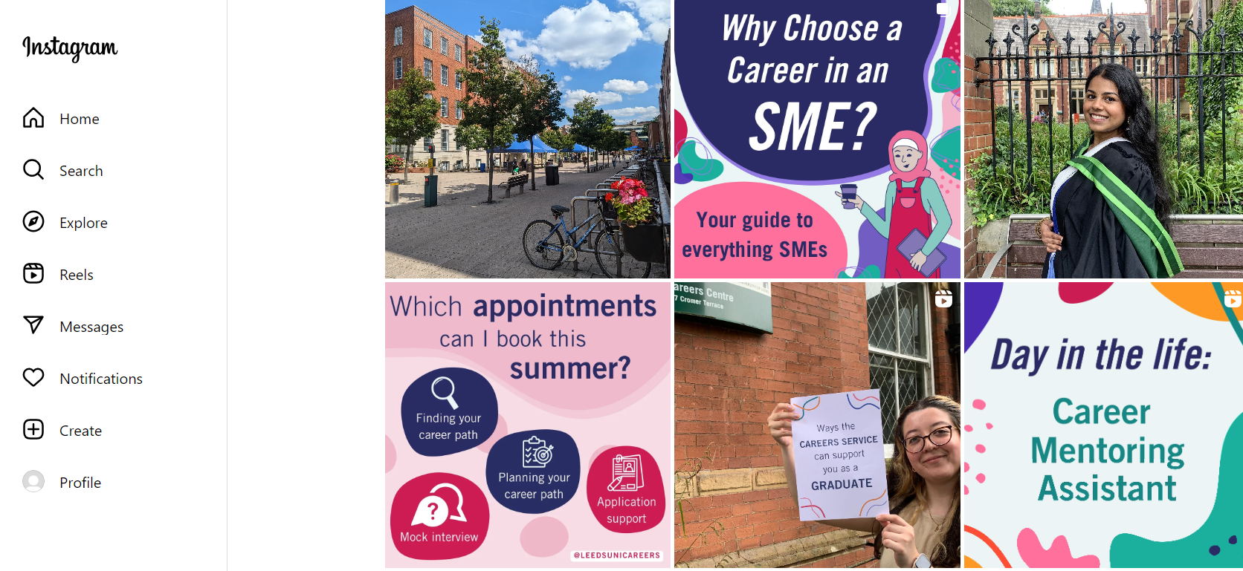
@leedsunicareers
Keep up with the latest news on events, workshops and opportunities.

Slide 7
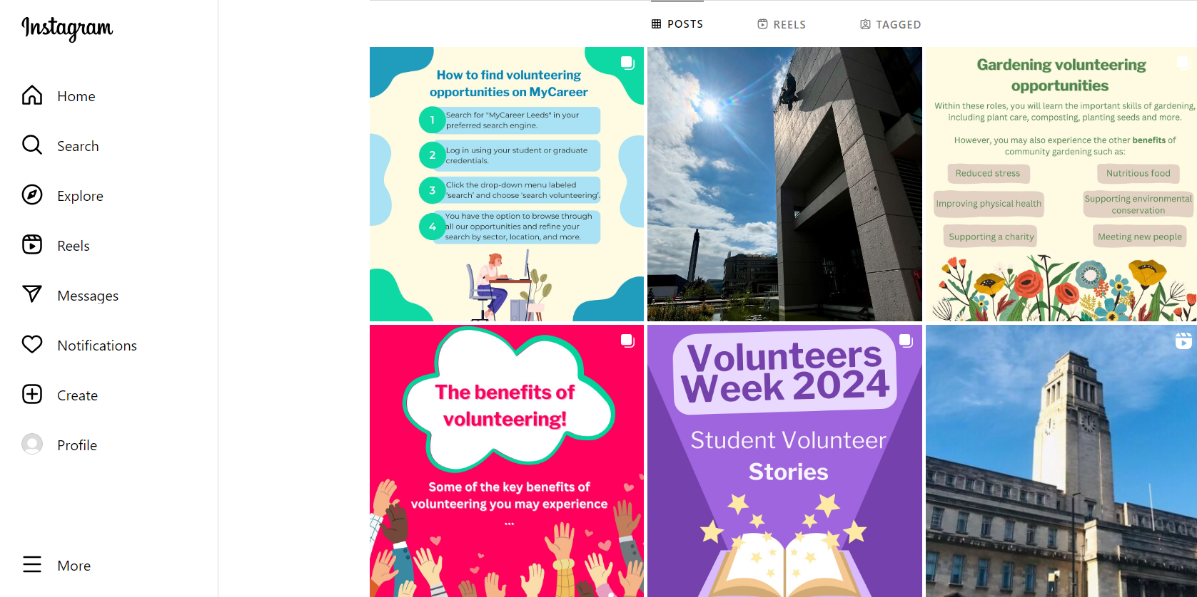
For volunteering opportunities and events, follow
@volunteeratleeds

Slide 8
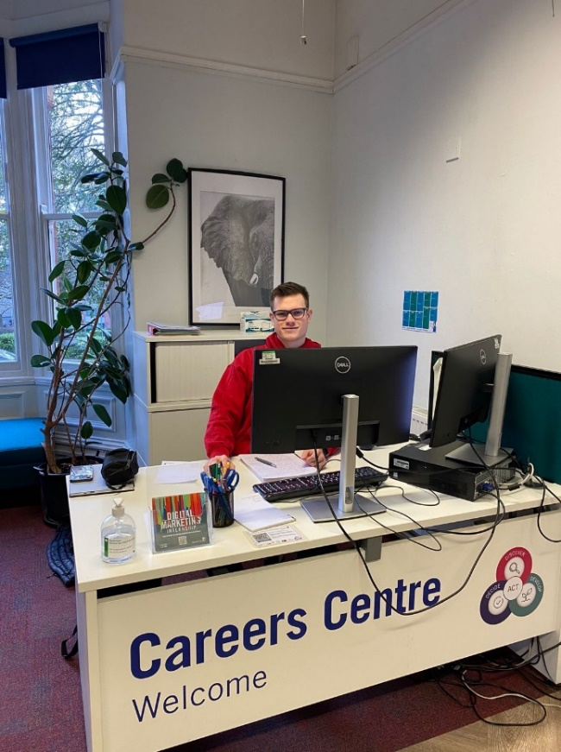
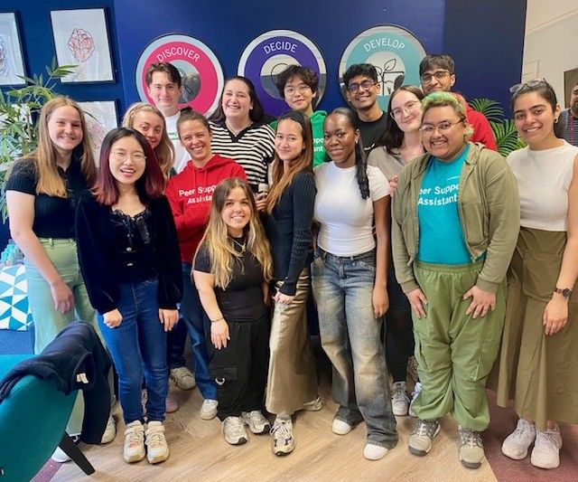
Do you have a question?
Come to the Careers Centre, 5-7 Cromer Terrace and speak to one of our friendly Peer Support Assistants, or email careerscentre@leeds.ac.uk

Slide 9
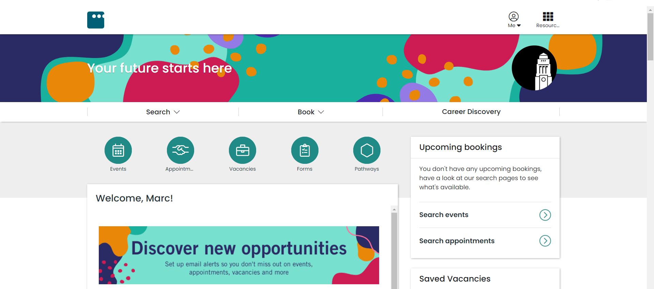
In the next couple of weeks, go to MyCareer.leeds.ac.uk and log in to your account.

Slide 10
