Slide 1
Understanding Wellbeing

Slide 2
Taking care of yourself
Emotional
Wellbeing
“A state of complete physical, mental and social wellbeing and not merely the absence of disease or infirmity”
Physical
Social
Foresight Mental Capital and Wellbeing Project 2008

Slide 3
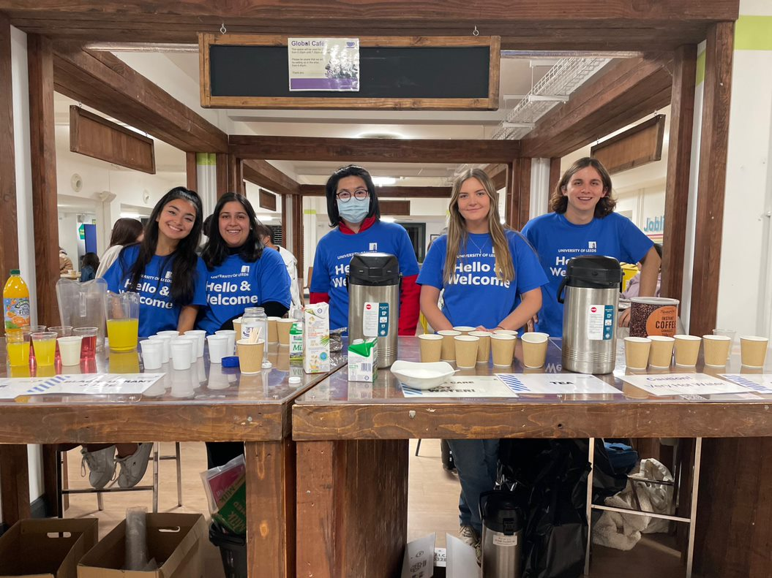
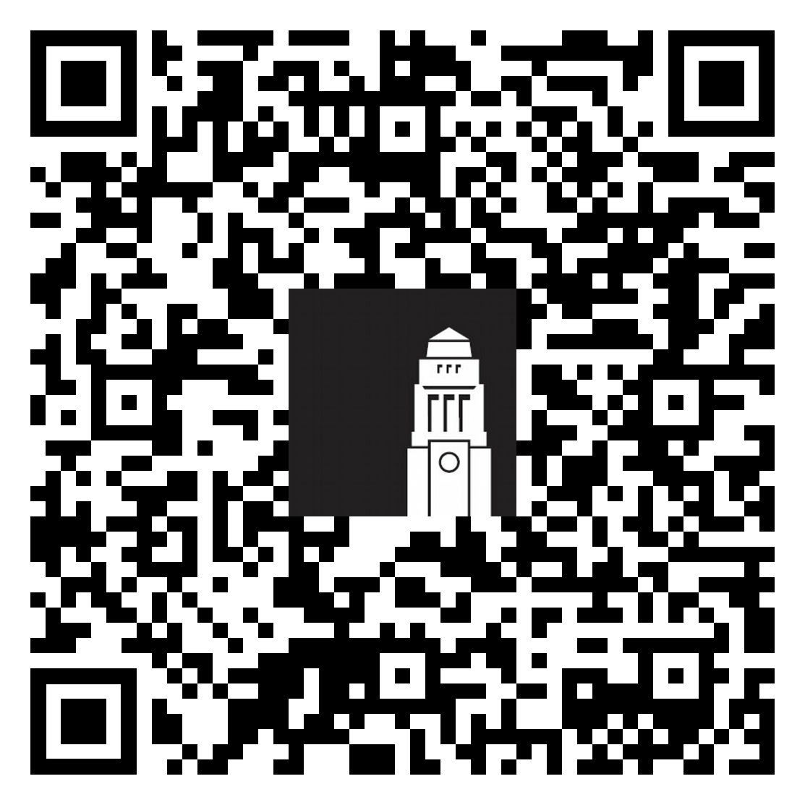
1. Connect with people
Some steps you can take from now:
Apply for the Buddy Scheme
Come to Global Café
Join a Leeds University Union society
Join the Feeling at Home in Leeds workshops
Upcoming Global Café events
Meet people and get involved

Slide 4
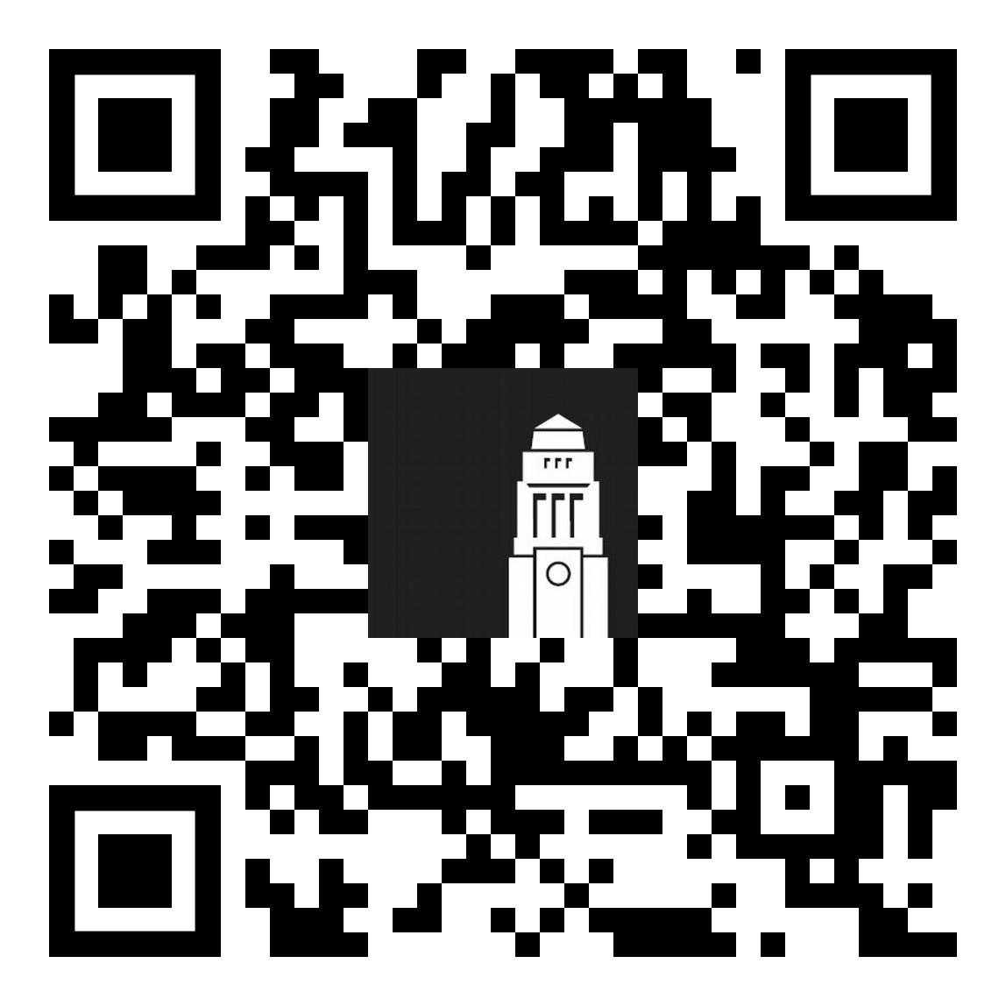
2. Be physically active
Some steps you can take from now:
Come along to Leeds and You events
Check what’s on offer our sports centre The Edge
Join events offered by Get Out and Get Active
Follow NHS advice on things you can do and apps to download
Leeds
and You events
5 ways to wellbeing

Slide 5
3. Learn something new
Some steps you can take from now:
Check the Give it a Go programme
Visit the Clubs and Societies Fair
Go to a Skills@Library workshop
5 ways to wellbeing

Slide 6
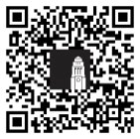
4. Give to others
Some steps you can take from now:
Apply for the Intercultural Ambassadors Programme
(applications open 16 September)
Find out more about volunteering opportunities Volunteering Fair: 14 October, Riley Smith Theatre
Apply for Writing Back
Find out more:
Intercultural Ambassadors
5 ways to wellbeing

Slide 7
5. Take notice
Take time to stop and be aware of your surroundings and pay attention to your thoughts and feelings.
Some steps you can take from now:
Record your thoughts and feelings
Download our University mindfulness MP3 recordings
Attend a Student Counselling and Wellbeing workshop
5 ways to wellbeing

Slide 8
Support Services

Slide 9
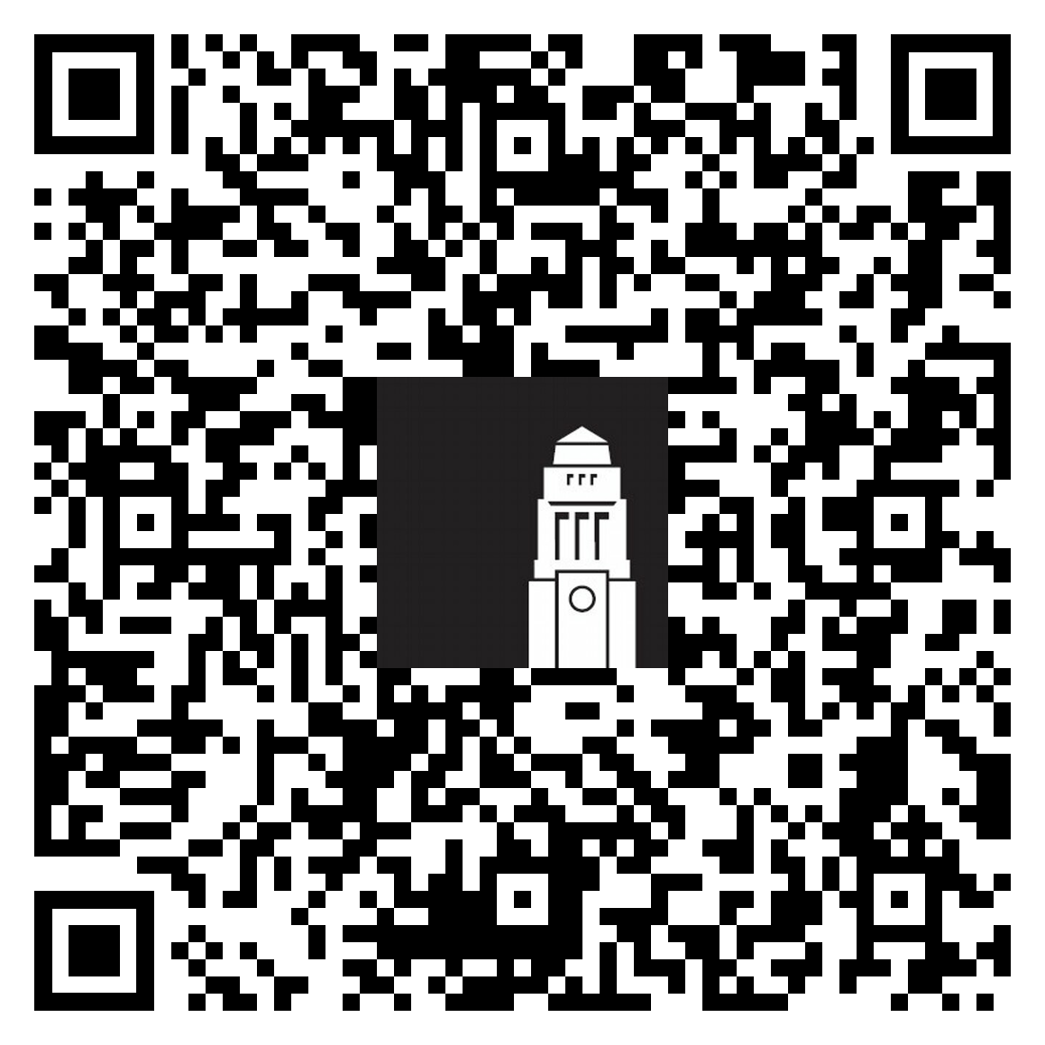
Student Counselling and Wellbeing
Free, confidential, specialist support from an experienced team of counsellors, mental health advisers and wellbeing practitioners in addition to online resources for you to access in your own time.
Feeling sad for no reason
Stress
Culture shock
Homesickness
Life events
Academic problems
and more…
Student Counselling and
Wellbeing
We’re here to help you
Student Counselling and Wellbeing

Slide 10
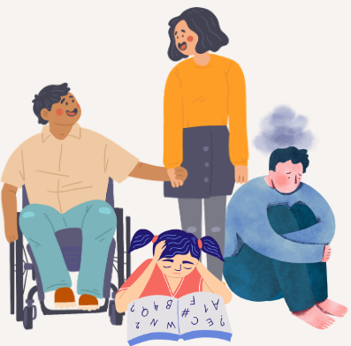
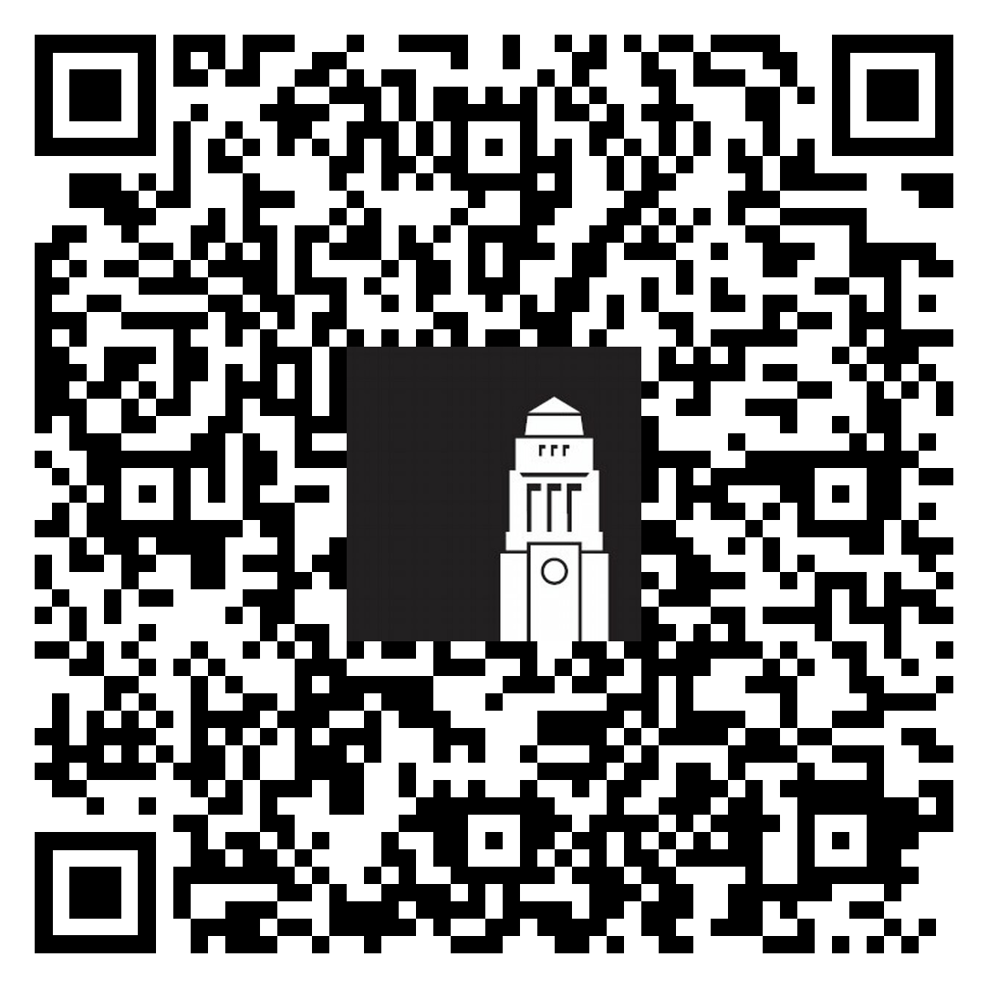
Disability
Visible
Invisible
or
Physical health
Mental health
or
A physical or mental health condition that can affect your academic success.
Disability@leeds.ac.uk
Disabled international
students
Disabled international students

Slide 11
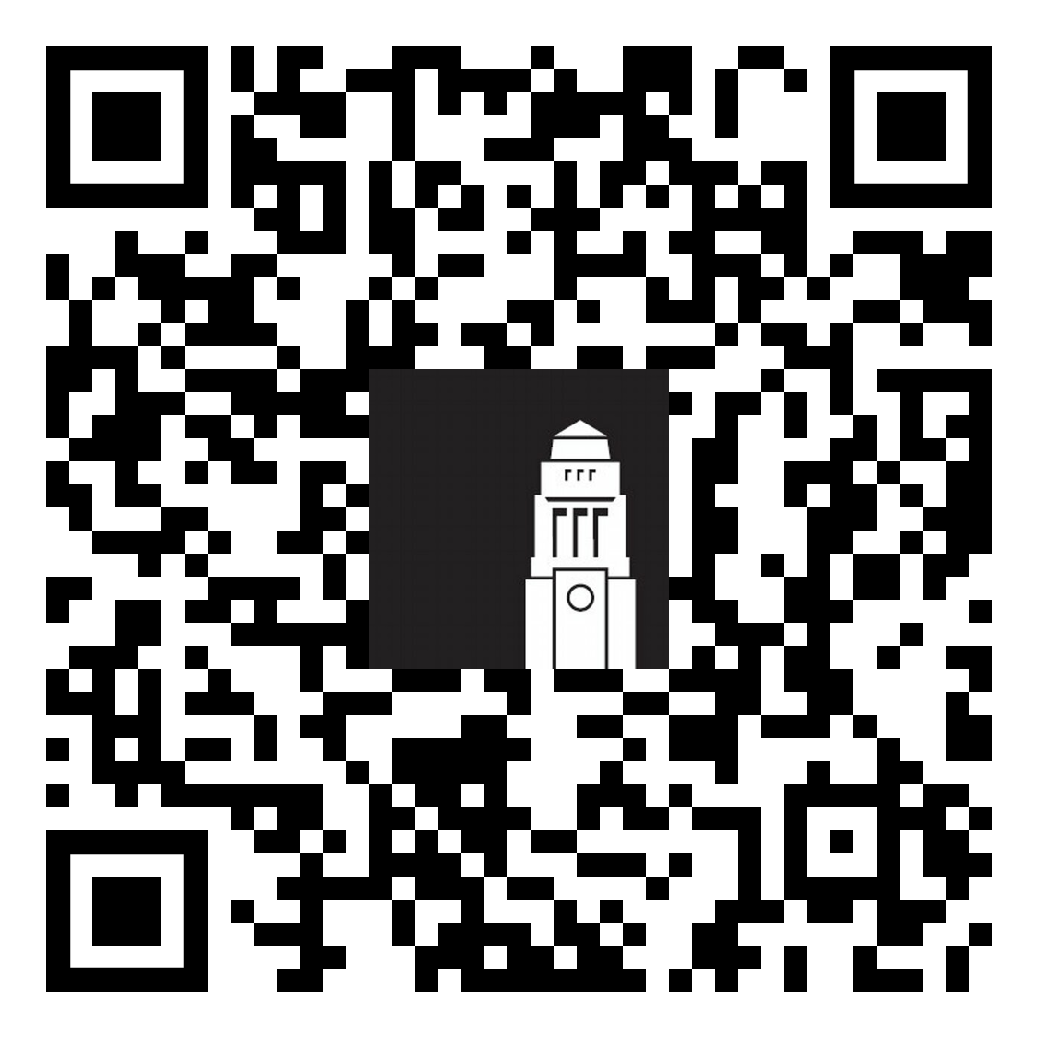
Disability Services
The Disability team can support your studies by:
Advising your academic School on the support you may need in your learning
Recommending academic adjustments for your course
Register for our
disability webinars
Giving you advice on a range of matters, from funding to assistive technology
Providing you with ongoing support throughout your time at Leeds
Monday 16 September (14:00 – 15:00)
Tuesday 24 September (14:00 – 15:00)
Disabled Student Support

Slide 12
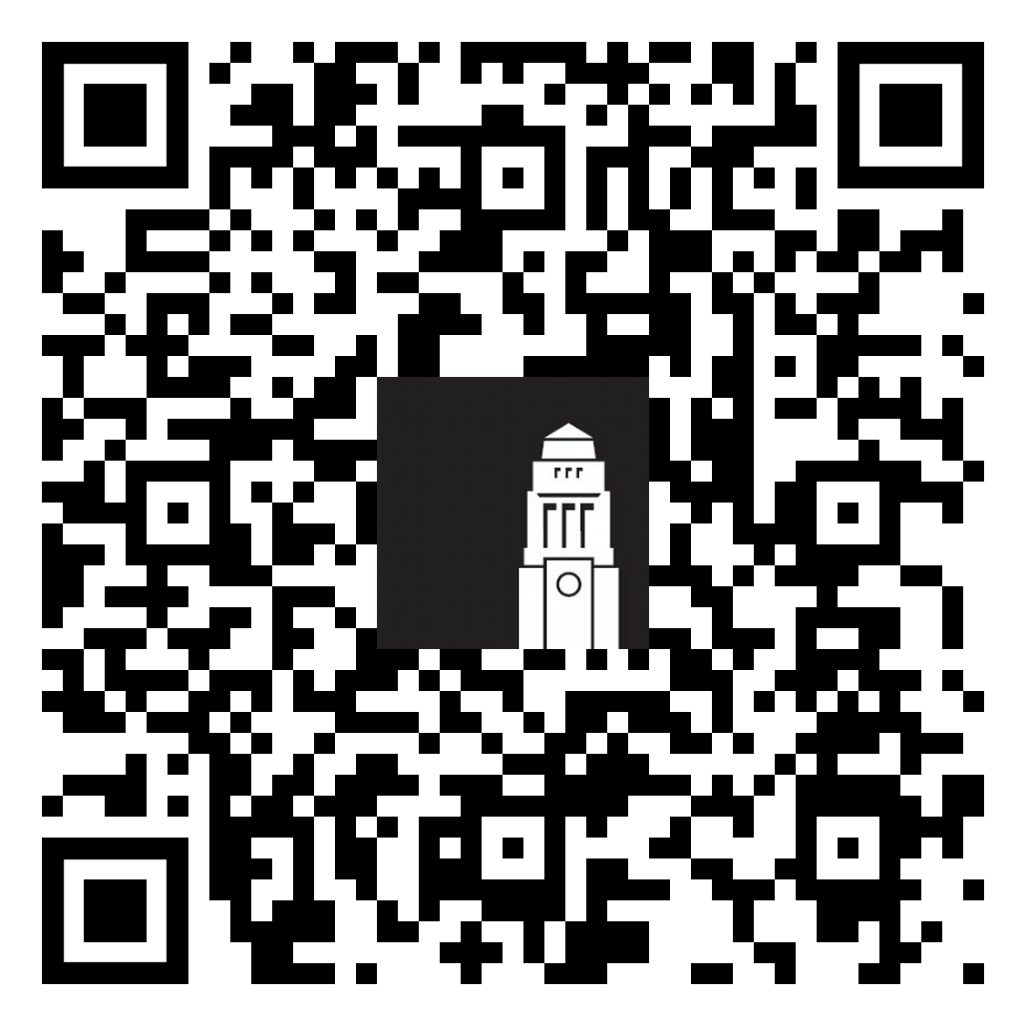
Faith based support
Many different prayer and quiet contemplation spaces on campus
Faith-based events and activities as part of Orientation and year round
You can join faith-based student societies in Leeds University Union
Chaplaincy supports students of all faiths, and none
Your Muslim Student Advisor – Sister Jaan Malik
International Student Chaplain – Reverend Foluso Enwerem
Chaplaincy, Emmanuel Centre
International Students Fellowship:​ every Wednesday 17:00 – 18:00 (term-time only)​ Chaplaincy, Emmanuel Centre
Prayer and
contemplation
Prayer, contemplation and faith based support

Slide 13
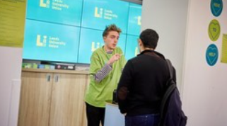
LUU Help & Support
Leeds University Union Help & Support Advisers can help with:
Wellbeing and your mental health
Budgeting and your finances
Living in Leeds,
private-sector accommodation
and staying safe
Exam support, appeal procedures and studying in Leeds
Student Life
Meet in person Foyer of the Students' Union building
Email advice@luu.leeds.ac.uk
Phone +44 (0)113 3801 400
LUU Help & Support

Slide 14
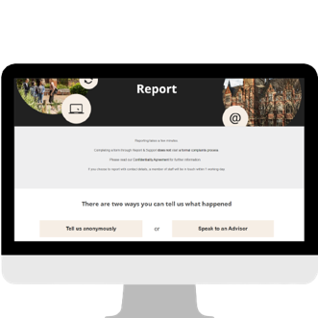
Harassment & Misconduct Team
Whatever you’re going through, you’re not alone. Violence, abuse, bullying, harassment, sexual misconduct, and discrimination are never okay.
If it happens to you or someone you know, the Harassment and Misconduct team can help however feels right to you, whether you want to explore support options, make a formal report, or just talk to someone.
We’re here for you every step of the way. Complete the disclosure form to talk to a specialist advisor.
Email: reportandsupport@leeds.ac.uk
Staying Safe in Leeds talk and webinars:
17 September (in person talk); 2:00 - 2:45
18 and 24 September (online webinar); 10:00 - 10:45

Slide 15
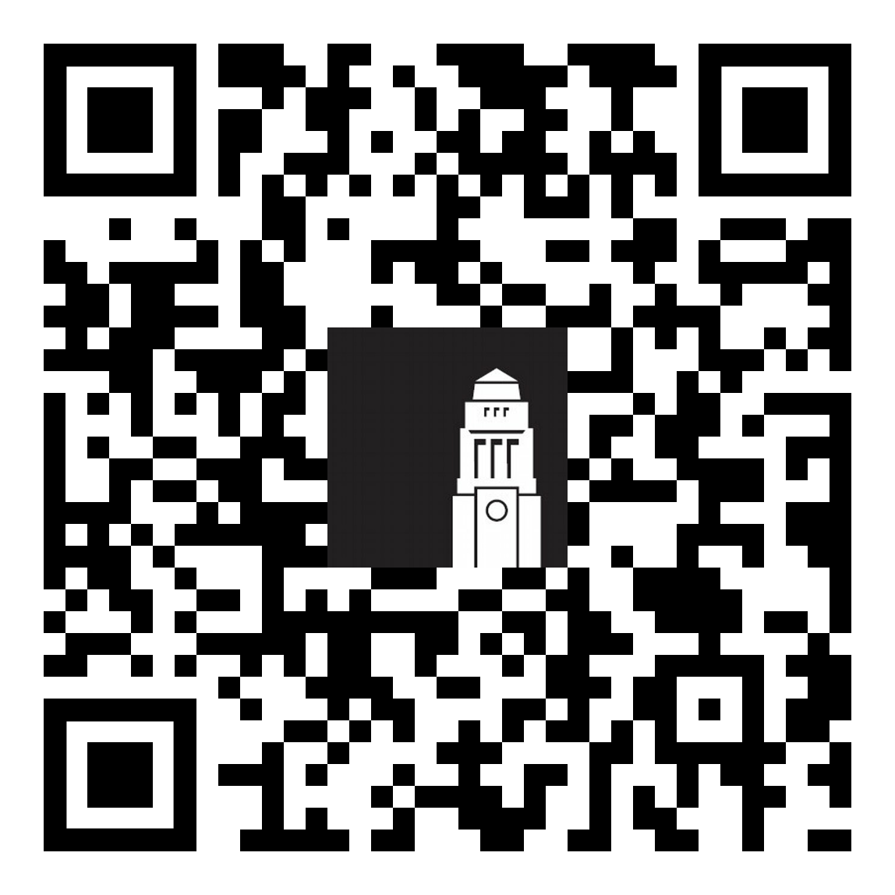
Thank you!
Any questions?
Contact the Student Information Service
International Orientation programme
Upcoming talks, sessions and events
Orientation resources and links from today's session
Feedback form
Student Information Service

