Slide 1
Healthcare and Wellbeing
International Orientation
Brought to you by the International Student Office and Student Information Service

Slide 2
Before we start
Your video and microphone are switched off, please use the chat
Time for questions at the end of the presentation
You’ll be asked to interact with us during the presentation – use the chat function
Click on the weblinks or use the QR codes on the slides, or after the webinar go to our International Orientation Resources webpage

Slide 3
The National Health Service
An institution at the heart of British culture
Public, government-sponsored
universal healthcare system
Free access to all services for UK residents
Understanding healthcare and where to get help

Slide 4
Healthcare glossary
GP
GP Surgery
UTC
A&E
General Practitioner,
doctor
Where a GP works
(medical centre or medical practice)
Urgent Treatment Centre
(walk-in centre)
Accident and Emergency
Notes:
Now that we have a better idea of what these abbreviations mean, we’re going to see when you use each service depending on the medical problem you might have.

Slide 5
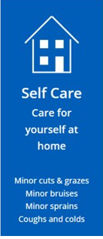
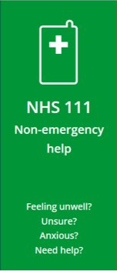
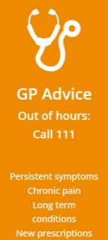
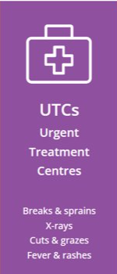
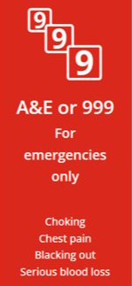
Who to contact if you’re ill
Understanding healthcare and where to get help

Slide 6
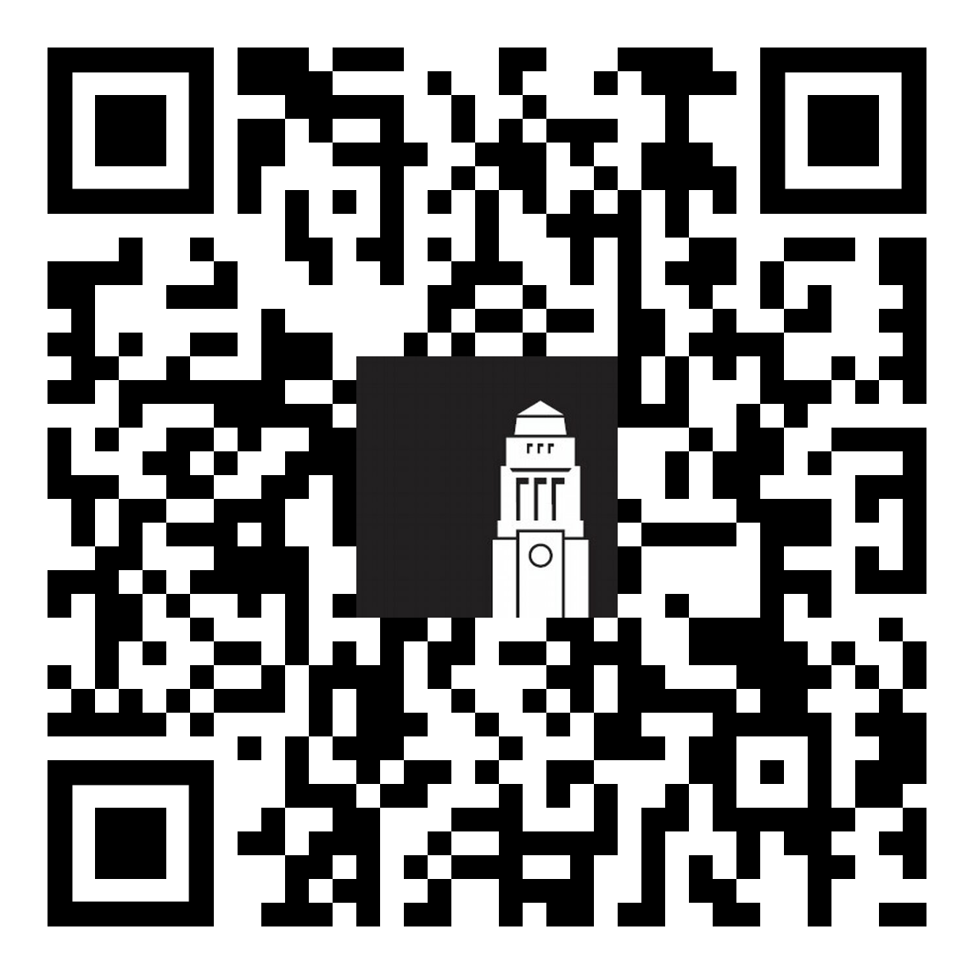
Healthcare and your visa Visa for less than 6 months
Healthcare webpages
You’ll be able to see a GP and receive A&E treatment for free
Specialist appointments, hospital stays are not free
Dental treatment is not free
It is important to have medical insurance to cover you for any treatment that you need to pay for
You’ll need to pay for all medications bought in the UK
If you’re a student from the EU, you can still use a valid EHIC to access healthcare
Healthcare and your immigration status

Slide 7
Healthcare and your visa Visa for more than 6 months
The Immigration Health Surcharge entitles you to receive free health services under the NHS
You’ll still need to pay for your medications and dental treatment
If you paid the Immigration Health Surcharge (IHS) and you’re a student from the EU or Switzerland with a valid EHIC card, you can apply for a refund (‘reimbursement’) of your IHS provided you don’t do any paid work whilst in the UK.
Healthcare and your immigration status

Slide 8
What your GP can help with
General practitioners (GPs) can:
Treat all common, short-term medical conditions
Prescribe medicines that you can’t buy in a shop (over the counter)
Monitor your condition/s and wellbeing
Offer advice on maintaining a healthy lifestyle
Arrange additional tests (blood tests, for example)
Refer patients to hospitals and other medical services for urgent and specialist treatment
Support you with your mental health

Slide 9
Find a local GP
Register with a local GP as soon as possible, even if you plan to continue using a medical service in your home country
Find a local GP surgery near your accommodation or near campus.
Leeds Student Medical Practice is the nearest GP surgery to campus.
This surgery can register students who live within specific areas of Leeds. If you live outside these areas, you'll need to register with a surgery nearer your accommodation.
Register with a doctor and a dentist

Slide 10
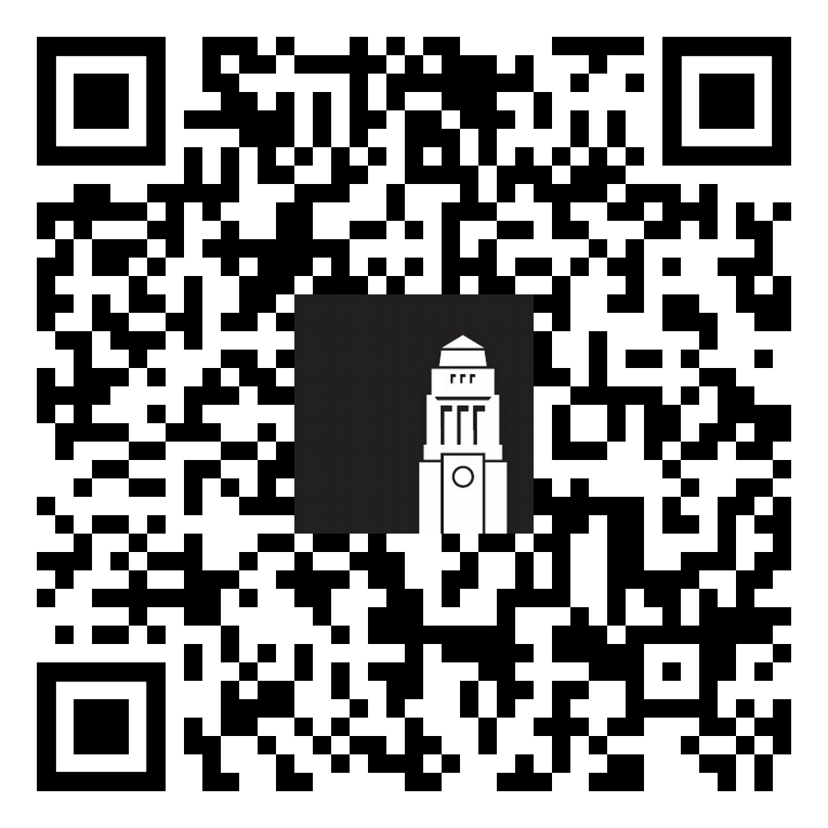
Register with a GP surgery
Register with a doctor
I’ve found a GP surgery, now what?
Check on the surgery website how to register. Call if you're not sure.
Check whether you need to provide any documents for the registration process
Complete your registration for you and any family members with you in Leeds
What do I need to ask ?
How long will it take to process my registration?
How will I know that I’ve been registered?
How do I book an appointment with a doctor?
Register with a doctor and a dentist

Slide 11
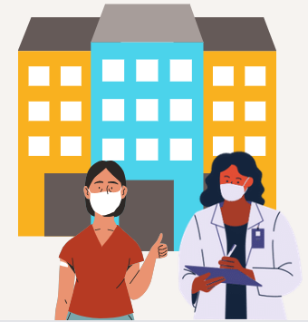
GP appointments What to expect
Find out more about booking and cancelling your GP appointments
An appointment may be offered:
By phone
Face-to-face
If you have a phone consultation, your GP will assess your situation and decide whether you need to be seen face-to-face.
Depending on your condition, your GP may:
Prescribe medication to resolve your problem
Refer you for tests or more consultations (including hospital, if necessary)
Give ongoing treatment for any long-standing condition.
Find out more about prescription charges and exemptions

Slide 12
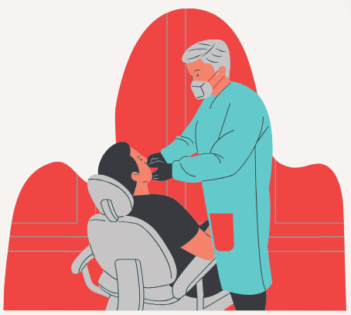
Dental care and your visa
Visa for less than 6 months
Cannot access NHS dental care
Arrange private dental treatment and claim costs from your insurance provider
Visa for more than 6 months
Can access NHS dental care for services offered by NHS dentists
Register with a doctor and a dentist

Slide 13
Comparing NHS and Private Dental care
NHS dental care
Private dental care
Only for students who have paid the International Health Surcharge
Fixed charges for treatment, unless you qualify for dental charge exemption (children and pregnant women get free treatment)
Longer wait for non-urgent appointments
Only treatment that’s clinically necessary
You must register with a practice. Only some dentists are accepting new NHS patients so start looking for a dentist now. Search for an NHS dentist
Available to everyone
Normally more expensive than NHS dental care and not free for children. Costs set by individual dentists and can change from practice to practice
Shorter waiting times for appointments
All treatments, including cosmetic
Register with a doctor and a dentist

Slide 14
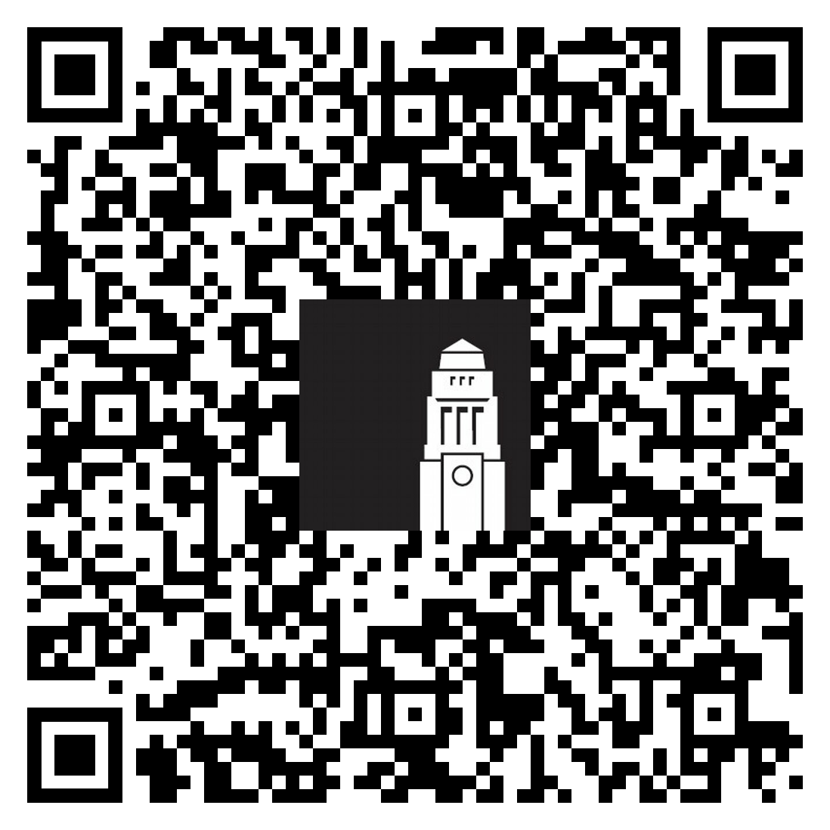
Who to tell when you’re ill
Who to tell when you’re ill
If you’re ill for up to 5 days
Self-certify your illness through Minerva on your return
If you’re ill for more than 7 days or you have to miss an exam or assessment
Tell your Student Support team in your School as soon as possible and find out:
How you report your absence
What support the School can offer
What documents you need to provide to certify your illness
Who to tell when you’re ill

