Slide 1
Fraud and scams

Slide 2
Fraud and scams
A scam is when someone tries to take your money by:
pretending to help you
offering you something which they are not going to give you
getting information that will help them to take your money
Specific scams target international students
We can all be vulnerable to scams
Stop and think before you share information or pay money
Fraud, phishing and scams

Slide 3
Visa scams
“A fraudster told me there was a serious problem with my visa and that I was at risk of being deported. They appeared to be genuine and convincing, and gave a false name and return phone number. They told me to send money as soon as possible using MoneyGram to stop any further action.”
Student Visa Advice

Slide 4
Impersonation scams
“The police called me to say my ID had been used to commit crimes and that I needed to pay legal fees to the courts to get help and assist with their investigation. They had a lot of information about me and told me that I shouldn’t tell anyone I knew as they may have been involved in the crime."
“My bank called me saying that I had been the victim of fraud and I needed to move my money to a new account urgently to keep my money safe”
Who calls me

Slide 5
Accommodation scams
"A fake profile reached out to a student with an accommodation offer.
This person introduced the student to a “landlord” who provided ID to identify themselves and offered private accommodation.
The student paid a deposit for the accommodation. After realising something wasn't right, the student asked for their money back. They were told they had to pay a fee to get the money back."
Your Accomodation

Slide 6
Tuition fee scams
Beware of people contacting you by social media including WeChat, in English or another language, offering to make tuition fee payments to the University on your behalf for a reduced amount or better exchange rate.
They may tell you this is how most international students pay their fees.
Always use the official University payment process.
How to pay

Slide 7
Too good to be true
"An individual approached me on WeChat claiming she had surplus Great British Pounds she wanted to exchange. I transferred 4,500 Chinese Yuan to her Chinese bank account. In return, she provided me with a screenshot of a transfer from her UK bank account. However, I did not receive any funds."

Slide 8
Stop and check
STOP
Stop and think before you pay money or share information
It's ok to reject, refuse or ignore requests, even if they say its urgent
Only criminals will try to rush you or stop you from seeking advice
CHECK
Contact the Harassment and Misconduct team
Ask Student Visa Advice
Contact the police (dial 101) or Action Fraud
​

Slide 9
If you think you've been scammed
Contact your bank straight away
Police
University IT Service Desk team
Harassment and Misconduct Team
Action Fraud

Slide 10
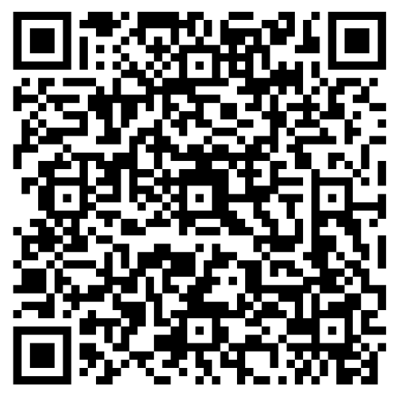
Fraud and scams: resources
Fraud, phishing and scams
Scam quiz 1
Scam quiz 2
Fraud, phishing and scams

Slide 11
Managing your money

Slide 12
TV licence
In the UK, you need to pay for a TV Licence to:​ ​ a) watch or record live TV programmes on any channel (including non-UK satellite channels) b) download or watch BBC programmes on iPlayer
For up-to-date information about cost and details on the many ways you can pay, visit the TV Licensing website.

Slide 13
Money saving tips
Cost of living hub
LUU online saving information
LUU online budgeting information
Read our Link to Leeds blogs on managing your finances in Leeds

Slide 14
LUU Help & Support
Leeds University Union Help & Support Advisers can help with:
Budgeting and your finances
Wellbeing and your mental health
Living in Leeds,
private-sector accommodation
and staying safe
Exam support, appeal procedures and studying in Leeds
Student life
Meet in person Foyer of the Students' Union building
Email advice@luu.leeds.ac.uk
Phone +44 (0)113 3801 400
LUU Help & Support

Slide 15
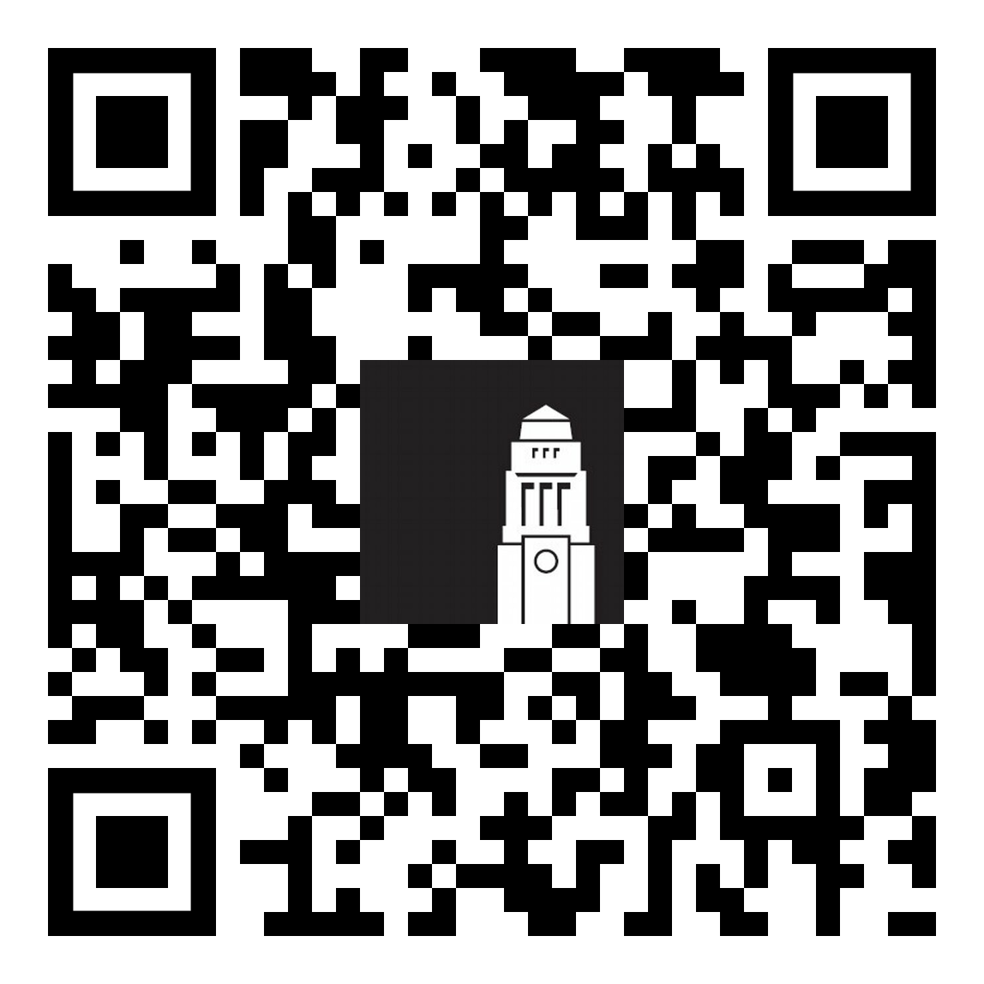
Student Information Service (SIS)
Get help with questions relating to registration, identity checks, and a range of other matters around university life, your studies and more throughout your studies.
Available Monday to Friday 9am – 5pm in person at our Student Information Points on campus.
Email: studentinfo@leeds.ac.uk
Phone: 0800 9150402 (Inside the UK) +44 (0)113 3437000 (Outside the UK)
Maurice Keyworth
Parkinson Building
Worsley Building
Student Information Service

Slide 16
Thank you!
Any questions?
International Orientation programme
Upcoming talks, sessions and events
Orientation resources and links from today's session
Feedback form
Contact the Student Information Service
Student Information Service

