Slide 1
Money and Banking
International Orientation
Brought to you by the International Student Office and Student Information Service

Slide 2
Before we start
Your video and microphone are switched off, please use the chat
Time for questions at the end of the presentation
You’ll be asked to interact with us during the presentation – use the chat function
Click on the weblinks or use the QR codes on the slides, or after the webinar go to our International Orientation Resources webpage

Slide 3
Opening a bank account

Slide 4
Digital banks
Traditional banking services but only app-based
Check that the bank is
Online and telephone customer support
Regulated by the Financial Conduct Authority (FCA)
Lock, unlock and cancel your card through the app
No fees for overseas transactions (within certain limits) and limited cash withdrawals
Protected by the Financial Services Compensation Scheme (FSCS)
Transfer money between your home country bank account and your UK bank account at very low interest rates
Normally open to international students and quick to set-up
Money for when you arrive

Slide 5
Digital banks: what documents do I need?
Verify your identity by taking a photo of your passport with your phone
Provide evidence of a UK address
Advantages
Disadvantages
Similar offer to a
traditional bank
Easier/faster to set up
No physical branch in the city
Savings accounts are not always protected
Not all digital banks have an overdraft function and may charge for it.
Money for when you arrive

Slide 6
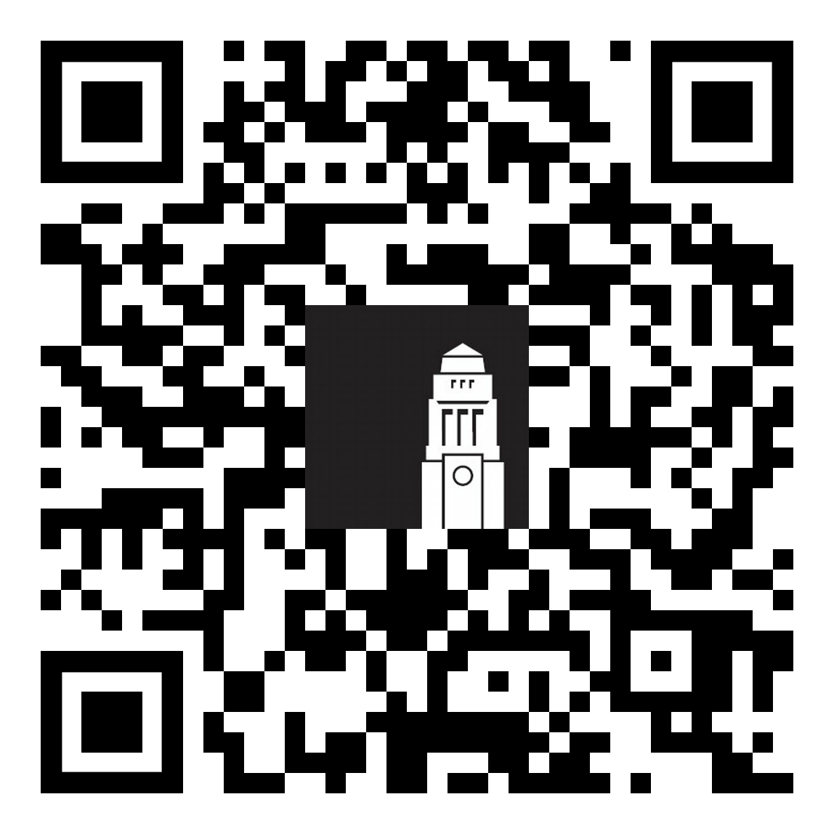
'High street' banks
Traditional banks that have a physical presence in the city
Offer online banking solutions
Offer more services than a digital bank
No limits on free cash withdrawals
More regulated than digital banks
Can take longer to set up an account
High street
banks
High street banks

Slide 7
Can I open a bank account?
Many banks require you:
to be in the UK for at least six months
to be over 18
BUT
There are some accounts you can open if you are here for fewer than six months or if you are under 18
Make sure you check the account requirements before applying to open an account with a specific bank
High street banks

Slide 8
High street banks
The University can't recommend any particular bank accounts but we do have information on high street banks to help you make a start.
Some things to consider when choosing a bank are:
What fees you will be charged for opening an account
What cards you can get (Visa/Maestro, credit cards/debit cards)
If the bank will stamp printed internet banking statements
How long it takes to open an account
High street banks

Slide 9
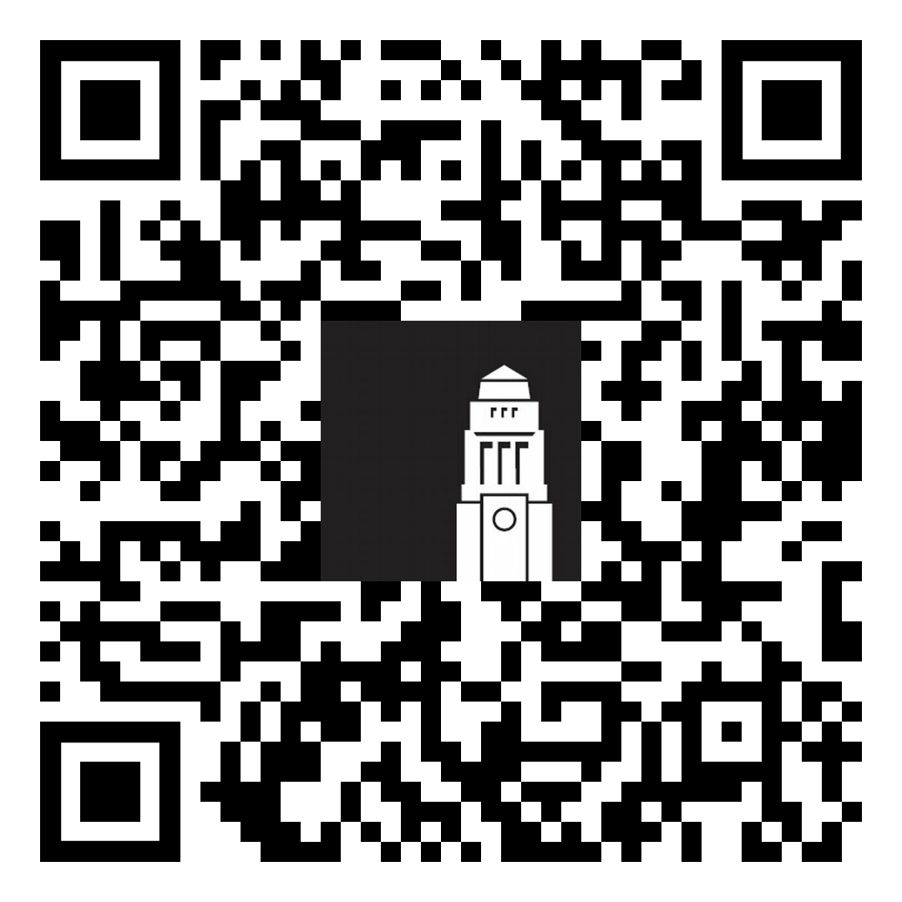
What documents will I need?
Your passport
A home and term-time address
A bank letter from the University
We'll send you your bank letter by email when you've completed the first three steps of your online registration.
The standard bank letter produced by the University won’t be addressed to a specific person.
The following banks accept the standard University of Leeds bank letter:
Lloyds HSBC Santander
Banking documents

Slide 10
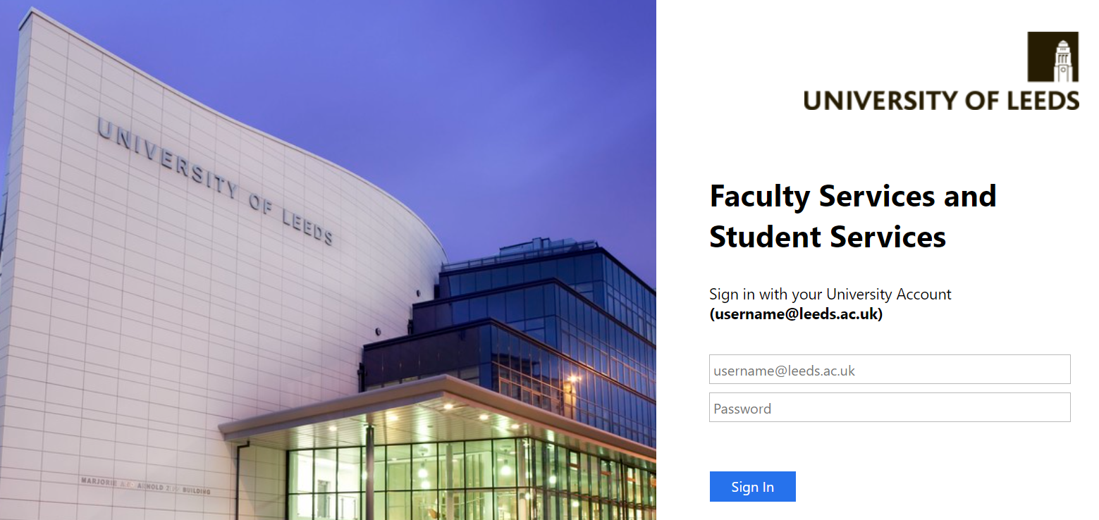
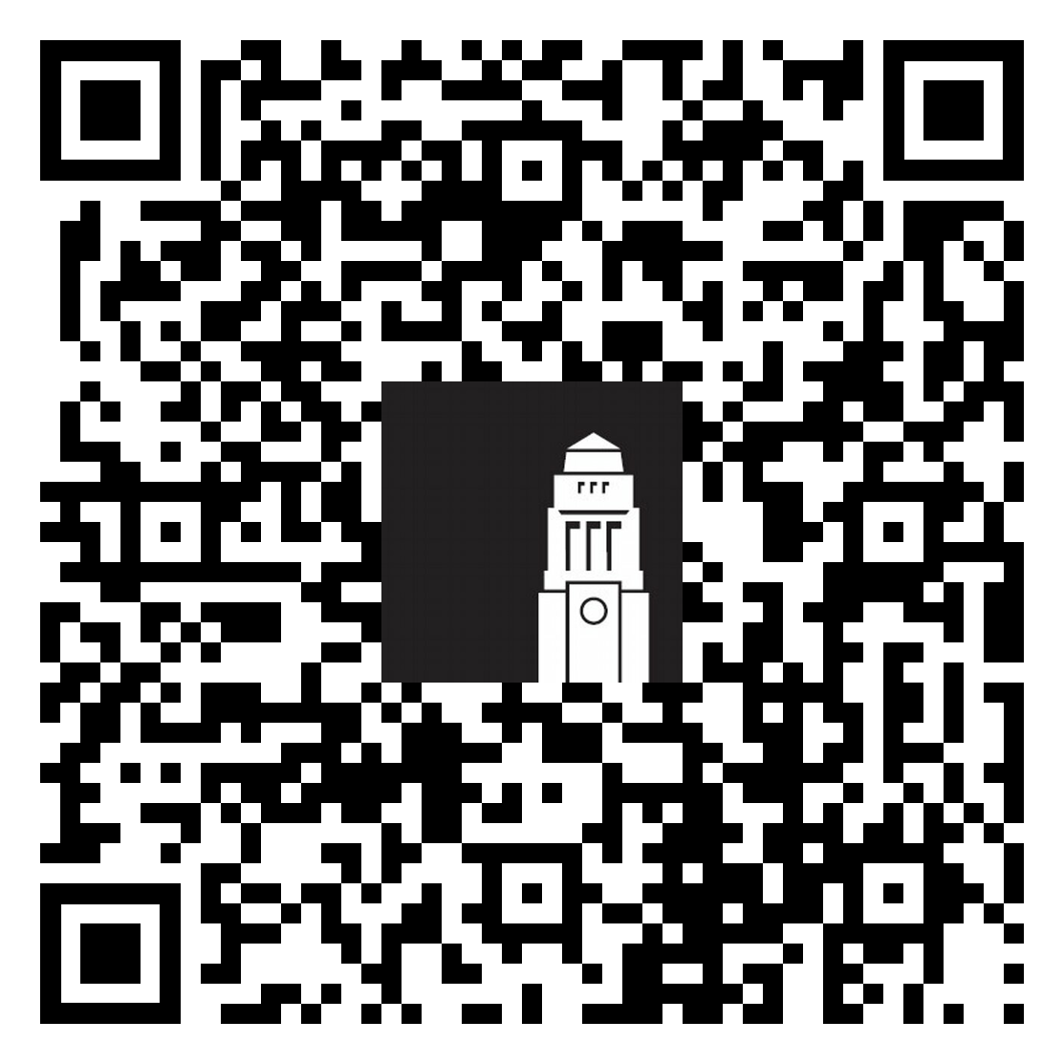
How do I get a bank letter?
Follow this process to receive the University standard bank letter
Complete the first three steps of the online registration process
Banking documents

Slide 11
Online registration: check name
When completing online registration, check your details appear in the correct format on Minerva.
If you don't enter your details correctly your bank letter will be delayed.
1. Your name
Your full name must match the information you have on your passport.​
​
First name, last name (for example, Jonathan Smith)
OR
First name, middle name, last name (if you have a middle name)
(for example, Jonathan James Smith)
Banking documents

Slide 12
Online registration: check address
When completing online registration, check your details appear in the correct format on Minerva.
If you don't enter your details correctly your bank letter will be delayed.
2. Your address
your address in your home country
Home address
Term time address
your address in the UK, including postcode in
the format of XXX XXX (for example LS2 9JT)
Complete all fields in full, including the ‘Nation’ field.
Banking documents

Slide 13
I need my bank letter to have more information
Some banks do not accept the University of Leeds standard bank letter.
Complete a Registration Status Certificate request
(allow up to 10 working days for the request to be processed)
You’ll still need to have:
Completed the first three steps of your online registration
Entered your name and surname correctly
Entered your home and term-time address information correctly
Banking documents

Slide 14
When will I receive my bank letter?
If you have:
Completed your online registration correctly
Entered your name and addresses correctly in Minerva
You’ll be sent your bank letter by email:
If you’re staying in private accommodation
After the start date of your term-time (UK) address
After completing the first three steps of online registration
If you’re in University accommodation
After the start date of your accommodation contract After completing the first three steps of online registration
Banking documents

Slide 15
I've not received my bank letter What do I do?
Have you waited 5 working days?
A working week is from Monday to Friday. Make sure you don't count weekend days.
Check your personal information on Minerva
Have you entered your full name correctly?
Have you entered your home and term time address correctly?
If you're in University accommodation, check your accommodation contract
Has your contract started yet? You need to wait until after the start date.
Everything seems fine! What do I do?
Check your spam/junk folder in both your personal and Leeds email address
Contact the Student Information Service – studentinfo@leeds.ac.uk
Banking documents

Slide 16
Opening an account
Visit your chosen bank’s website to find out more about how you can book an appointment to open your bank account
Many banks are now starting applications for new accounts online
Check what documents you’ll need and bring them with you to your appointment (if the bank gives you one)
Opening a bank account

