Slide 1
Disability Services
Ask questions anonymously via vevox and we will answer at the end of the session.
Carly Miller
Disability Coordinator
Airasa Maughan-Strickler
Disability Advisor

Slide 2
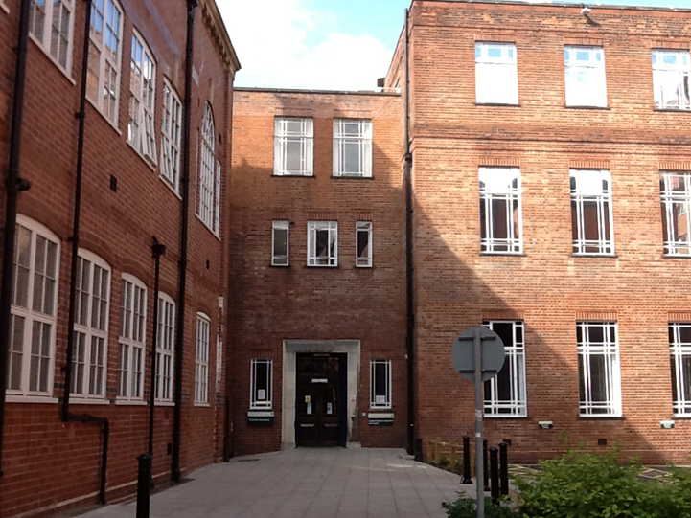
Disability Services
The Disability Services is made up of 3 teams:
Front of House / Disability Service Reception
Disability Advisory Team
The Support Worker Team

Slide 3
Disability Services – who qualifies for disability support
In the UK the Equality Act 2010 defines a disabled person as someone who:
“has a physical or mental impairment that has a substantial and long-term adverse effect on his or her ability to carry out normal day-to-day activities.”
Approximately 19% of students at the university have declared a disability
‘Long term’: has lasted, or is likely to last, 12 months or more

Slide 4
Disability Services - who do we support?
We support a wide range of disabled students, including those who:
Are D/deaf, hearing impaired or hard of hearing
Are blind, visually impaired or partially-sighted
Have a physical disability, and/or mobility difficulties
Have a specific learning difficulty (e.g. dyslexia or dyspraxia)
Have ADHD
Are autistic
Have a long-term mental health condition
Have a long-term medical condition (e.g. chronic fatigue syndrome, diabetes, epilepsy)
Have a combination of these
This list is not exhaustive. If you’re not sure whether you qualify for support please contact us for more advice and information disability@leeds.ac.uk

Slide 5
Disability Services – can we support you?
Did you have exam arrangements in school or receive classroom support?
Do you have a long term medical condition?
Did you have informal support networks at home that you can’t access in Leeds?
Please come and talk to us if you have any questions or want to discuss how we can support you.

Slide 6
Disability Services – Available support
Could include:
Funding for academic related disability support e.g. one to one support
Exam arrangements
Directed reading lists
Timetabling arrangements
Assistive technology

Slide 7
Disability Services - What next?
1
Complete our online Sign Up form
2
Send us appropriate supporting documentation
3
Contact Disability Services about disability-related funding
How does disability affect you? Previous exam arrangements.
It can take up to 10 weeks for your registration to be processed. We recommend you register as soon as possible even you have not confirmed you are coming to Leeds.

Slide 8
Other things to consider
There are additional things to consider before you arrive:
Medication for a long-term condition (e.g., antidepressants, ADHD medication, insulin)​
Equipment (e.g., wheelchairs)​
Personal Care Support​ - this is not provided by the University, we can provide information about options.
Accommodation needs - The accommodation team have a separate process for requesting specific accommodation due to disability. You can contact them directly at accom@leeds.ac.uk if you have any questions. ​

Slide 9
Contacting Disability Services
Disability Services Reception open 9am-5pm Monday-Friday
Ground floor, Chemistry West Building
(Building 55a on campus map)
In-person drop-ins and online appointments available daily – visit Reception, phone or email to check times and book
Phone or email with any queries.
Check our social media for updates.
Email: disability@leeds.ac.uk
Telephone: 0113 343 3927
UoLDisabilityTeam
@UoLDisability

Slide 10
Disability Services
Any Questions?

