Slide 1
Welcome!
Notes:
Promo blurbs:
Studying in a new country is like any other major life transition - it can be simultaneously exciting and daunting. In this session, we will reflect on the past learning experience, and consider how studying at Leeds may be similar or different from them. We will delve into essential study habits that are fundamental for improving productivity and for making the most out of your study. There is also the opportunity to chat with staff and fellow new students in a welcoming online setting.

Slide 2
Webinar tips
Yes, we are recording this session!
4
Ask questions and use emojis in the chat
1
Take part in activities.
Draw or write on screen using tools above the slides to the left
2
Sound problems? Check your audio settings or leave and re-enter the room.
3
Notes:
Haven’t been to a webinar before?
Here are some tips to help you!
It is an interactive session - I will be making you ‘interactive’ by taking part in a number of short activities.

Slide 3
“Prepare to Study at Leeds”
Amy Allhouse
Learning Advisor in Skills@Library
Notes:
I am a learning advisor in Skills@ Library which is a service to support all taught students with their academic skills.
Today’s session is all about …. which aims to explore some aspects of your incoming study at Leeds.

Slide 4
In this session,
Reflect on the past learning experience, and consider how studying at Leeds may be similar or different from them.
Consider good study habits that are fundamental for improving productivity
Introduce other opportunities and support available at Leeds
Notes:
In this session, we will reflect on the past learning experience, and consider how studying at Leeds may be similar or different from them.
We will think about essential study habits that are fundamental for improving productivity and for making the most out of your study.
I will also introduce great opp and support available to you as a student at Leeds

Slide 5
Where are you today? On the map (in the next slide): Use the pointer in the top left of the ‘Annotation Bar’
Notes:
Alternatively, type in the chat bar or add text (T) on the screen.

Slide 7
How are you feeling about studying at Leeds?
Super excited and confident
Quite confident
Not sure yet
Quite nervous
Super nervous. Please help!
Respond in a Poll
Notes:
How are you feeling about your masters research project?

Slide 8
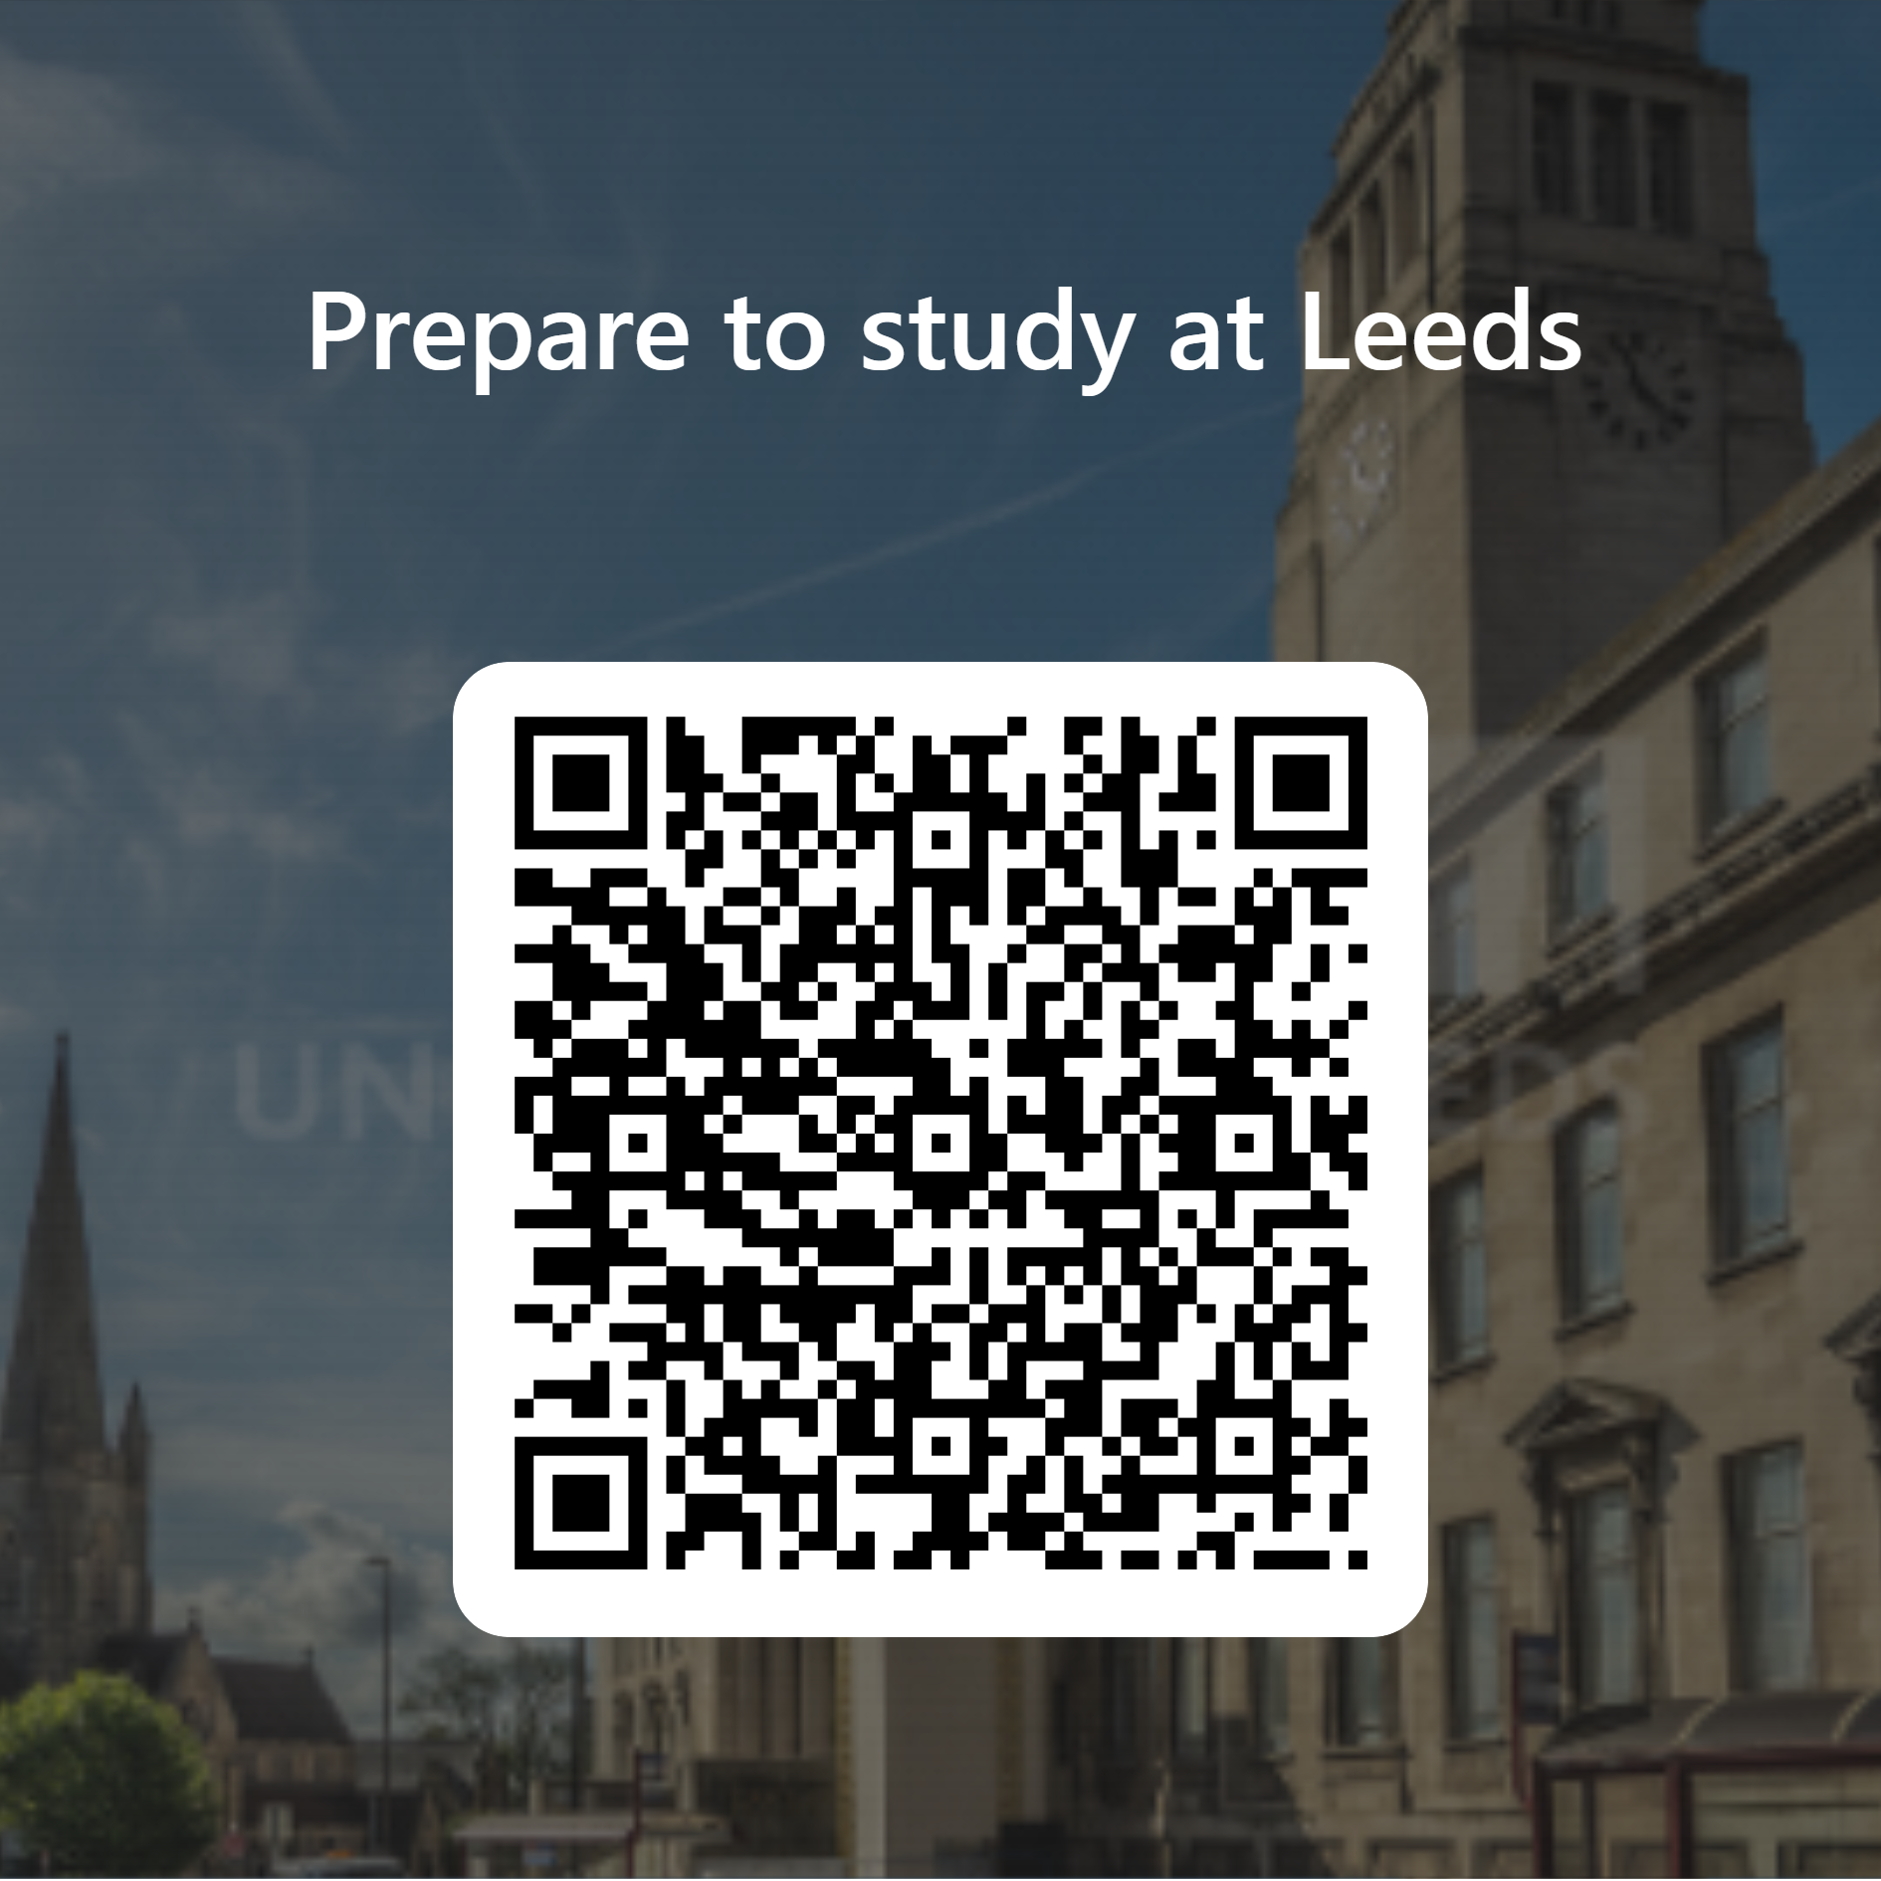
Reflection activity:
To what extent, studying in your home institution is similar or different to studying at Leeds?
Please scan the QR code to complete the survey.
Notes:
https://forms.office.com/e/ZfcVZpFyWJ
Spend time to comment on the responses.

Slide 9
Learning Community
Notes:
"At the University of Leeds, students are part of a learning community that shares ideas and develops new ones.
As part of this, you need to learn how to interpret and present other people's ideas and combine them with your own to produce academic work. This can be in This is academic integrity."
Talk about good practices good skills eg Note-making, paragraphing, referencing – to demonstrate good academic practices.

Slide 10
… just like having a discussion ...
Another category that has been examined widely in study abroad literature is demographic factors. Among these are gender (e.g. Terzuolo, 2018), age (e.g., Kruse et al., 2014), language proficiency (e.g. Vande Berg et al., 2009), and ethnicity (e.g., Mahon, 2009). However, unlike program factors whose impact has been found to be significant across the board, the impact of demographic factors is harder to predict. For example, while several studies reported that female students made greater intercultural gains than male students (Terzuolo, 2018, Tompkins et al., 2017), the relationship between gender and intercultural competence was not found to be significant in other studies (Cui, 2016).
Mu, B., Berka, S., Erickson, L. and Pérez-Ibáñez, I. 2021. Individual experiences that affect students’ development of intercultural competence in study abroad, International Journal of Intercultural Relations, 89, pp.30-41.
Notes:
"Academic study involves a lot of independent research. You will need to find and use information to explore topics in your subject area and to complete written assignments" like the para showing on the slide.
This paragraph (from lit review section) directly taken from a academic journal article, which is a research into the development of intercultural competence in study abroad experience. The author has done a lot of reading and critical reading – [talk about Referencing, paragraphing, and independent research]
Access to the article: https://www.sciencedirect.com/science/article/pii/S0147176722000578

Slide 11
Good study practices
Finding and using appropriate information
Reading and note making
Thinking and analysing
Creating and writing to express your personal understanding
Citing and referencing
Working collaboratively as well as independently
Notes:
Here are some specific academic skills that support good practice, such as: (...on slide)
Academic study involves a lot of independent research. Often required you to find and use information. How you keep track of this information has a big impact on your academic integrity when you come to write and present your work. Effective note making is part of good academic practice and can help you avoid accidental plagiarism – so you need to keep a record of the sources of info when using those info in your work.
4-5 Good study practice helps you to make clear the difference between information you find and your own ideas. You can be transparent about when you use other people's work at the same time as demonstrating your own understanding of the topic. 5- One of the key aspects of academic integrity is acknowledging other people’s contributions to your work.
6- It is natural to want to support each other on your course and within friend groups. There are times when this can be very beneficial, for example, reminding each other about deadlines, or explaining where to find something on Minerva. It’s important to remember that when you start working on assignments, you need to make sure that you are working as an individual.

Slide 12
Academic Integrity
Academic integrity is a commitment to good study practices and shared values which ensures that my work is a true expression of my own understanding and ideas, giving credit to others where their work contributes to mine. More information:
https://bit.ly/3NXkBnk
Notes:
A closely related concept in relation to this (in slide 10/Referencing..) is Academic Integrity.
Academic integrity means engaging in good academic practice. This involves essential academic skills, such as keeping track of where you find ideas and information and referencing these accurately in your work. And you can learn more about the principles of AI and what does it involve by going to the webpage: https://bit.ly/3NXkBnk
https://bit.ly/3NXkBnk

Slide 13
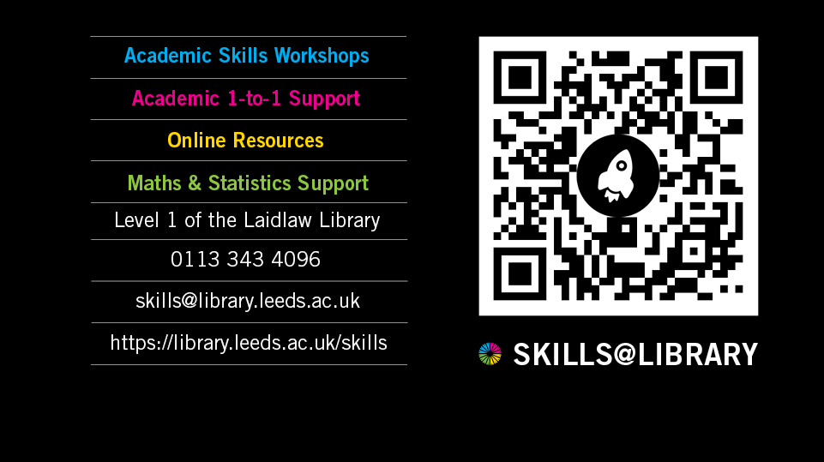
Notes:
"So I am going to tell you about SKills@Library, which is where I am based, and the diff ways we support students to achieve academic success and skills development."
Skills@Library offer free workshops to all taught students, which you can attend alongside your degree.
Skills@Library – Leeds University Libraries Blog (wordpress.com)

Slide 14
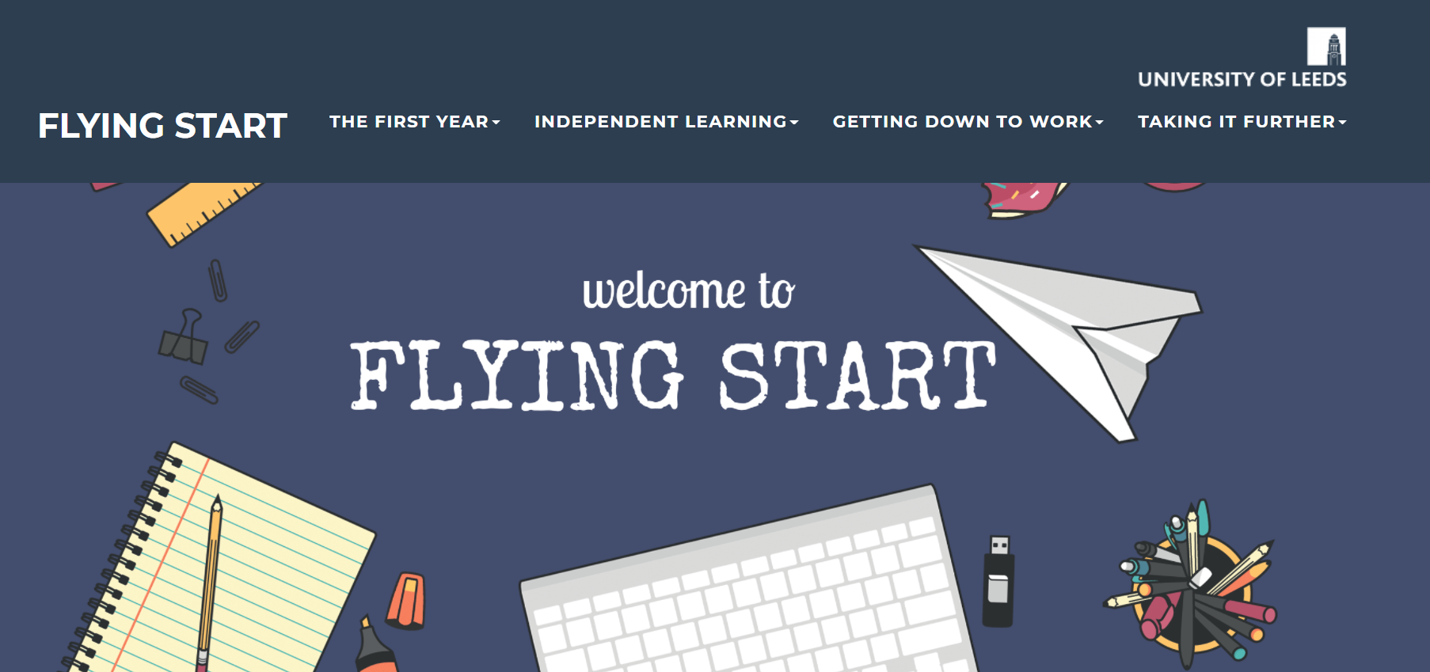
Flying Start https://resources.library.leeds.ac.uk/flyingstart/

Slide 15
Academic English courses and workshops
The Language Centre provides opportunities for students to become more confident in using academic language in their discipline. Your School may offer these workshops and academic English support specific to your area of study.
Weekly classes
1:1 and/or small group consultations
Online resources for modules
Find out about workshops and learning opportunities you can access from your School
Notes:
The Language Centre at Leeds provides a range of learning opportunities for students to become more confident in using academic language in their discipline. These may take the form of: Weekly classes, 1:1 and/or small group consultations, online resources for modules.
If you'd like to develop your confidence in using academic language, there are workshops and advice appointments that can help you to do this.
You can find out more by visiting the webpage [share link] For Students | English for Academic Purposes: Insessional (leeds.ac.uk)

Slide 16
Language Zone
A dedicated space and resource centre for language learning.
Workshops
Activities
And many more....
Language Zone | University of Leeds
Notes:
Independent English language learning support is also available at the Language Zone, which has free resources and activities to help you develop your language skills.
The Language Zone - A dedicated study space and resource centre for language learning. Workshops + Activities to help you practise and improve your skills.

Slide 17
Research show that it is important to use English in social contexts. This is because practising English socially can have positive impacts on using English in an academic context. Get involved!
Notes:
Some students will have had lots of experience of using English before and others less.
Stress the importance of using English in social contexts, recognising that going out and practising English socially can also have positive impacts on using English in an academic context.
The more engaged you are with the university and in social contexts, more successful you can be academically.
Lots of opps to get involved: S@L workshops, LUU events and activities, being a school/course rep, joining sports and societies, coming along to the Language Zone, as well as taking part in events organsied by your local school and progs.

Slide 18
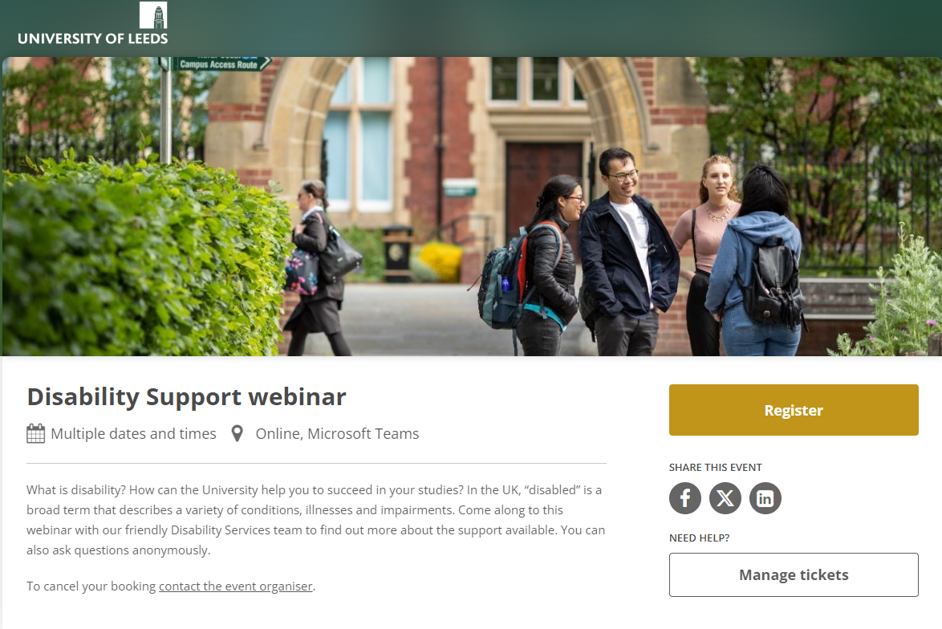
Scan the QR code to register
Notes:
Finally, a shout out for the Disability Support Webinar run by our friendly Disability Services team.
In the UK, “disabled” is a broad term that describes a variety of conditions, illnesses and impairments. Some of these conditions are diagnosed by health professionals, and some are self-diagnosed. In this webinar, you can find out more about the support available in the context of developing academic skills as well as asking questions anonymously.
Scan QR to register.
Register – Disability Support webinar – Microsoft Teams (tickettailor.com)

Slide 19
Useful sites for information Student Information Service https://students.leeds.ac.uk/askingforhelp International Orientation programme https://students.leeds.ac.uk/orientation
Upcoming talks, sessions and events
Orientation resources and links from today's session
Notes:
https://forms.office.com/e/NvjKzMBS13

Slide 20
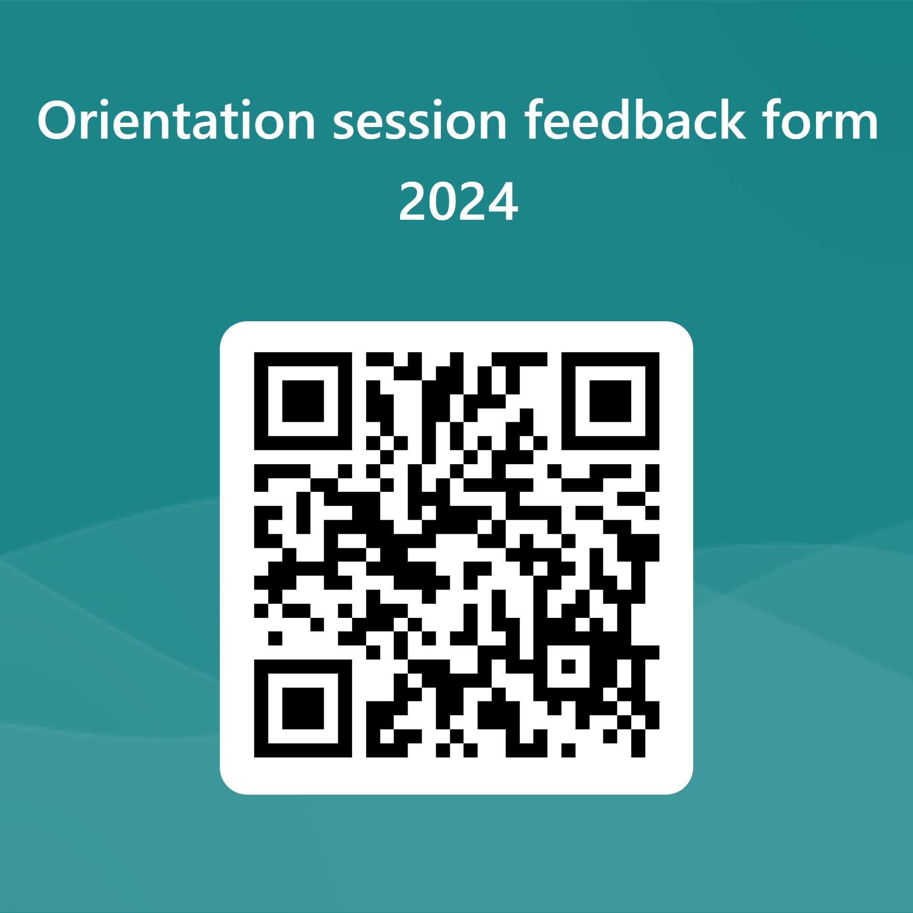
Have your say!
Notes:
https://forms.office.com/e/NvjKzMBS13

