Slide 1
Disabled Students’ Allowances (DSA)

Slide 2
Things we’ll discuss
What is Disabled Students’ Allowances (DSA)?
Who is eligible?
What support can DSA fund?
The DSA application process
Frequently Asked Questions
Any questions, just ask!

Slide 3
What is DSA?
DSA is funding provided by Higher Education Funding Bodies to pay for additional support to help you to manage the impact of your disability on your studies.
This may include the provision of assistive technology and relevant training, support from people and assistance with travel costs.
DSA is a grant; you do not need to pay any of it back at the end of your course.
Notes:
DSA is separate to the university but we can provide information and guidance with the process

Slide 4
Who is eligible?
If you are eligible for funding (e.g. maintenance or tuition loan) from any of the following funding bodies you should be eligible for additional disability-related funding:
• Student Finance England
• Student Finances Wales
• Student Finance Ireland
• Student Awards Agency for Scotland
• NHS Awards Agency for Scotland
• NHS BSA Student Bursaries
• A Research Council
In most cases you do not have to be in receipt of a student loan in order to apply for DSA, you just need to be eligible for one.
Notes:
If you’re unsure if you’re eligible then just ask us
If you’re not eligible then come talk to us

Slide 5
What support can DSA fund?
Specialist equipment and software
Assistive Technology Training
Non-Medical Helpers
General Allowances
Travel Allowances
https://www.youtube.com/watch?v=71_L-ZdU0CU
Notes:
Specialist equipment, software and training
Laptop (£200 contribution)
Dictaphone
Text Help Read & Write
Dragon
Mindview
Pro Study
Non-medical helper support
Study Skills Tutor
Specialist Mentor
General allowances
Non core study skills books
Printing allowances
Travel allowances
Taxis

Slide 6
DSA Application Process
Apply for DSA
Eligibility Letter
Study Needs Assessment
Entitlement Letter
From start to finish, the DSA application process can take approximately 12-14 weeks – Apply early for support to be in place at the start of the semester!

Slide 7
Step 1- Application
Apply for DSA
Eligibility Letter
Study Needs Assessment
Entitlement Letter

Slide 8
Step 1- Application
Different funding bodies have different application processes:
For SFE, apply online via your student finance account or complete a paper application form:
Slim form- Undergraduate, studying full-time with a student loan
Full form- Postgraduate or studying part-time or without a student loan
https://www.gov.uk/disabled-students-allowances-dsas
If you are in receipt of a NHS Bursary, apply online via your BOSS account:
https://myaccount.nhsbsa.nhs.uk/Pages/Login.aspx
You will need to include appropriate evidence such as a diagnostic assessment or a medical letter.
Notes:
DSA form and medical evidence form on desks!
Medical evidence criteria/ medical evidence form

Slide 9
Step 2- Eligibility Letter
Apply for DSA
Eligibility Letter
Study Needs Assessment
Entitlement Letter

Slide 10
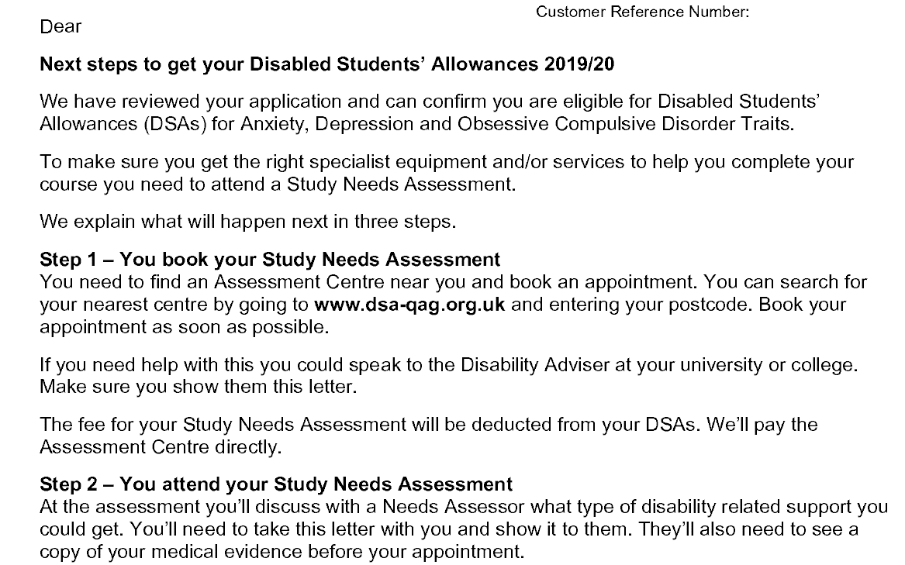
Step 2- Eligibility Letter
Notes:
An example of what you’ll receive. This is a confidential version
You need to contact the assessment centre once you receive this letter. There’s one here but you can go elsewhere too
There’s no cost to you for the assessment- the funding body pays instead

Slide 11
Step 3- Study Needs Assessment
Apply for DSA
Eligibility Letter
Study Needs Assessment
Entitlement Letter

Slide 12
Step 3- Study Needs Assessment
What is a Study Needs Assessment?
A Study Needs Assessment is where you will meet with an Assessor to discuss how your condition affects your studies and what support can be recommended to help you in your studies. The assessment isn’t a test and there are no right or wrong answers, instead it is an informal face-to-face discussion where you may have equipment and/or software demonstrated to you that you may find useful in your studies.
Once the assessment has finished, your Assessor will write a report where they will recommend any potential equipment, software and/or support that may help you in your studies.
https://www.youtube.com/watch?v=PZGY3r_XXGg
Notes:
It’s a compulsory step to identify what support would be beneficial rather than diagnosing a condition
It’s not an ASSESSMENT- it’s an informal conversation with an assessor

Slide 13
Step 4- Entitlement Letter
Apply for DSA
Eligibility Letter
Study Needs Assessment
Entitlement Letter

Slide 14
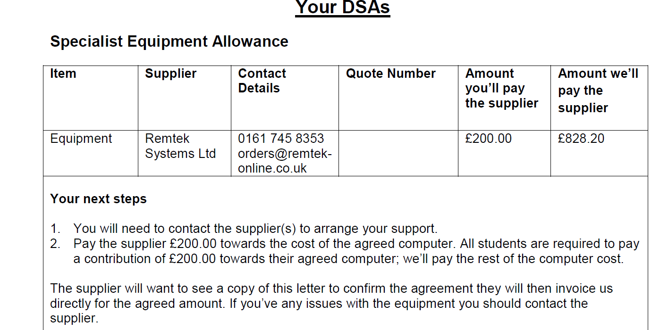
Step 4- Entitlement Letter
Notes:
Read letter carefully
Contact the suppliers. E.g. equipment- give quote number

Slide 15
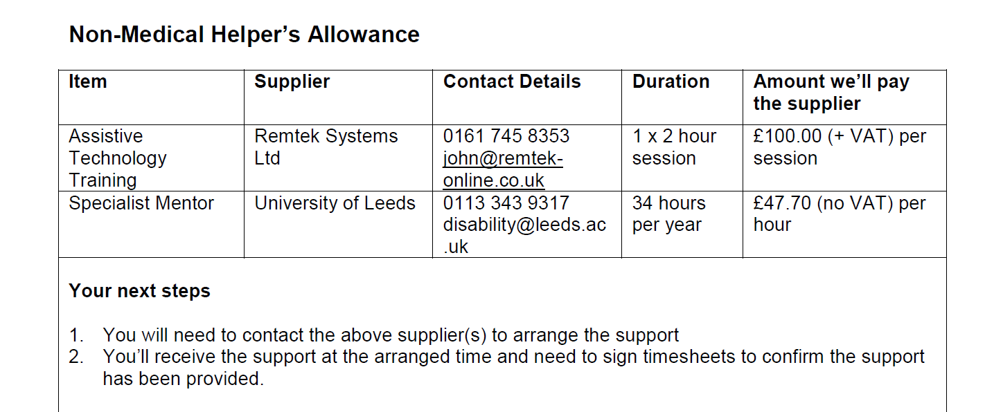
Step 4- Entitlement Letter

Slide 16
Frequently Asked Questions
I’m going to a different university so my suppliers are wrong, what do I do?
You will need to contact the funding body to advise them of any changes.
I already have DSA but I would like to disclose an additional diagnosis, what do I do?
Submit medical evidence to your funding body including your Customer Reference Number.
Do I need to reapply every year for my DSA?
If you are a postgraduate student, or studying part-time, or you do not receive a student loan then it is likely you will need to reapply each year. This varies between funding bodies.

Slide 17
Frequently Asked Questions
Can I upgrade my equipment?
Yes but you will need to pay the difference and the equipment must meet the minimum specification.
What do I do if my equipment stops working?
Whilst your equipment is under warranty, you will need to contact the equipment supplier. If it’s out of warranty, you should contact the DSA Team.
What is Disability Services’ role in the DSA process?
DSA is external to Disability Services and the University. We can support you with information and guidance as you progress through the DSA process.

Slide 18
Student Finance England
Contact Details:
Phone: 0300 100 0607
Email: dsa_team@slc.co.uk
Website: www.gov.uk/studentfinance

Slide 19
Thank you.
Any questions?

