Slide 1

Prepare to study at Leeds
International orientation
Welcome!
Use the chat to introduce yourself and tell the group:
Your name
Where you're from
One thing you're looking forward to doing in Leeds

Slide 2
Disclaimer
All content in this presentation has been prepared for the 2026/27 academic year and is subject to future updates or modifications.​

Slide 3

Useful resources
International Orientation

Slide 4
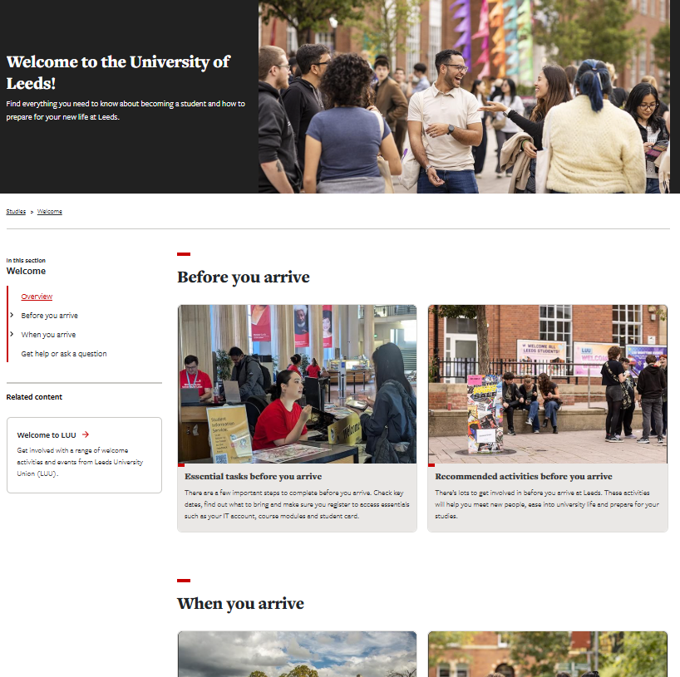
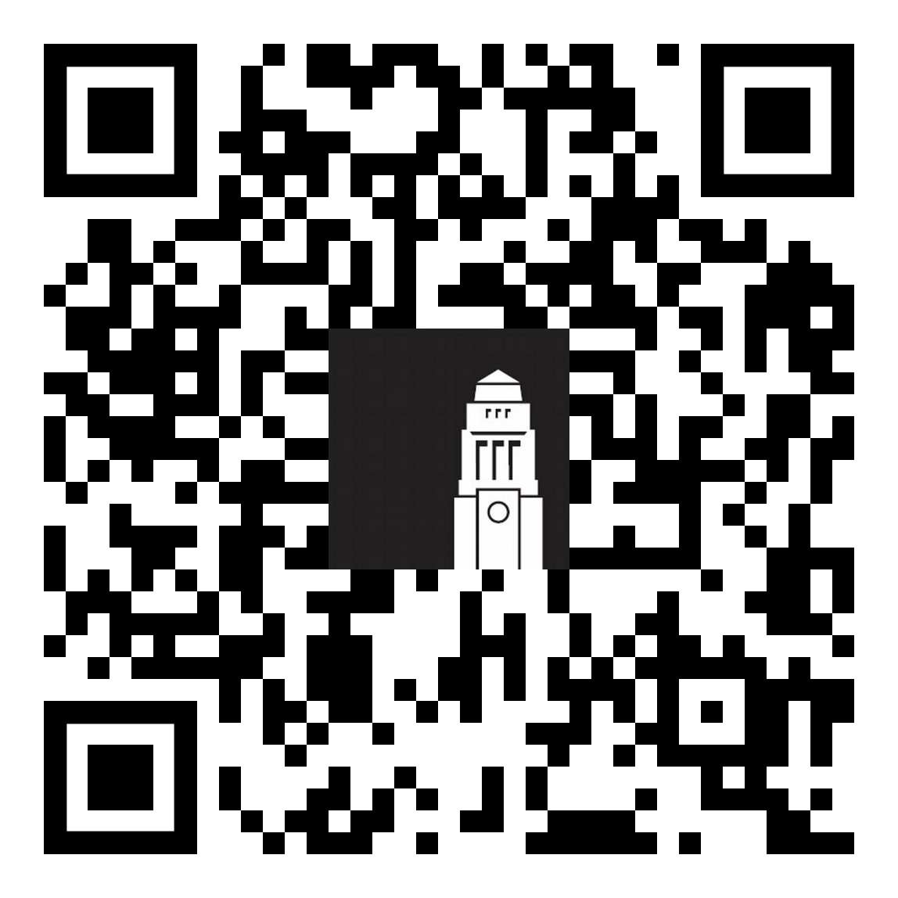
Welcome guide
Your guide to preparing for life in Leeds.
Check admin tasks to complete before and when your arrive to ensure you're ready to start your studies
Browse opportunities to meet people, get involved and start networking
students.leeds.ac.uk/welcome​

Slide 5

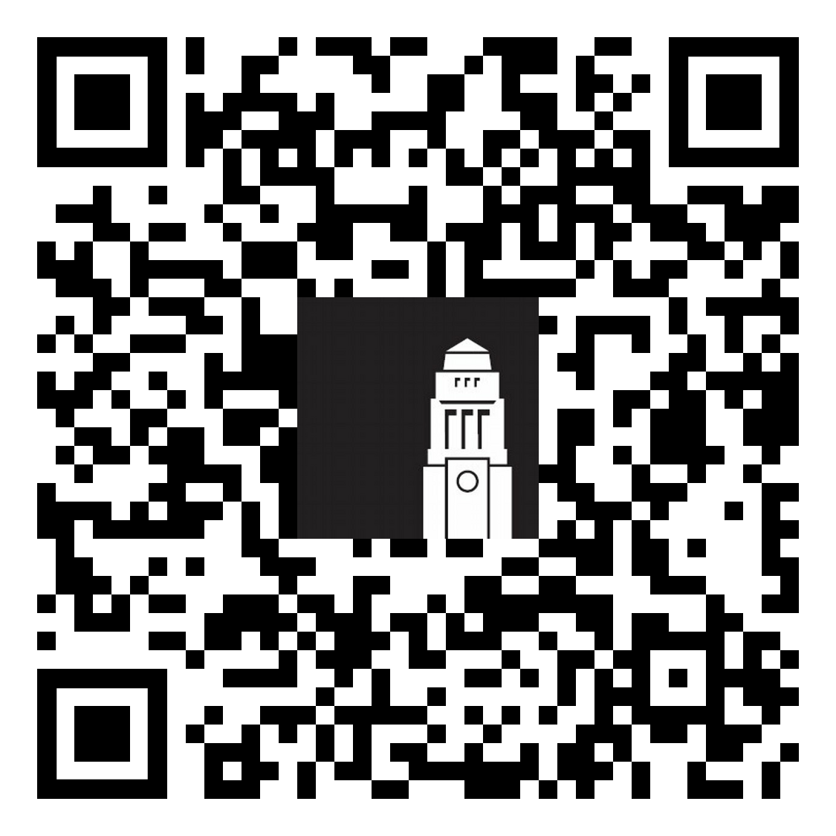
Welcome Hub
Run by the Student Information Service, the Welcome Hub is your place to ask questions and get help.
The team can help with questions on online registration and identity checks, getting a SIM card, IT support, banking and more.
Getting help - The Student Information Service

Slide 6

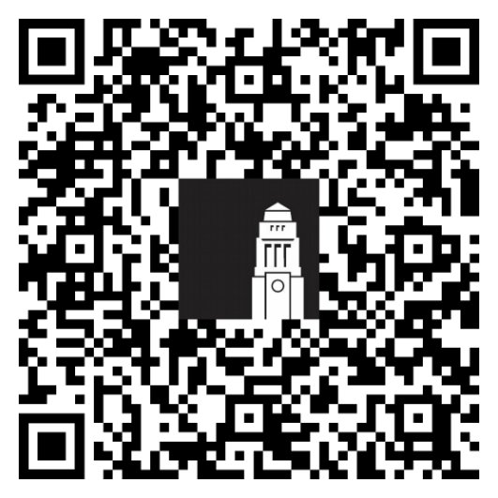
International orientation
Get involved in International orientation!
Book on more webinars and sign up for in-person talks – don't miss the 'Welcome to Leeds' talk
Book a campus, city chase or Muslim faith
Browse events on campus and in the Leeds University Union

Slide 7
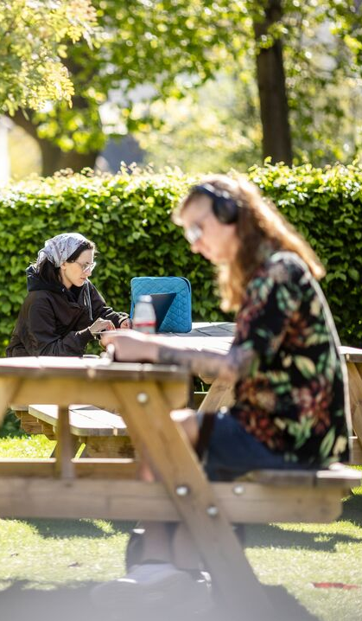
Supporting your academic success
Developing good study habits
Academic resources to help you succeed at university
Ways to improve your English skills

Slide 8

Today, we will:
Explore how studying at Leeds may be similar or different from your past learning experience.
Consider good study habits that are fundamental for academic success
Introduce opportunities and support available at Leeds

Slide 9
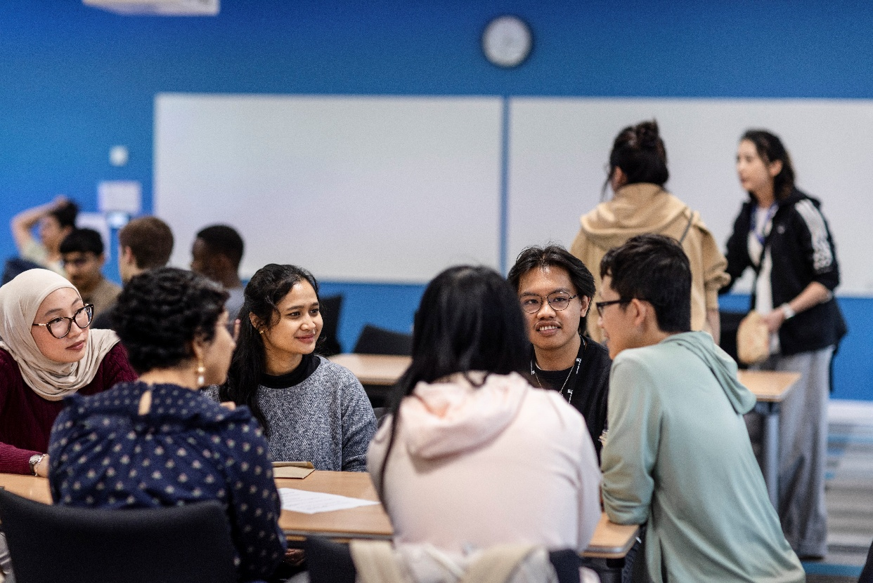
University learning
At the University of Leeds, our learning approach is:
Active and collaborative
Independent: students are encouraged to take ownership of their learning

Slide 10

Good study habits
Tips for making a good start to your academic journey:
Reading and note making
Critical thinking
Creating and writing to express your understanding
Citing and referencing
Working together and working independently.

Slide 11
Critical thinking
Think back to how you chose your degree course and university:
Which information sources did you trust most, and why?
Did you seek out advice? How did you deal with different opinions?
What were the most important factors in your final decision?
Would you make the same decision again today? Why or why not?

Slide 12

Critical thinking in your studies
Being critical involves more than simply agreeing or disagreeing.
It involves making connections, considering limitations and different approaches, suggesting areas of additional research, noting generalisations or assumptions, and demonstrating how different ideas link together.

Slide 13

Academic integrity
Be honest and responsible
Do your own work
Credit sources properly
Show respect for learning
Use technology responsibly, such as generative AI tools
Take the Academic Integrity tutorial and test - Student Guide

Slide 14

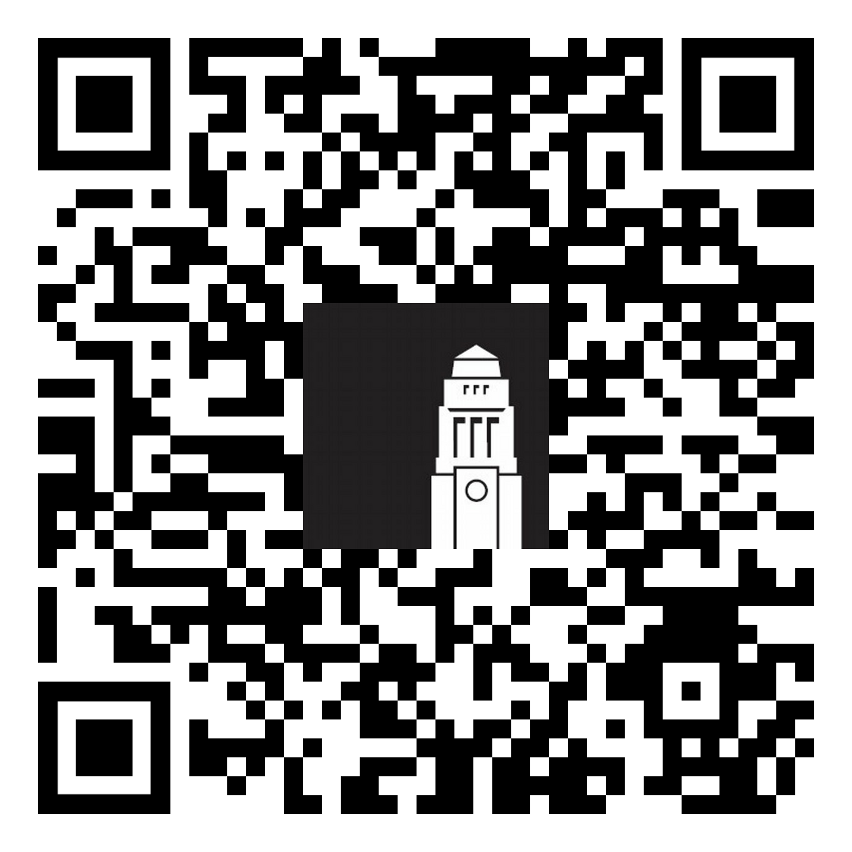
Skills@Library
Skills@library supports your academic success through expert guidance. We offer:
Academic skills workshops
One-to-one academic skills appointments
Online resources
Maths and statistics support
Find out more about Skills@library
Contact the team at skills@library.leeds.ac.uk

Slide 15

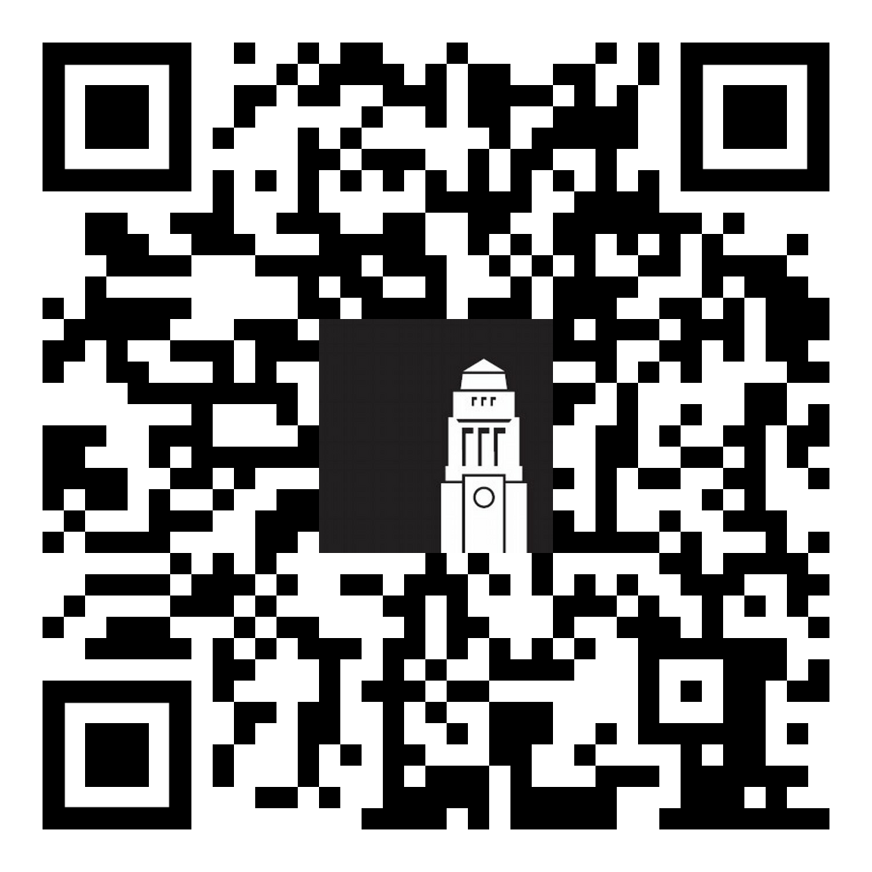
Flying Start
Flying Start is your introduction to studying at the University of Leeds.
Learn about independent learning and academic expectations
Develop study skills and time management strategies
Explore four key areas for first-year success
Build confidence for your transition to university life
Flying Start website

Slide 16

Improving your English language skills
Formal support
Individual and self-led opportunities
Informal social ways to improve your language skills

Slide 17

Academic English language skills
Improve your academic English skills
Support tailored to your subject area
Weekly classes, workshops, or one-to-one, online resources
Build confidence in academic study
Academic English support and workshops

Slide 18

The Language Zone
The Language Zone is a dedicated space and resource centre a range of workshops and activities to help you practise and improve your language skills.
Improve your English language skills independently:
Join language groups and language exchanges
Use the Language Zone digital materials and resources
...and more!
Find out more about the Language Zone

Slide 19

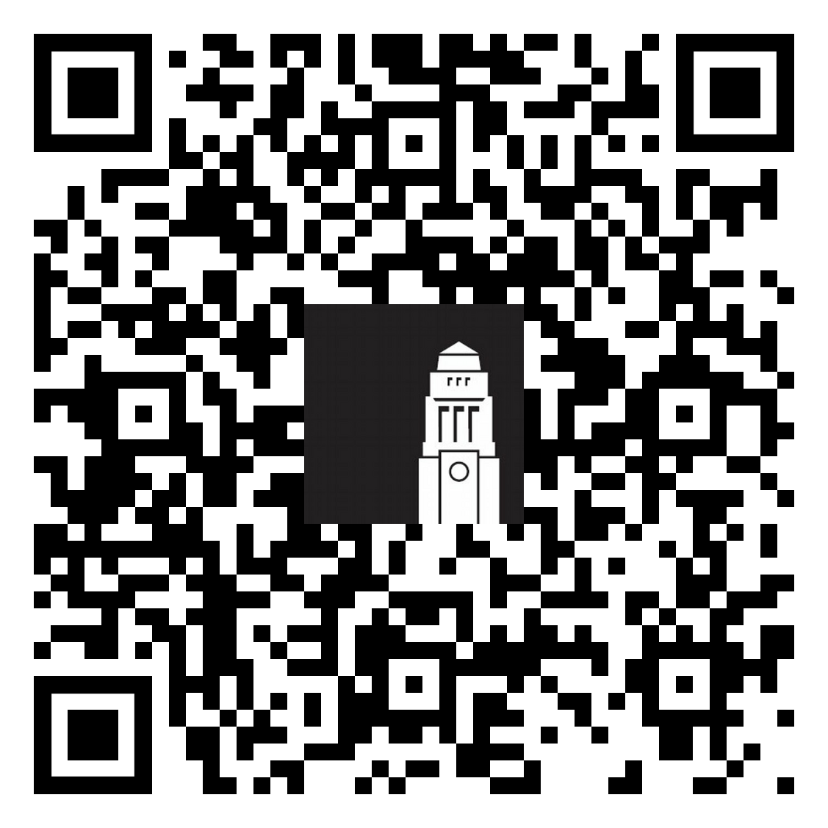
Meeting people
There are plenty of opportunities to meet people and socialise when you arrive in Leeds.
Make the most of International orientation
Join events on campus, in the Leeds University Union and halls of residence
Get involved in school-specific programmes and events
Become your School's representative
All events in September and throughout the year

Slide 20

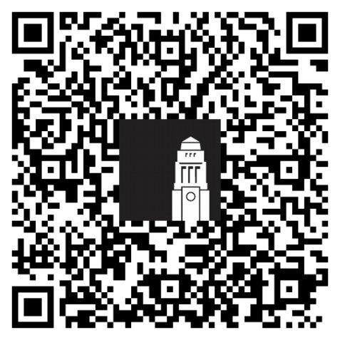
Disability Services
Advising your academic School on the support you may need in your learning.
Recommending academic adjustments for your course.
Giving you advice on a range of matters, from funding to assistive technology.
Providing you with ongoing support throughout your time at Leeds.
Contact the Disability Services team at Disability@leeds.ac.uk
Disabled Student Support - website

Slide 21
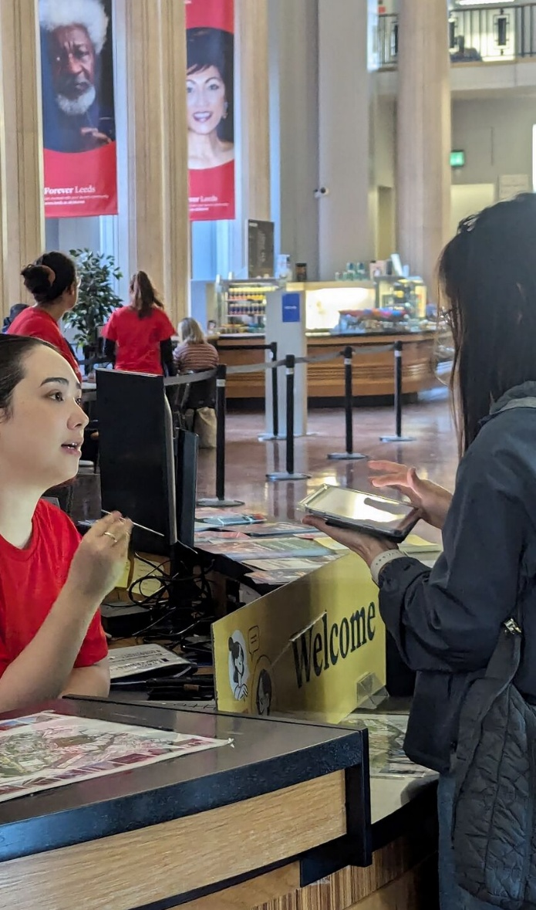
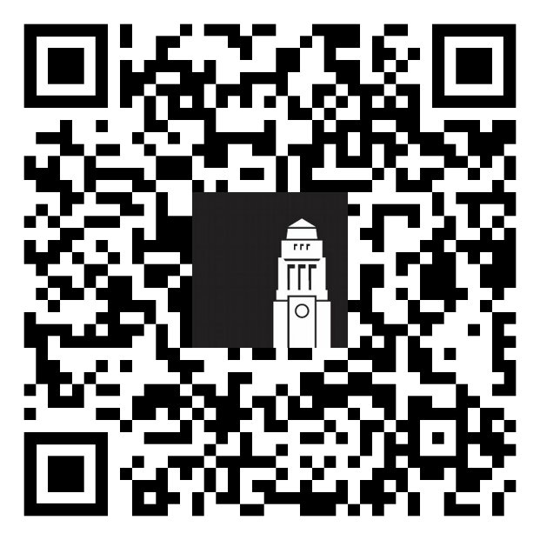
Student Information Service
The Student Information Service team can help with questions on online registration and identity checks, getting a SIM card, IT support, banking and more.
Before you arrive - get help by email or phone
When you’re in Leeds - visit the Welcome Hub in the Parkinson Building or another information point on campus.
Getting help - The Student Information Service

Slide 22
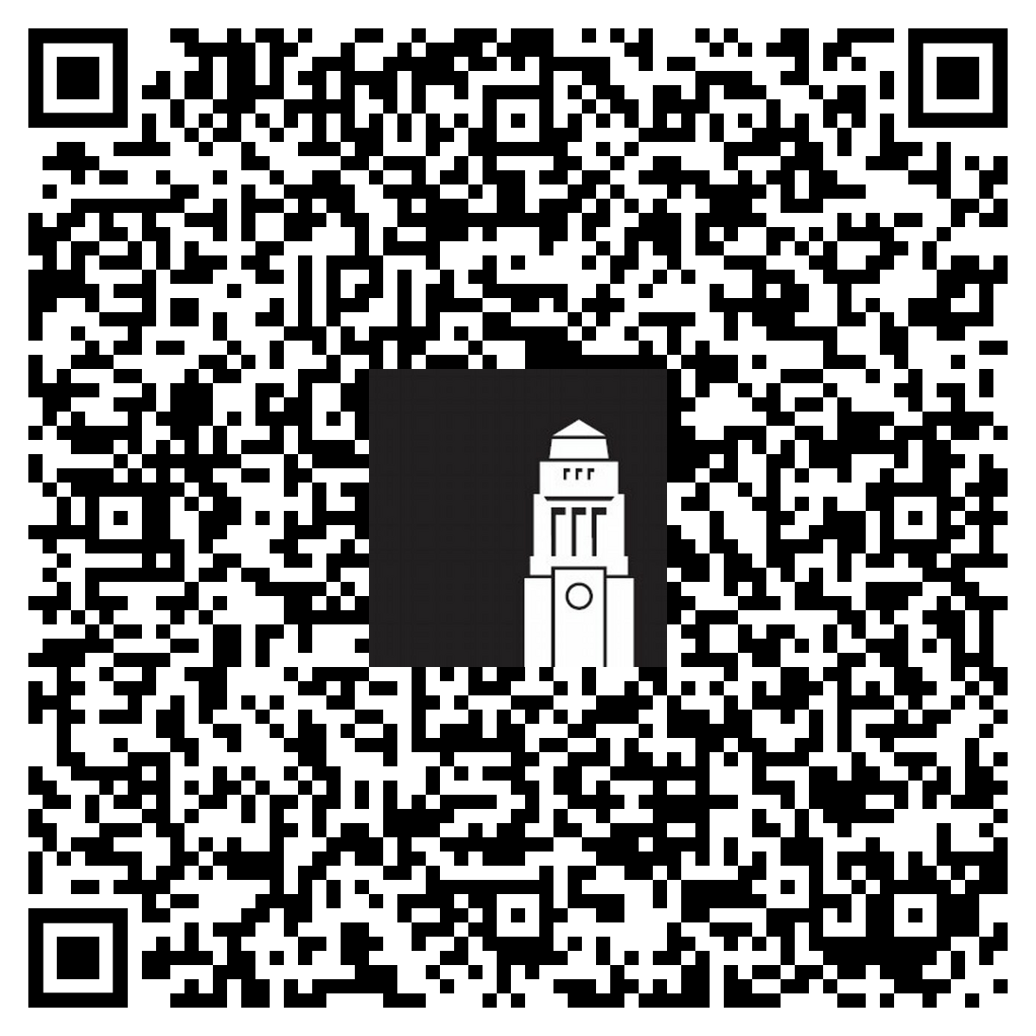
Thank you
How was this session?
Give us feedback on the Prepare to Study at Leeds session for a chance to win one of three £30 shopping vouchers.
Notes:
Facilitator 1
We hope you've found today's session useful.
Remember that you can contact the Student Information Service at any point with questions by email before you arrive or in person when you're on campus. We look forward to welcoming you to Leeds!
(Stop recording and invite any questions)
Finally, we would be very grateful if you could leave us feedback on this session – it'll really help to know what you've liked and what we need to improve. Click on the link on the slide or scan the QR code for more information.
*Post a link to the recording in the chat and ask students to click on the link, and remind students that they'll receive an email with the slides and feedback form today*

