Slide 1

Bridging academic expectations
International orientation
Presenter: Amy Allhouse
Skills@Library

Slide 2
Disclaimer
All content in this presentation has been prepared for the 2026/27 academic year and is subject to future updates or modifications.​

Slide 3

Useful resources
International Orientation

Slide 4
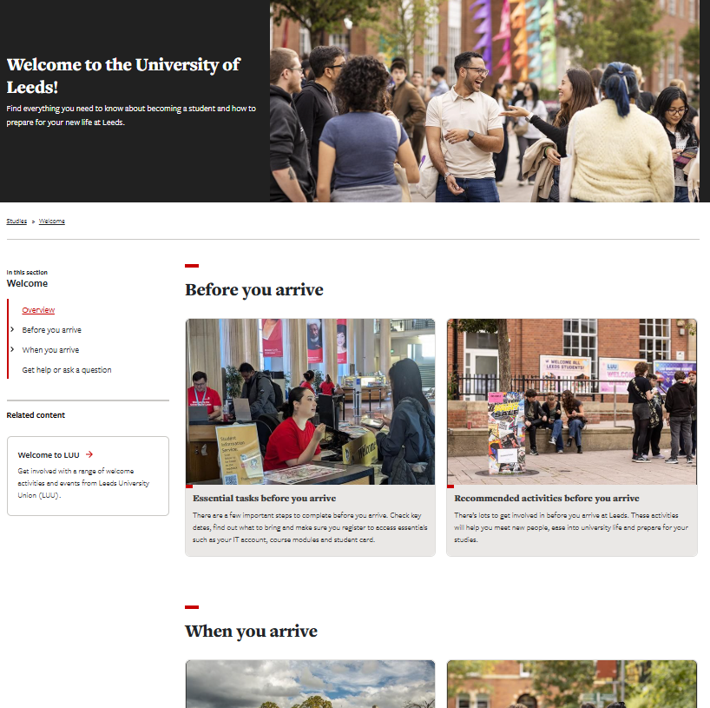
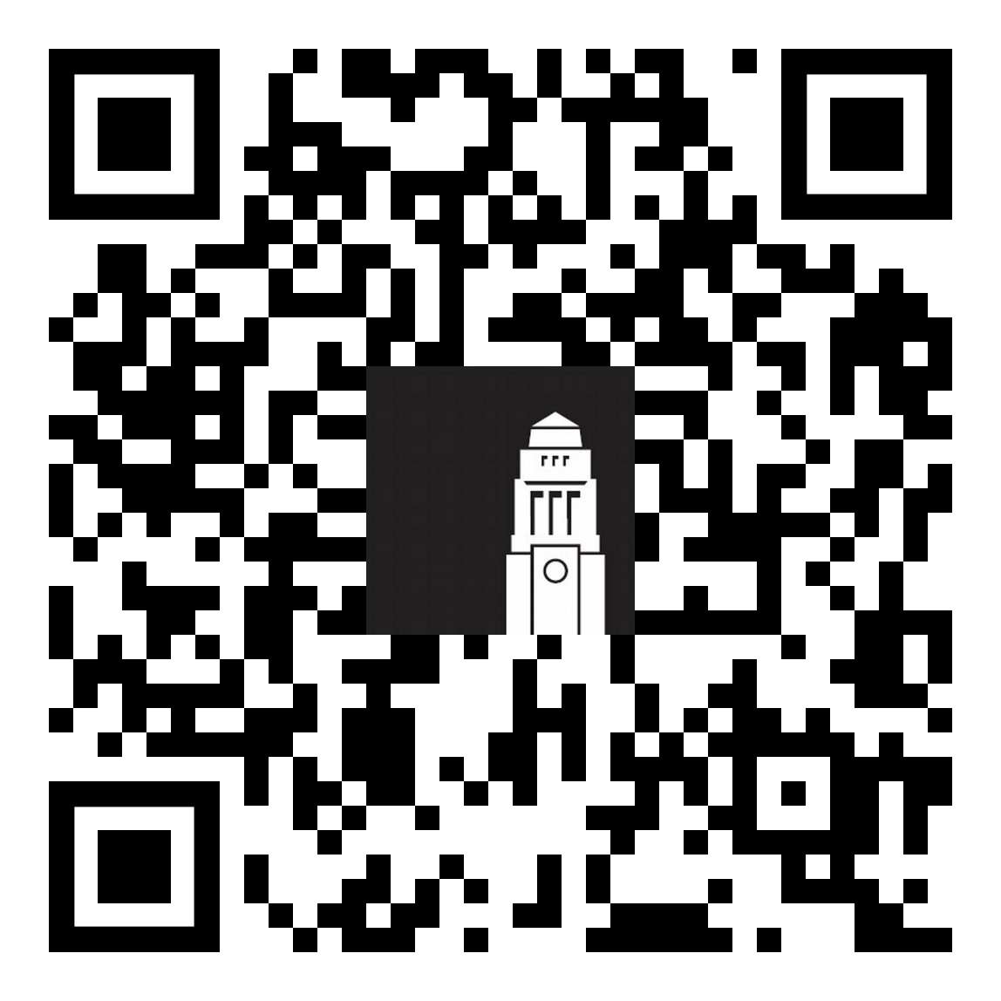
Welcome guide
Your guide to preparing for life in Leeds.
Check admin tasks to complete before and when your arrive to ensure you're ready to start your studies
Browse opportunities to meet people, get involved and start networking
students.leeds.ac.uk/welcome​

Slide 5

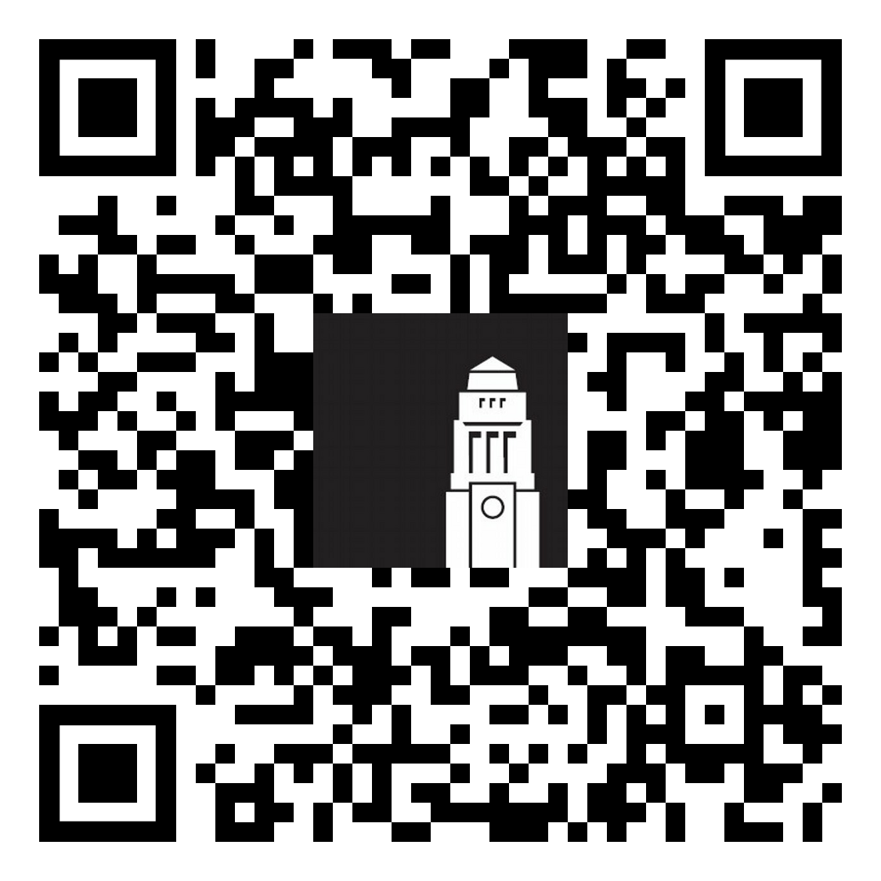
Welcome Hub
Run by the Student Information Service, the Welcome Hub is your place to ask questions and get help.
The team can help with questions on online registration and identity checks, getting a SIM card, IT support, banking and more.
Getting help - The Student Information Service

Slide 6

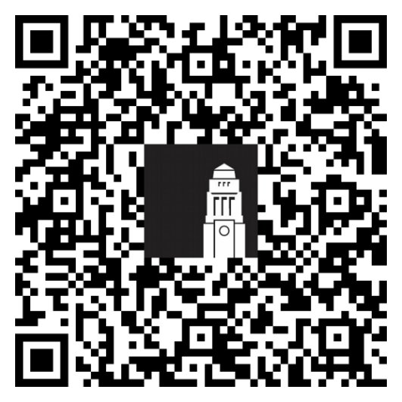
International orientation
Get involved in International orientation!
Book on more webinars and sign up for in-person talks – don't miss the 'Welcome to Leeds' talk
Book a campus, city chase or Muslim faith
Browse events on campus and in the Leeds University Union

Slide 7

Today, we will talk about:
What studying at university involves
Key expectations in UK higher education
Skills for success in your studies

Slide 8

Academic culture quiz

Slide 9

Question 1
What is likely to be the biggest demand on your time for successful study?
Group-work with others
Socialising
Academic reading
Preparing for and attending classes

Slide 10

Question 2
What kind of texts will you be reading? (multiple answers)
Books
Academic journal articles
Government reports and papers
Websites and other internet resources
All of them are right!

Slide 11

Question 3
What is the likely ratio of independent study to classroom study?
1:2
3:1
1:3
2:1

Slide 12

Question 4
What activities are considered as ‘independent study’? (multiple answers)
Reading and writing assignments
Meeting module leaders in office hours
Discussions with fellow students
Meeting a Learning Advisor from Skills@Library
All of them are right!

Slide 13

Question 5
What is the most important skill to develop for good marks in assignments?
Referencing
Critical analysis
Research skills (ie finding information)
Academic writing

Slide 14

Academic expectations
Critical thinking
Understanding academic terms
Understanding academic integrity and applying adequate referencing

Slide 15

Critical thinking in your studies
Being critical involves more than simply agreeing or disagreeing.
Question information
Reflect on your own ideas and assumptions
Look beyond simply agreeing or disagreeing
Make connections between ideas
Consider different perspectives
Recognise limitations and gaps

Slide 16
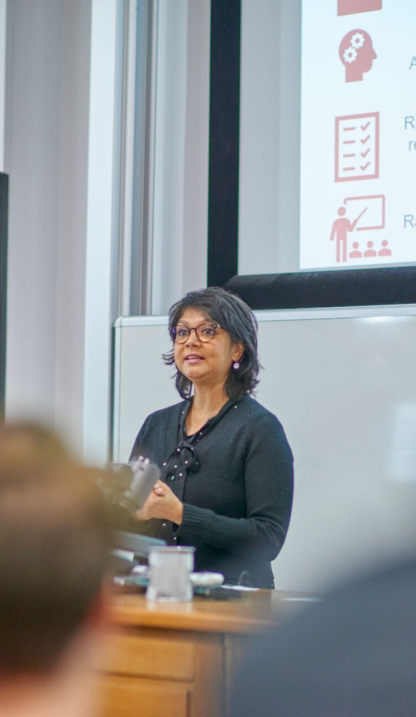
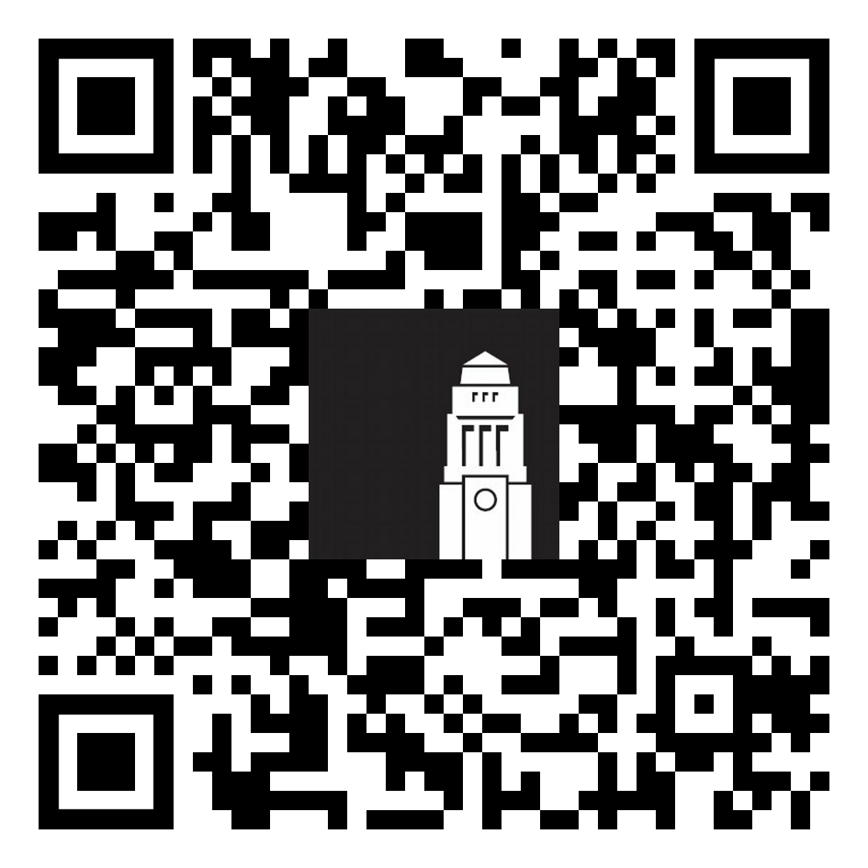
Student Education glossary
Learn the language of university life with the Student Education Glossary, your guide to understanding key terms, systems and processes at Leeds.
Explore the Student Education Glossary:
Learn about common university terms and jargon
Understand Leeds systems and processes
Build confidence in navigating university life

Slide 17

Academic integrity
Be honest and responsible
Do your own work
Credit sources properly
Show respect for learning
Use technology responsibly, such as generative AI tools
Take the Academic Integrity tutorial and test - Student Guide

Slide 18

Referencing
Citation: where you indicate within the body of your work where you have made use of someone else's work.
Reference: includes the full details of the source, and is normally listed at the end of your assignment in the “reference list” or “bibliography”.
Find out more about referencing:
Referencing explained
Referencing made simple - Tutorial

Slide 19

Good study habits
Tips for making a good start to your academic journey:
Reading and note making
Critical thinking
Creating and writing to express your understanding
Citing and referencing
Working together and working independently.

Slide 20

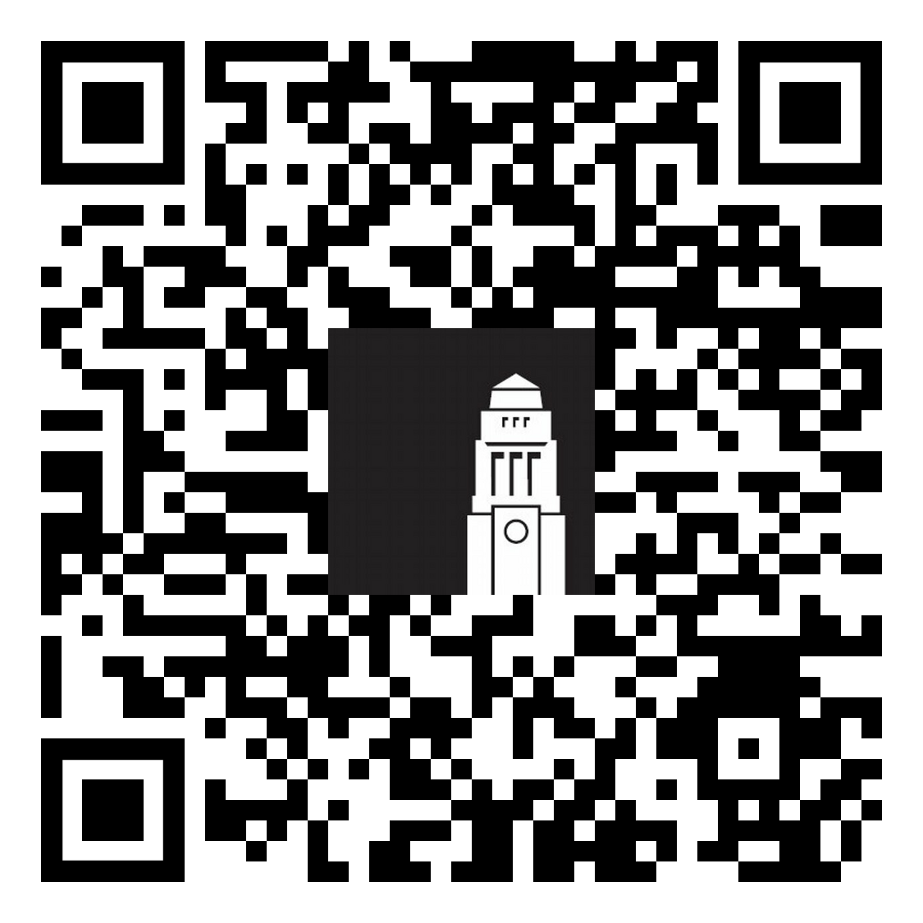
Skills@Library
Skills@library supports your academic success through expert guidance. We offer:
Academic skills workshops
One-to-one academic skills appointments
Online resources
Maths and statistics support
Find out more about Skills@library
Contact the team at skills@library.leeds.ac.uk

Slide 21

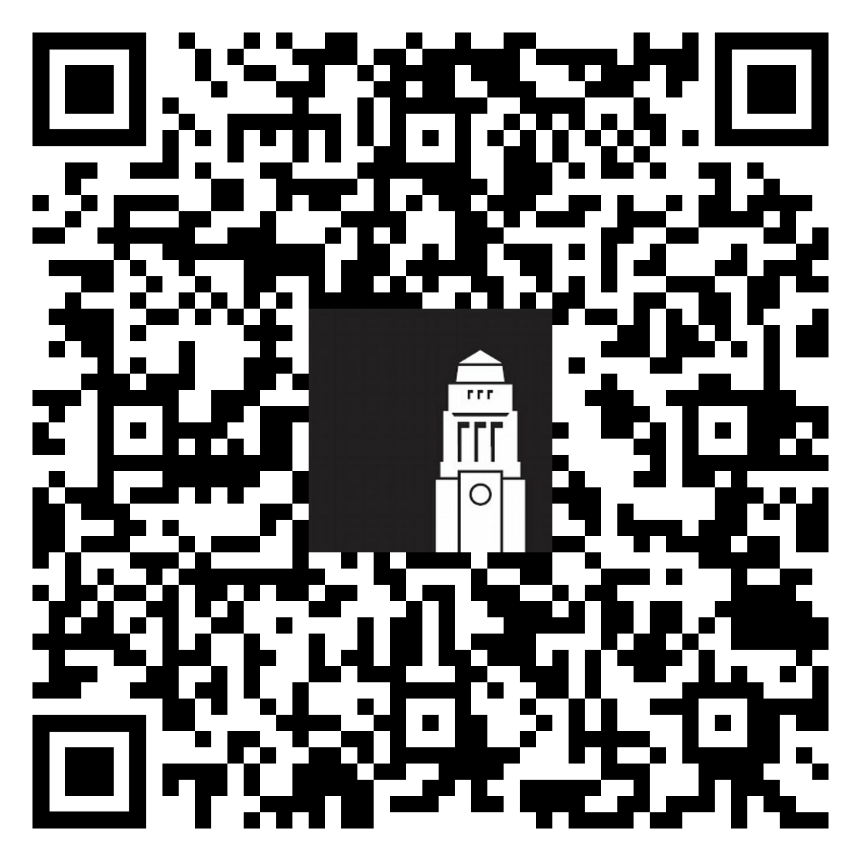
Step up to Master – for Masters students
Step Up to Masters is designed to help you develop the skills, confidence and strategies needed to succeed in postgraduate study at the University of Leeds.
Covers topics such as academic expectations, pro-active learning, developing academic voice, and many more.
Helps you learn strategies and tips from other postgraduate students.
Step up to Master website

Slide 22
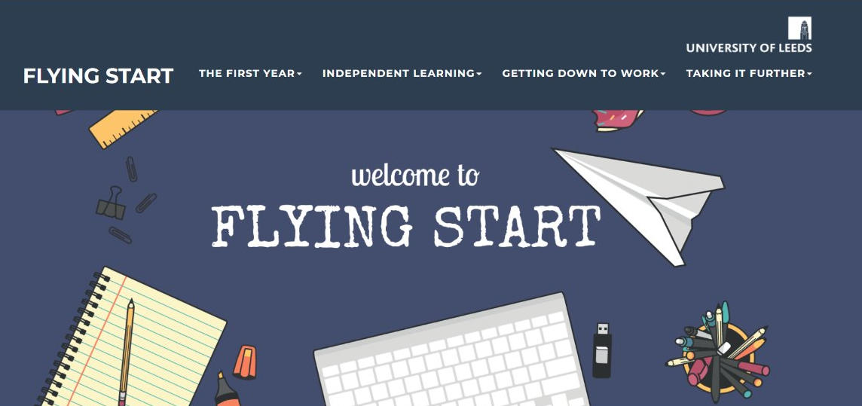
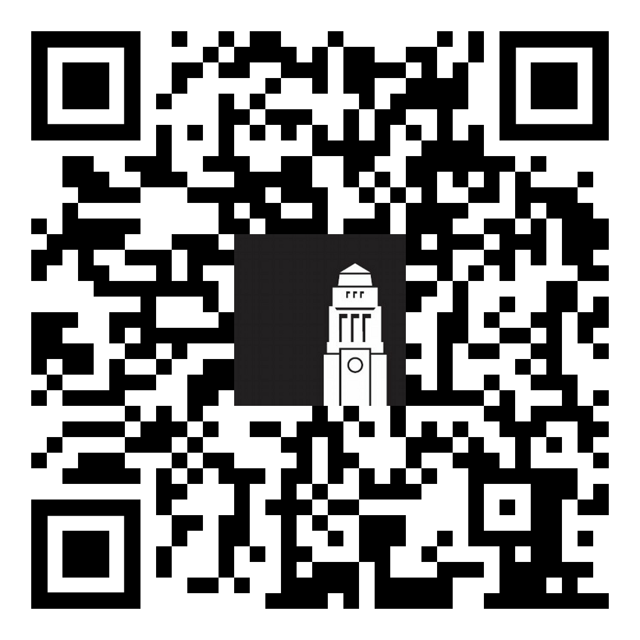
Flying Start – for undergraduate students
Flying Start is your introduction to studying at the University of Leeds.
Learn about independent learning and academic expectations
Develop study skills and time management strategies
Explore four key areas for first-year success
Build confidence for your transition to university life
Flying Start website

Slide 23

Improving your English language skills
Formal support
Individual and self-led opportunities
Informal social ways to improve your language skills

Slide 24

Academic English language skills
Improve your academic English skills
Support tailored to your subject area
Weekly classes, workshops, or one-to-one, online resources
Build confidence in academic study
Academic English support and workshops

Slide 25

The Language Zone
The Language Zone is a dedicated space and resource centre a range of workshops and activities to help you practise and improve your language skills.
Improve your English language skills independently:
Join language groups and language exchanges
Use the Language Zone digital materials and resources
...and more!
Find out more about the Language Zone

Slide 26

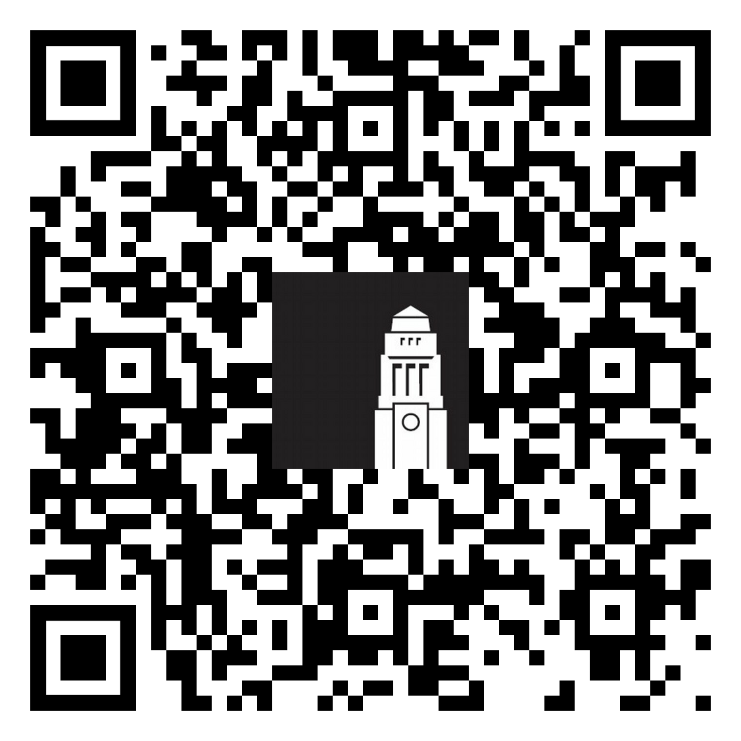
Meeting people
There are plenty of opportunities to meet people and socialise when you arrive in Leeds.
Make the most of International orientation
Join events on campus, in the Leeds University Union and halls of residence
Get involved in school-specific programmes and events
Become your School's representative
All events in September and throughout the year

Slide 27

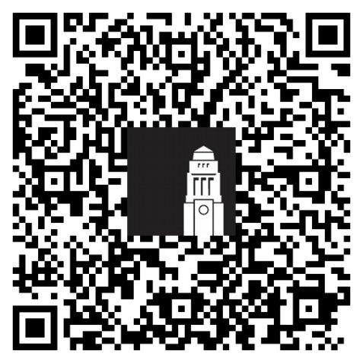
Disability Services
Advising your academic School on the support you may need in your learning.
Recommending academic adjustments for your course.
Giving you advice on a range of matters, from funding to assistive technology.
Providing you with ongoing support throughout your time at Leeds.
Contact the Disability Services team at Disability@leeds.ac.uk
Disabled Student Support - website

Slide 28
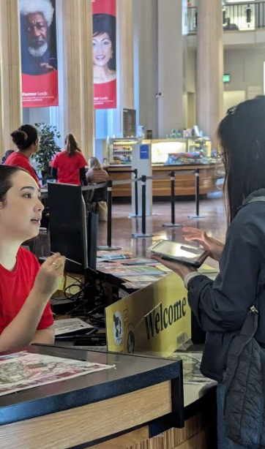
Student Information Service
The Student Information Service team can help with questions on online registration and identity checks, getting a SIM card, IT support, banking and more.
Visit the Welcome Hub in the Parkinson Building or another information point on campus and get in-person help.
Email the Student Information Service at studentinfo@leeds.ac.uk
Getting help - The Student Information Service
Notes:
Facilitator 2
A reminder that the Student Information Service is your main point of contact for any questions as a new student and throughout your time in Leeds. We can help you with any process that you need to complete and with anything related to university life. If you're struggling to register with a doctor, we can help with that too.
Our team works Monday to Friday between 9am and 5pm. From the 14 September you'll also find us in the Welcome Hub (located in the Parkinson building). Come and speak to us in person and we'll help you with anything you might need, form completing university tasks to getting tips on how to make a good start in Leeds.

Slide 29
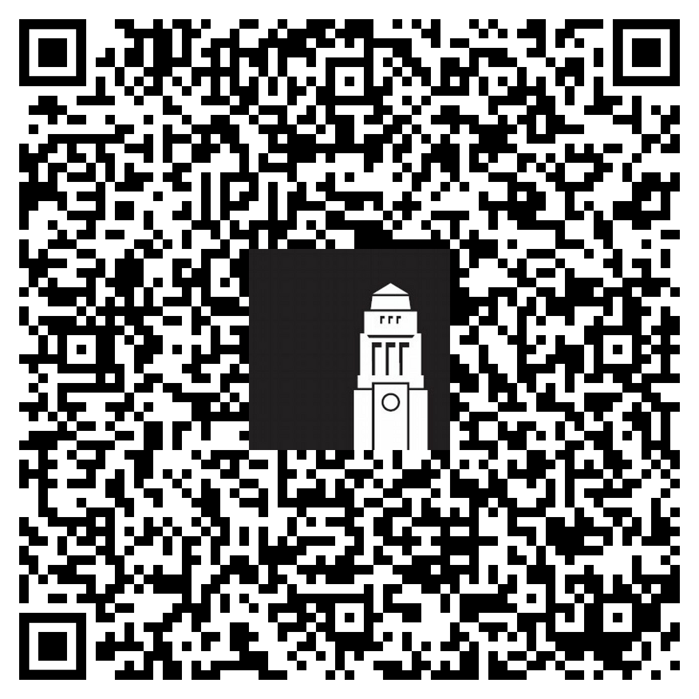
Thank you
How was this session?
Give us feedback on the Prepare to Study at Leeds session for a chance to win one of three £30 shopping vouchers.
Notes:
Facilitator 1
We hope you've found today's session useful.
Remember that you can contact the Student Information Service at any point with questions by email before you arrive or in person when you're on campus. We look forward to welcoming you to Leeds!
(Stop recording and invite any questions)
Finally, we would be very grateful if you could leave us feedback on this session – it'll really help to know what you've liked and what we need to improve. Click on the link on the slide or scan the QR code for more information.
*Post a link to the recording in the chat and ask students to click on the link, and remind students that they'll receive an email with the slides and feedback form today*

