Slide 1

Money and banking webinar
International orientation
International Student Office
Student Information Service

Slide 2
Disclaimer
All content in this presentation has been prepared for the 2026/27 academic year and is subject to future updates or modifications.​

Slide 3

Useful resources
International Orientation

Slide 4
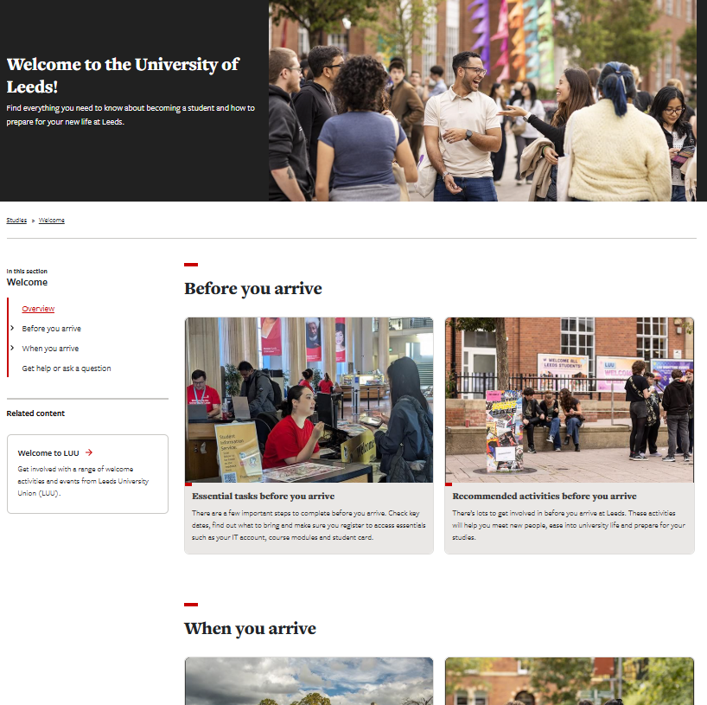
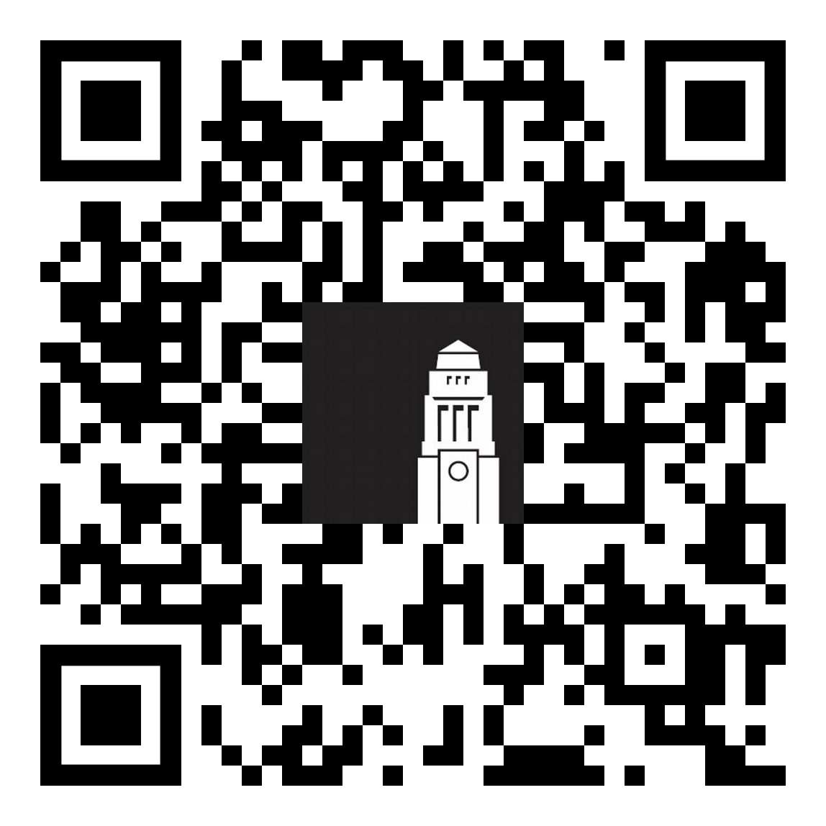
Welcome guide
Your guide to preparing for life in Leeds.
Check admin tasks to complete before and when your arrive to ensure you're ready to start your studies
Browse opportunities to meet people, get involved and start networking
students.leeds.ac.uk/welcome​

Slide 5

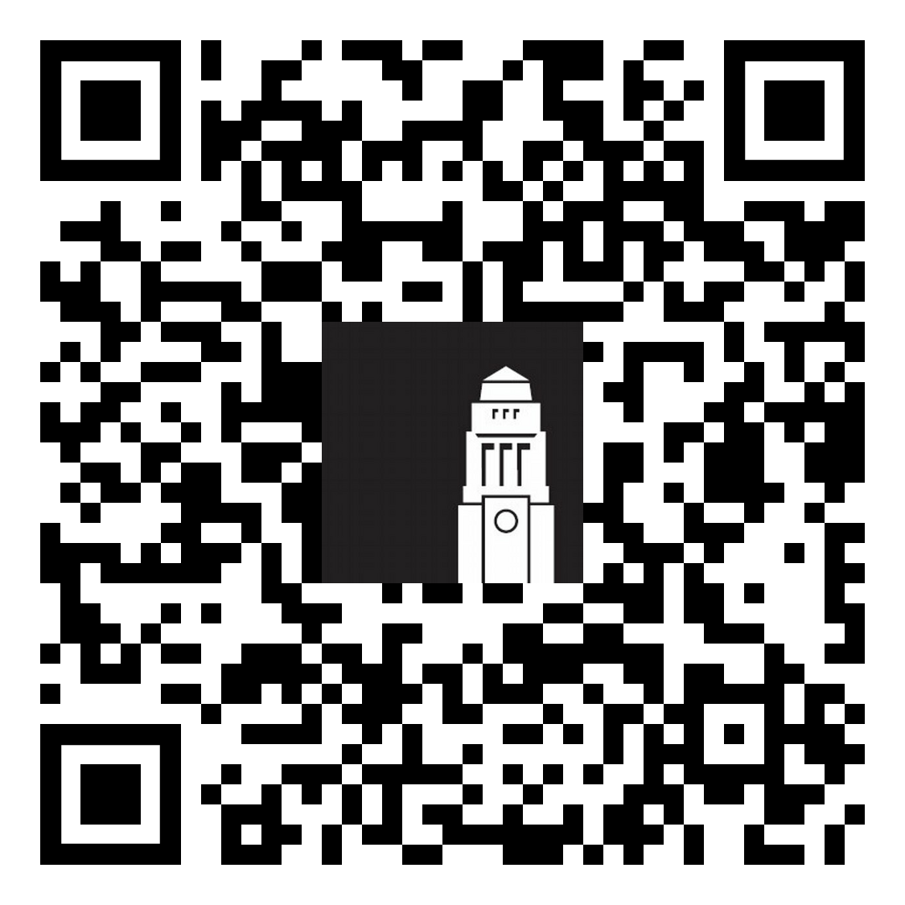
Welcome Hub
Run by the Student Information Service, the Welcome Hub is your place to ask questions and get help.
The team can help with questions on online registration and identity checks, getting a SIM card, IT support, banking and more.
Before you arrive - get help by email or phone
When you’re in Leeds - visit the Welcome Hub in the Parkinson Building or another information point on campus.
Getting help - The Student Information Service

Slide 6

Opening a bank account
International Student Office
Student Information Service

Slide 7

Before you leave home
Tell your bank you're coming to the UK to help prevent your card or account from being blocked for unusual overseas activity.
Check whether your bank has UK branches or partner services that can support you while you're studying.
Ask if you can open a UK account before you travel, as some banks offer this option.

Slide 8

Types of bank accounts
Digital banks
High-street banks

Slide 9
Digital Banks
Popular UK digital bank providers:
Monzo
Starling
Revolut
Wise
Monese
Managed mainly through a mobile app, often quicker and easier to open than a traditional bank account
Some providers allow you to open an account before arriving in the UK
Can be used as a temporary option while waiting for a traditional bank account or be used alongside a traditional bank account
Digital and physical payment cards are usually available
Customer support is typically online or through the app
Not all digital banks offer overdrafts or cash deposit services
Opening a UK bank account - Choosing a bank

Slide 10
Digital Banks (1)
Popular UK digital bank providers:
Monzo
Starling
Revolut
Wise
Monese
Why choose a digital bank:
Similar offer to a traditional bank
You can usually open an account from your home country
It's usually easier/faster to set up
Ensure you can use your money safely while travelling
Check that the bank you choose is:
Regulated by the Financial Conduct Authority (FCA)
Protected by the Financial Services Compensation Scheme (FSCS)
Opening a UK bank account - Choosing a bank

Slide 11
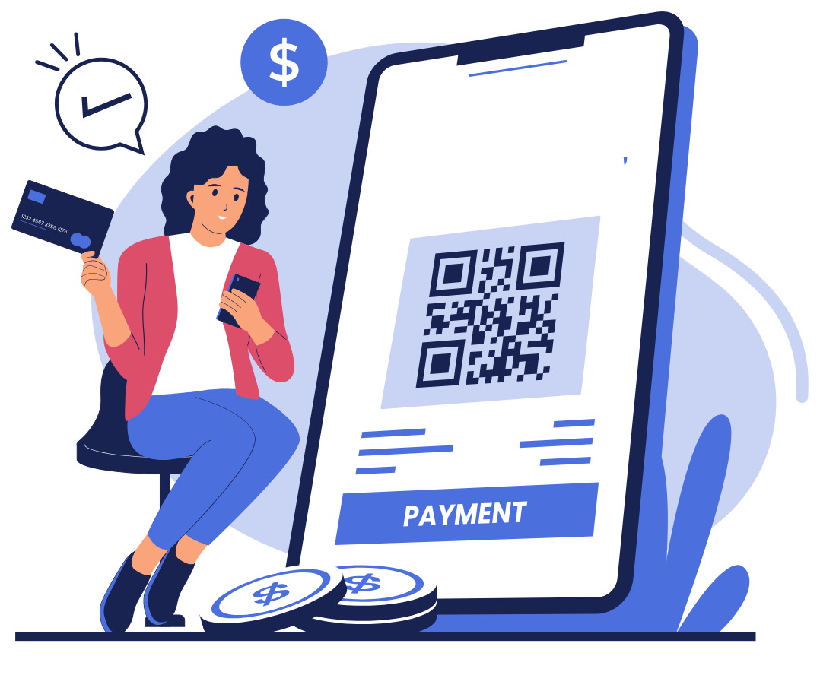
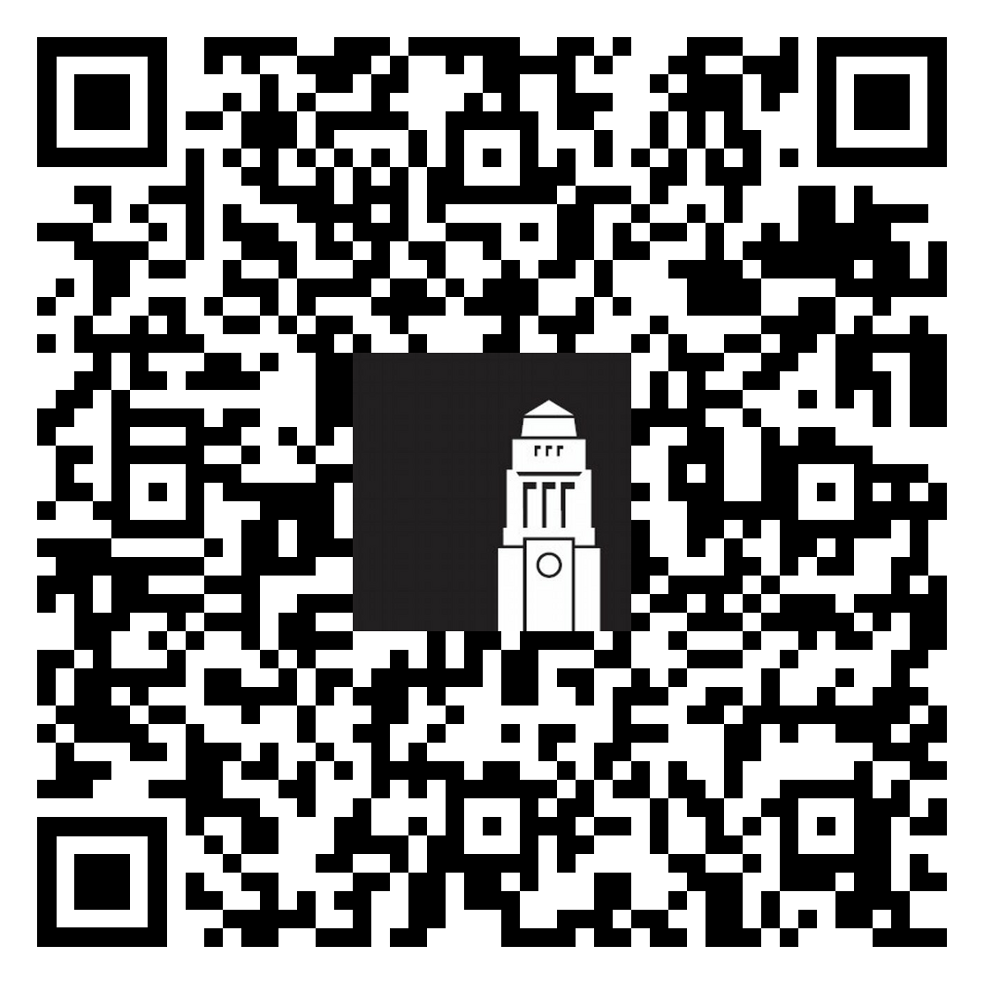
Digital Banks (2)
Requirements change depending on the bank, but in most cases you would need to upload:
Proof of identity (your passport)
Proof of address (the address in your home country)
In many cases, the process is 100% online:
you upload photos/scans of documents and complete identity verification in the app.
Opening a UK bank account - Choosing a bank

Slide 12

'High street' banks
Traditional banks that have a physical presence in the city
Offer online banking solutions
Offer more services than a digital bank
No limits on free cash withdrawals
More regulated than digital banks
Can take longer to set up an account
Opening a UK bank account - Choosing a bank

Slide 13

How to choose a bank
The University of Leeds cannot recommend or endorse any particular bank.
We encourage you to research your options and check each bank's application process, fees and eligibility requirements.
We have a list of useful questions to ask your bank of choice to help you make a decision.
If you’re staying in Leeds for a semester or less, a digital bank may be a more suitable option.
Opening a UK bank account - Choosing a bank

Slide 14

Popular bank choices
In the years, international students have opened accounts with these banks. Most of them allow you apply for a bank account online without needed to visit a branch in person.
HSBC Bank Account for International Students
Lloyds Classic Account
Bank of China Student Prime
Barclays Bank Account
Santander Everyday Current Account or Santander Edge Student Current Account
Nationwide FlexBasic or FlexStudent
Opening a UK bank account - Choosing a bank

Slide 15
Account requirements
Many banks require you:
to be in the UK for at least six months
to be over 18, although there are some banking options for under 18 students too.
Provide additional documentation to check your identity
If you're staying for less than six months, we'd recommend opening an account with a digital bank instead.
Opening a UK bank account - Choosing a bank

Slide 16

Documents you need to open an account
To open a bank account, you would normally need:
Proof of your identity – your passport or EU national identity card.
Proof that you’re a student – your offer letter or a bank letter from the University.
Proof of your address – accepted documents include a housing contract, a utility bill or a bank letter from the University.
If you provide a tenancy agreement for private sector accommodation, it will need to be signed by the landlord.
Opening a UK bank account - Choosing a bank

Slide 17

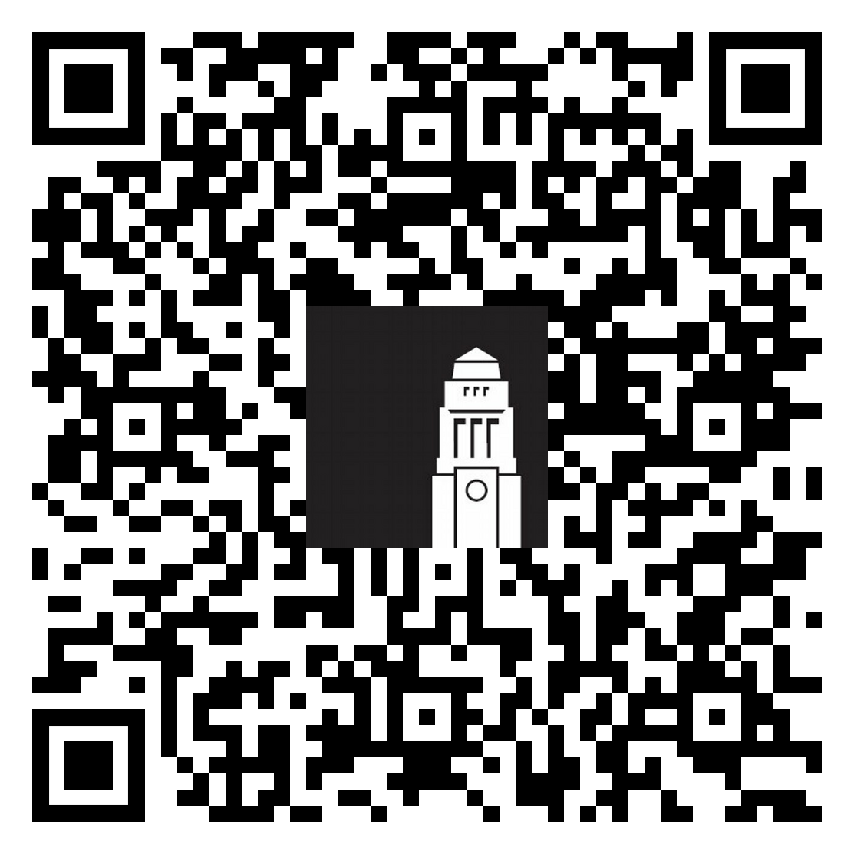
Getting your bank letter
To the get a University bank letter:
Activate your IT account.
Complete the first three steps of the online registration process - follow written and video guidance on how to register
Make sure to:
Accept or reject your accommodation offer before you start online registration.
Contact the Student Information Service if you get stuck.
Lloyds, HSBC, Santander would normally accept our standard University bank letter.
Online registration steps - How to register

Slide 18

Registration step 1
Personal details 1
You’ll be asked to confirm your name and nationality.
Make sure your family name, first name, middle name, and legal name are complete and match your passport.
If you prefer to be called by a name that is different to your legal first name, you can enter this into the preferred name field. This name will appear on Minerva, your University email, and other systems.
Confirm if you are a parent or carer.
Online registration steps - How to register

Slide 19
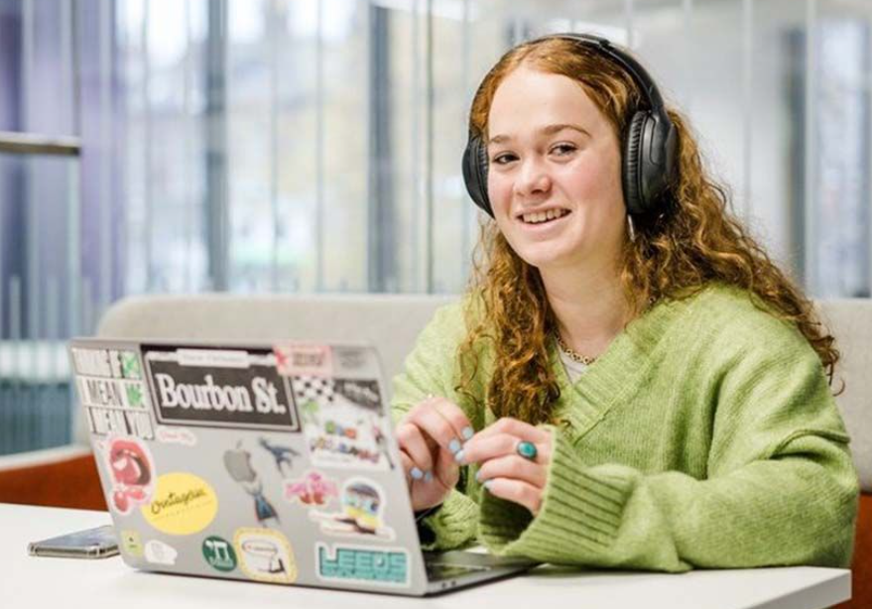
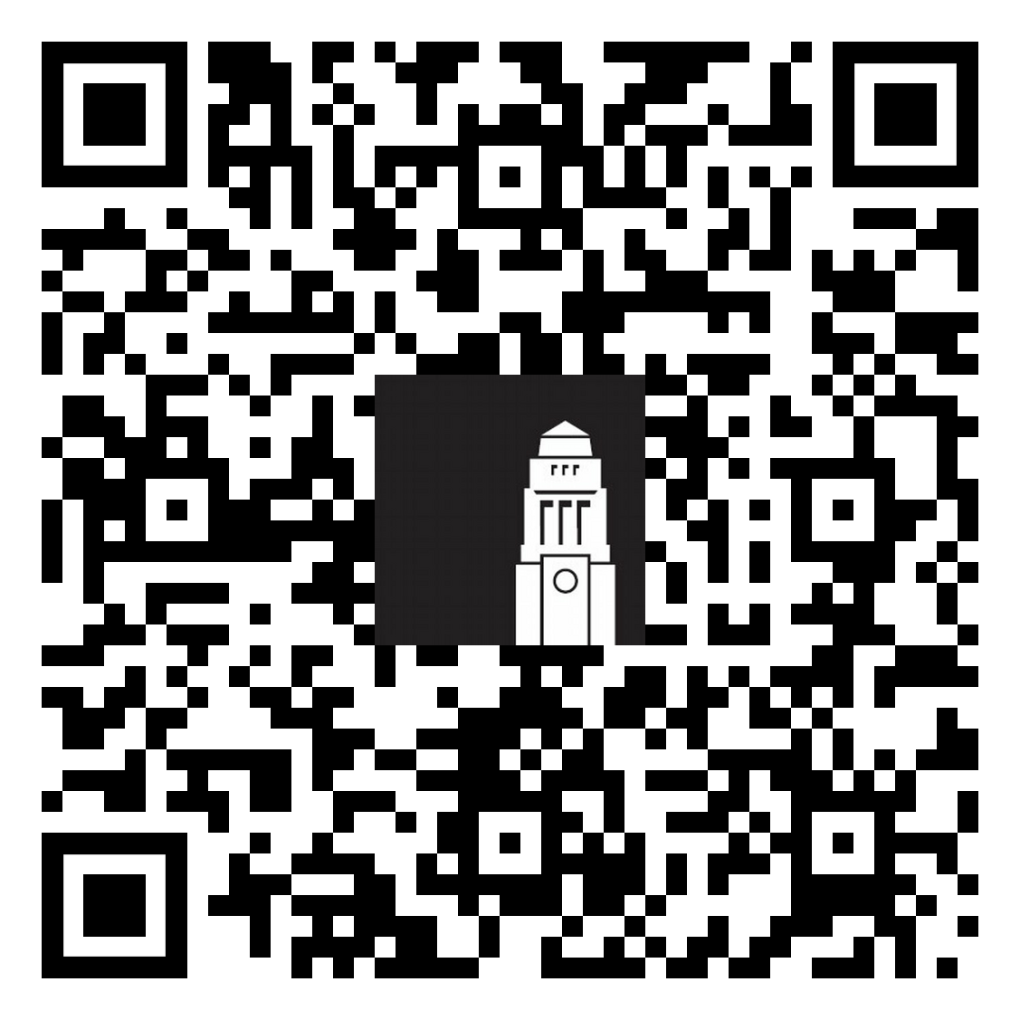
Registration step 2
Personal details 2
You’ll be asked about any disabilities you might have.
You may be asked whether you have a disability, long-term health condition, illness, or impairment.
Telling us about a disability is optional. If you share this information, it will be used by Disability Services to help identify any support you may need.
If you have more than one disability, select "Multiple disabilities" and choose all relevant options.
Contact Disability Services at Disability@leeds.ac.uk to discuss support
and check your eligibility.
Online registration steps - How to register

Slide 20

Registration step 3
Address details
You’ll be asked to provide your permanent home address, your term time address, and full contact details for your emergency contact, in that order.
Permanent home address = address in your home country.
Term-time address = your address in Leeds, including postcode in the format of XXX XXX (for example LS2 9JT).
Your emergency contact cannot be yourself.
Online registration steps - How to register

Slide 21

Getting your bank letter
After completing the first three steps of online registration:
You’ll be sent your bank letter to your University of Leeds email address within 5 working days from the start of your accommodation contract.
Your bank letter will be valid for three months.
Please note:
A working week is from Monday to Friday. Make sure you don't count weekend days.
Lloyds, HSBC, Santander would normally accept our standard University bank letter.
Opening a bank account - Receiving your bank letter

Slide 22

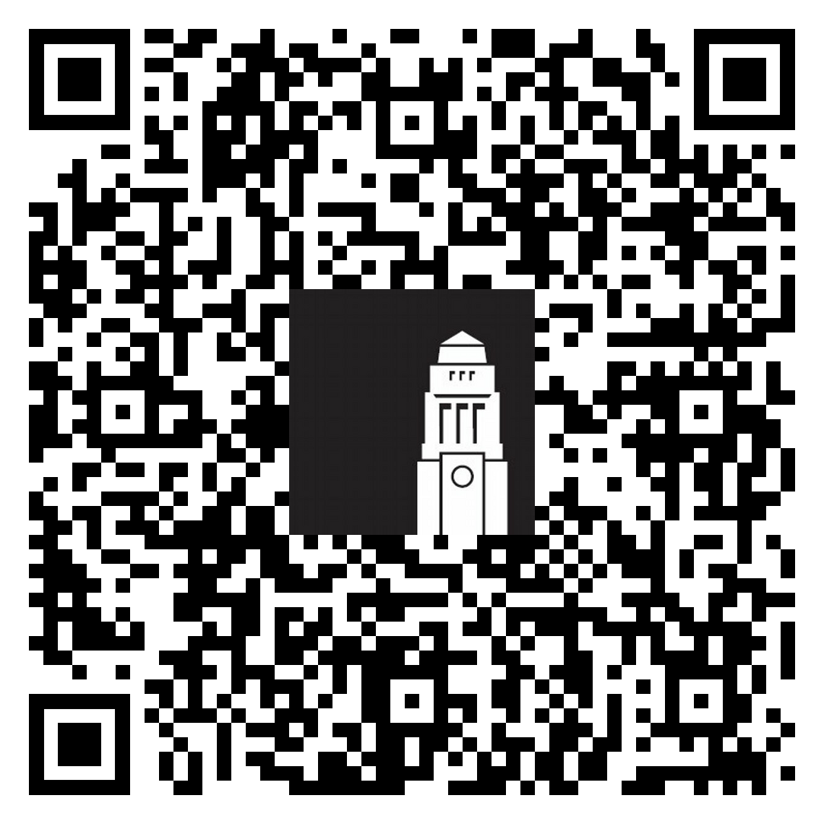
Bespoke letter
If the bank of your choice doesn't accept the University of Leeds bank letter or might require extra details.
In this case you can request a Registration Status Certificate.
This is an official document confirming that you are University of Leeds student.
Your certificate will be sent to your University of Leeds address within 10 working days.
Request a Registration Status Certificate

Slide 23

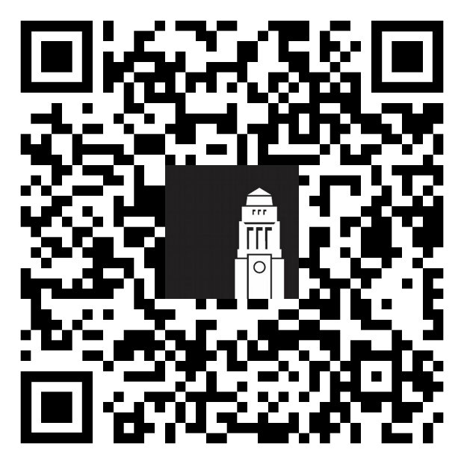
The Student Information Service
Problems with bank letters or help with opening a bank account - Get help with questions relating to online registration, identity checks, banking and a range of other matters related to university life, your studies and more throughout your time at Leeds.
Before you arrive - get help by email or phone​
When you’re in Leeds - visit the Welcome Hub in the Parkinson Building or another information point on campus.​
Getting help - The Student Information Service

Slide 24
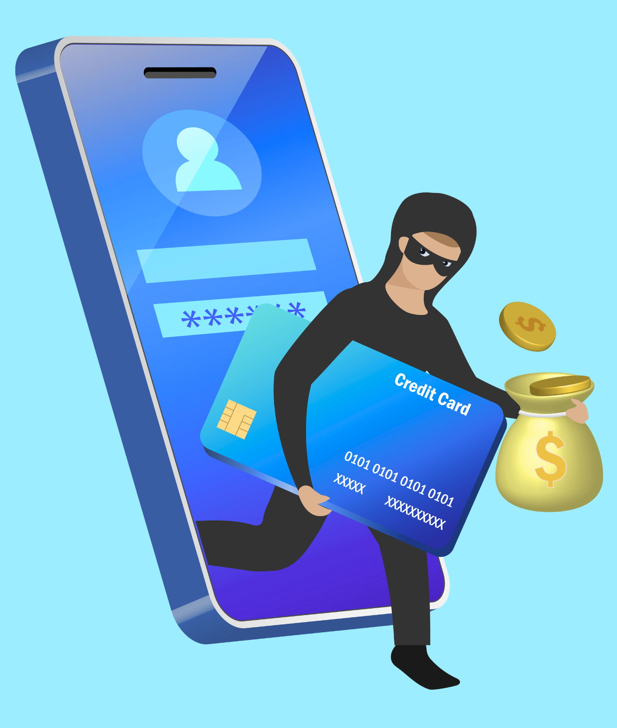
Fraud and scams
Types of scams
Ways to protect yourself
Support for victims of fraud and scams

Slide 25

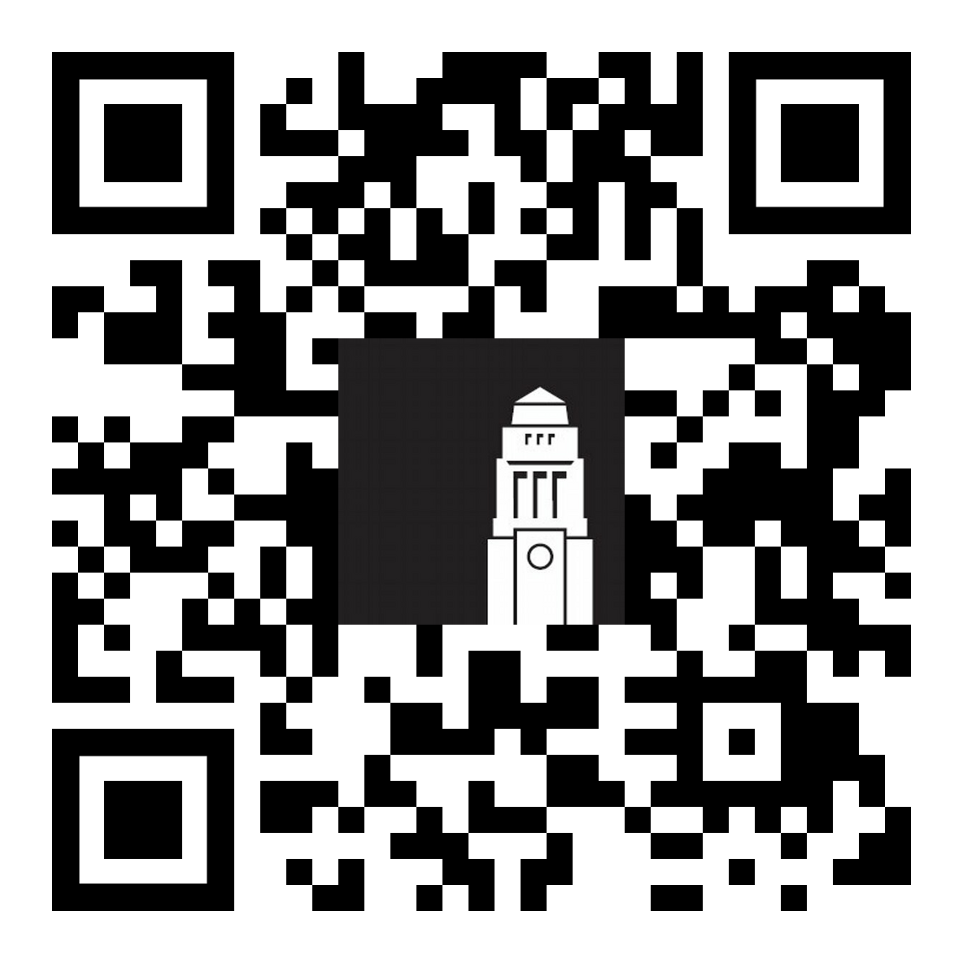
Fraud and scams
A scam is when someone tries to take your money by:
pretending to help you
offering you something which they are not going to give you
getting information that will help them to take your money
Over a third of students in the UK have been targeted by fraud, scams and phishing.
Stop, think and check before you share information or pay money.
Remember - a genuine organisation will never pressure you to act immediately.
Fraud, scams and phishing

Slide 26
Real student stories (1)
Visa scams
“A fraudster told me there was a serious problem with my visa and that I was at risk of being deported. They appeared to be genuine and convincing, and gave a false name and return phone number. They told me to send money as soon as possible using MoneyGram to stop any further action.”
Impersonation scams
“The police called me to say my ID had been used to commit crimes and that I needed to pay legal fees to the courts to get help and assist with their investigation. They had a lot of information about me and told me that I shouldn’t tell anyone I knew as they may have been involved in the crime."
“My bank called me saying that I had been the victim of fraud and I needed to move my money to a new account urgently to keep my money safe”

Slide 27
Real student stories (2)
Accommodation scams
"A fake profile reached out to a student with an accommodation offer.
This person introduced the student to a “landlord” who provided ID to identify themselves and offered private accommodation.
The student paid a deposit for the accommodation. After realising something wasn't right, the student asked for their money back. They were told they had to pay a fee to get the money back."
People offering money
"An individual approached me on WeChat claiming she had surplus Great British Pounds she wanted to exchange.
I transferred 4,500 Chinese Yuan to her Chinese bank account.
In return, she provided me with a screenshot of a transfer from her UK bank account. However, I did not receive any funds."

Slide 28

Tuition fees scams
External organisations
Beware of external companies and organisations contacting you on social media including WeChat, in English or another language.
They might offer to make tuition fee payments to the University on your behalf offering a deal or a better exchange rate.
They may tell you this is how most international students pay their fees.
Always use the official University payment process.
Fraud, scams and phishing

Slide 29

Protect yourself from fraud and scams
Stop and check – an easy way to protect yourself from fraud and scams:
Stop
Don't rush into decisions – only criminals will try to rush you or stop you from seeking advice.
It's ok to take time before you pay money or share information.
It's ok to reject, refuse or ignore requests, even if you're told it's urgent.
Check – Email the Harassment and Misconduct team at reportandsupport@leeds.ac.uk to check if you're being targeted by scammers.
Fraud, scams and phishing

Slide 30

Support for victims of fraud or scams
If you think you've been scammed:
Contact your bank – they may be able to put a stop on any payments leaving your account and can give advice if your data has been stolen.
Report online or call Action Fraud on 0300 123 2040.
Contact the University IT Service Desk team – if you have opened a link or attachment on your device.
Contact the Harassment and Misconduct team – if you feel you need further support.
Support for victims of fraud or scams

Slide 31

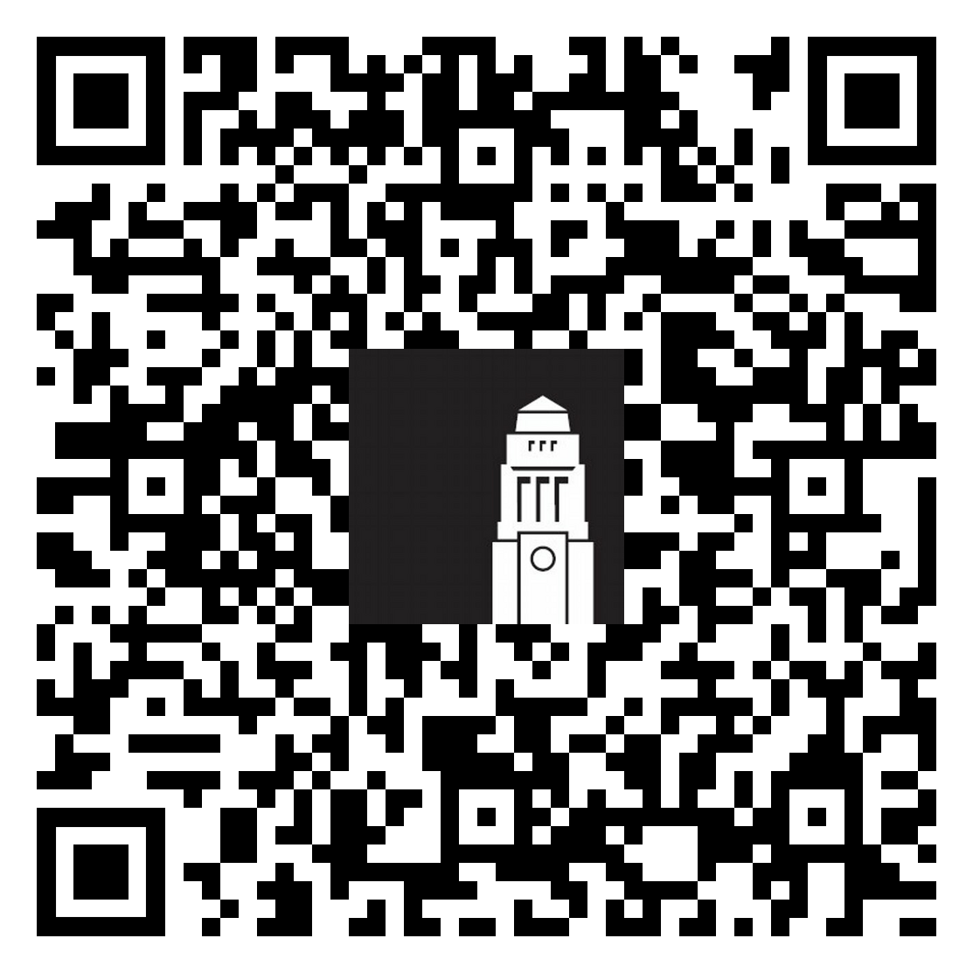
Safety and Support sessions
Find out more about staying safe in person and online:
Sign up for a Safety and Support session – learn more about how the Harassment and Misconduct team supports students against fraud and scams, violence and discrimination.
Enrol on the Student Fraud Awareness Minerva module –
learn more about common types of fraud and scams from real-world examples and complete the “Escape the Scam” gamified escape room.

Slide 32

Managing your money
Money saving tips and resources
Working in the UK

Slide 33

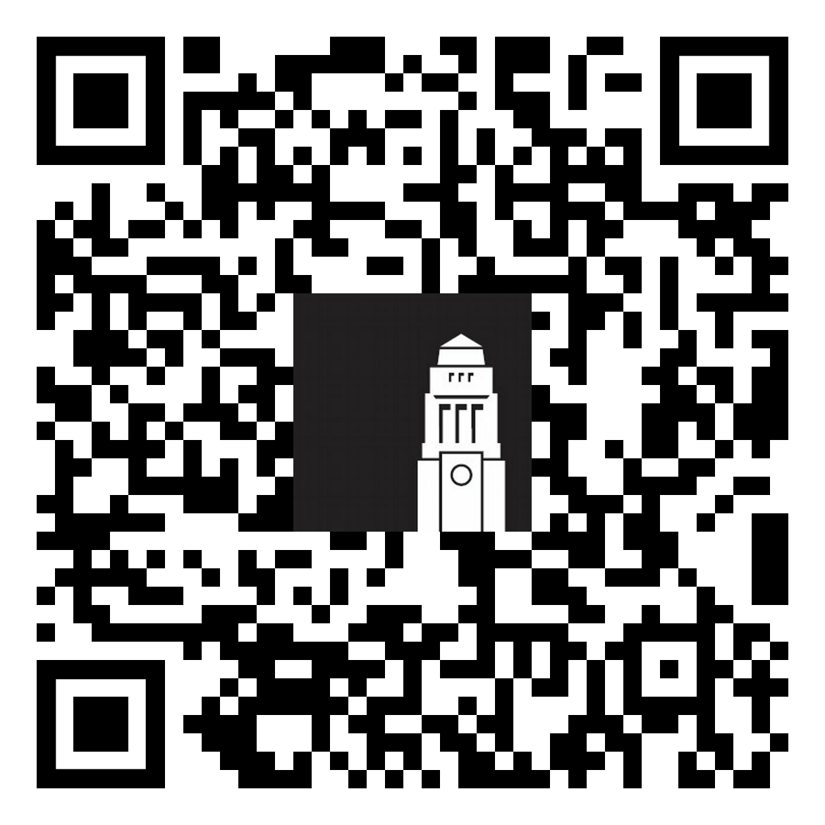
Money saving tips
Check our Money management advice page and find out:
Create a budget and keep track of your spending
Find tips to help you save money on everyday expenses
Learn about part-time jobs, internships and other funding opportunities
Check guidance on working in the UK as an international student
Access financial support if you're experiencing money difficulties
Find advice from University and independent money support services
Money management advice

Slide 34

Jobs, careers and volunteering in the UK
If you're hoping to work while in the UK, don't miss these webinars delivered pre-arrival and in person during International orientation:
Sign up for our ‘Jobs, careers and volunteering in the UK'
International orientation - full programme

Slide 35

Getting help

Slide 36


LUU Help and Support
Leeds University Union Help & Support Advisers can help with:
Wellbeing and your mental health
Budgeting and your finances
Living in Leeds, private-sector accommodation and staying safe
Exam support, appeal procedures and studying in Leeds
Student life
Meet in person Foyer of the Students' Union building
Email advice@luu.leeds.ac.uk
Phone +44 (0)113 3801 400
LUU Help & Support

Slide 37
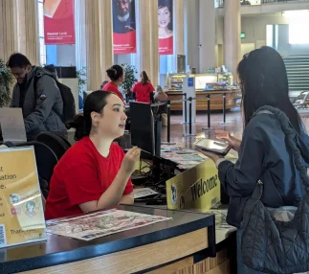
Student Information Service
The Student Information Service team can help with questions on online registration and identity checks, getting a SIM card, IT support, banking and more.
Before you arrive - get help by email or phone
When you’re in Leeds - visit the Welcome Hub in the Parkinson Building or another information point on campus.
Getting help - The Student Information Service

Slide 38
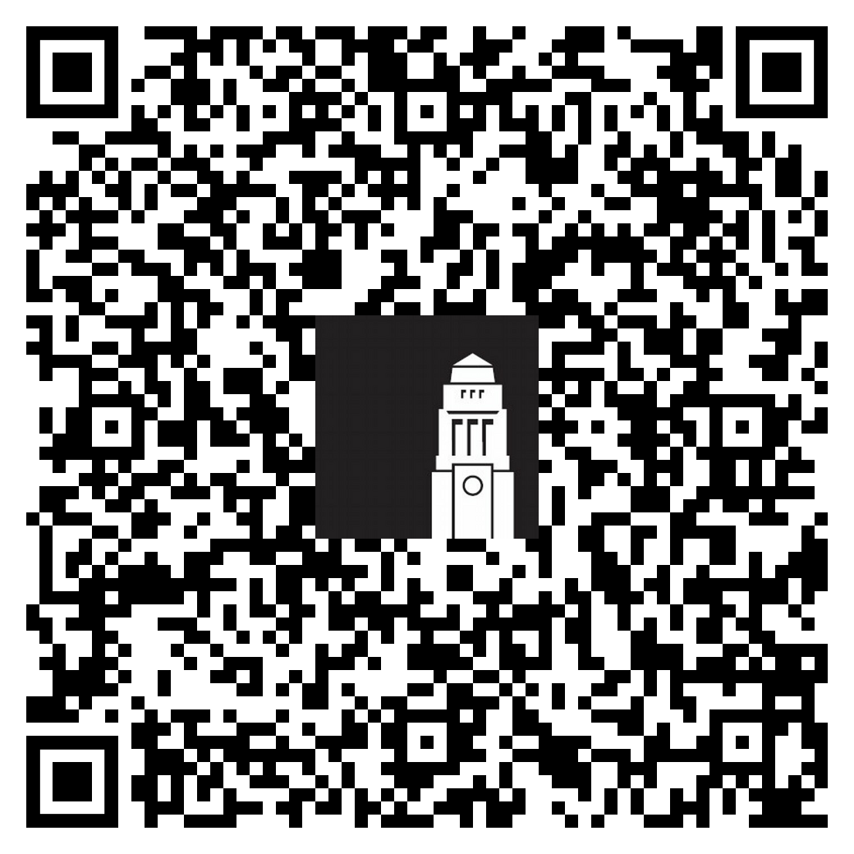
Thank you
How was this session?
Give us feedback on the Money and Banking webinar for a chance to win one of three £30 shopping vouchers.

