Slide 1

Healthcare and
Wellbeing
International Orientation
International Student Office
Student Information Service​

Slide 2
Disclaimer
All content in this presentation has been prepared for the 2026/27 academic year and is subject to future updates or modifications.​

Slide 3

Useful resources
International Orientation

Slide 4
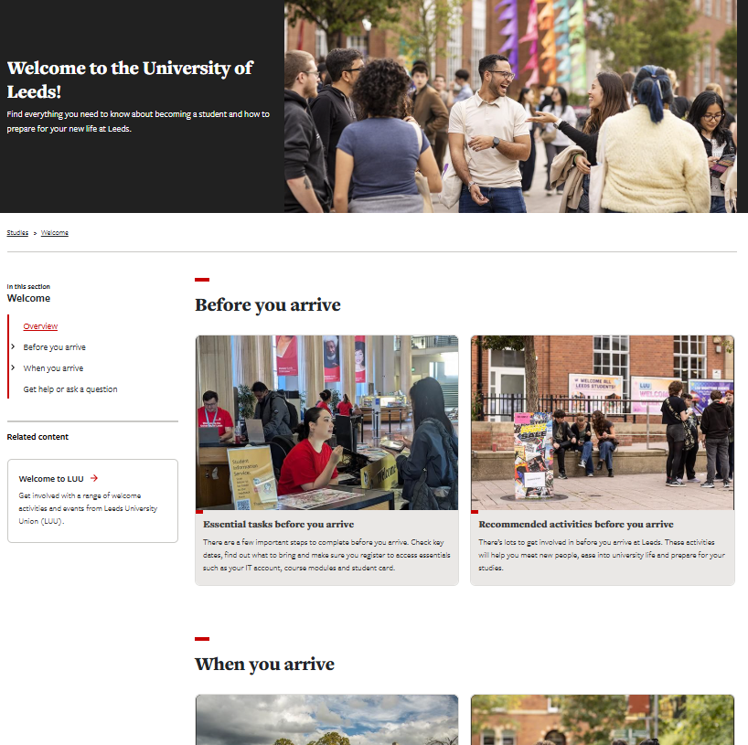
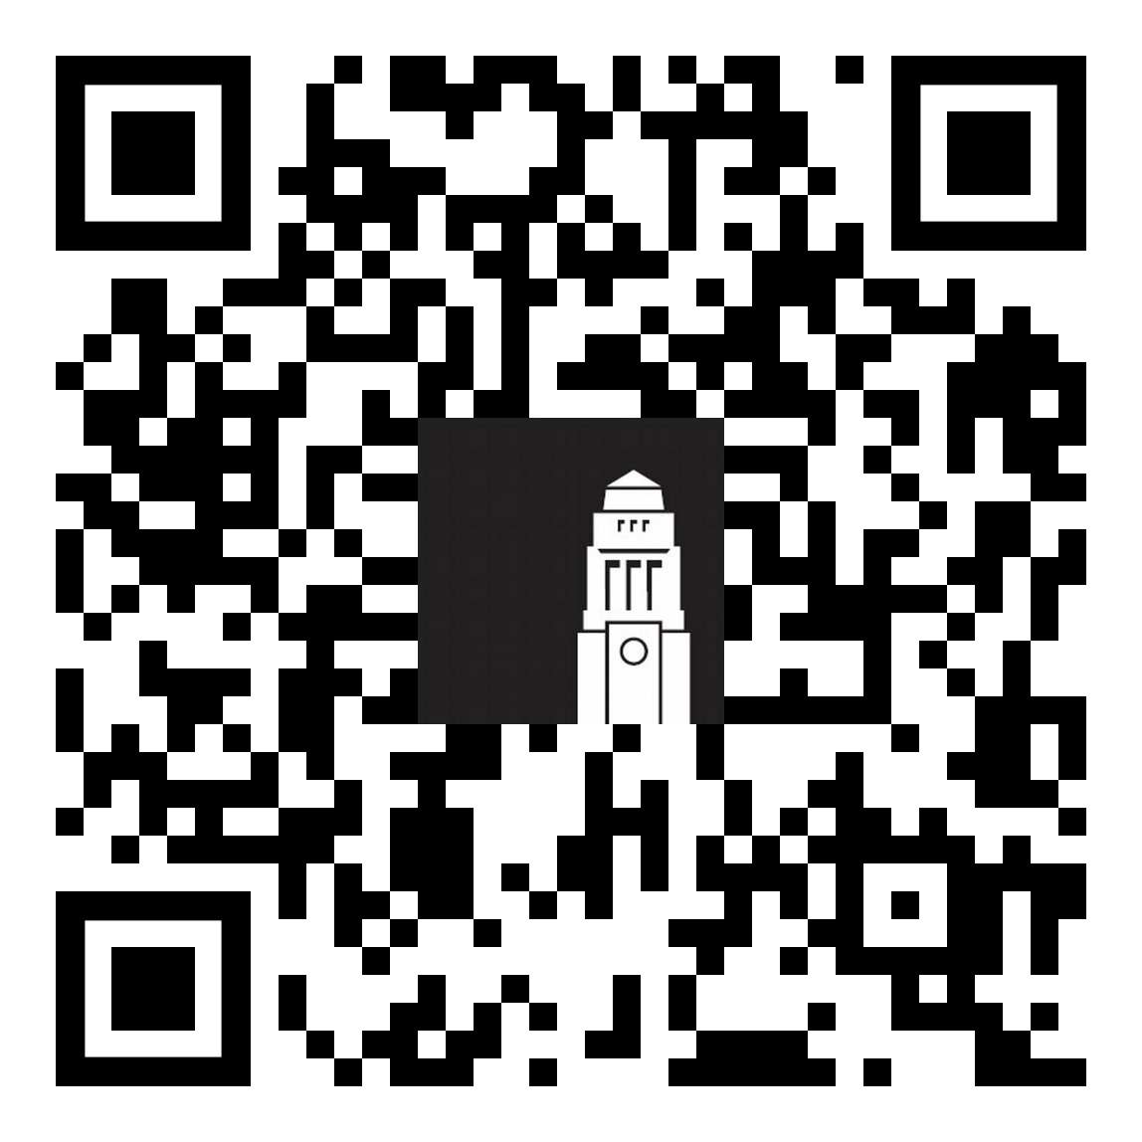
Welcome guide
Your guide to preparing for life in Leeds.
Check admin tasks to complete before and when your arrive to ensure you're ready to start your studies
Browse opportunities to meet people, get involved and start networking
students.leeds.ac.uk/welcome​

Slide 5

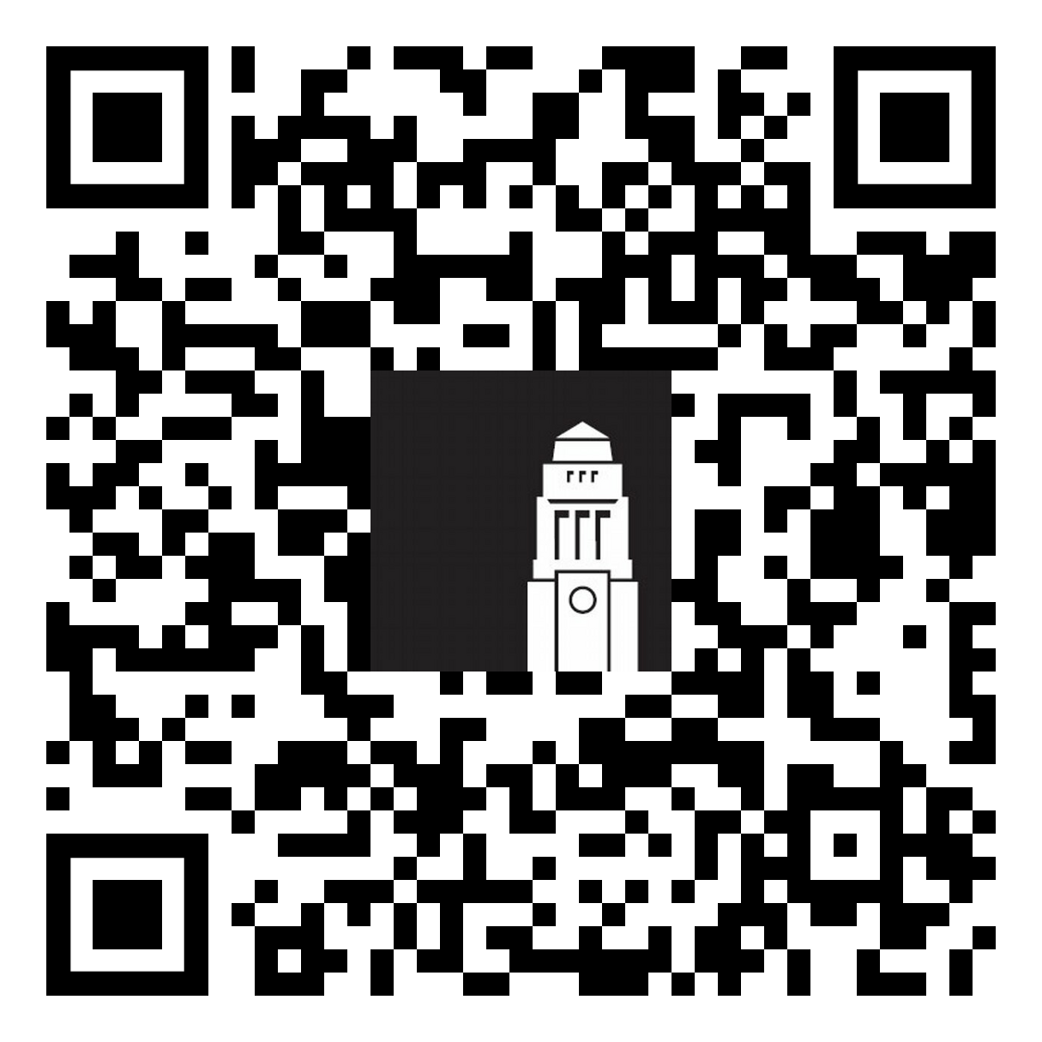
Welcome Hub
Run by the Student Information Service, the Welcome Hub is your place to ask questions and get help.
The team can help with questions on online registration and identity checks, getting a SIM card, IT support, banking and more.
Getting help - The Student Information Service

Slide 6

Healthcare in the UK
International Orientation

Slide 7

The National Health Service
Public, government-sponsored universal
healthcare system
Free access to services for UK residents and international students who have paid the International Health Surcharge (IHS)

Slide 8
Healthcare essentials
Important numbers
GP
GP Surgery
111
999
General
Practitioner
Where a GP works
(medical centre or medical practice)
Non-emergencies
Emergencies

Slide 9
NHS 111 (1)
NHS 111
Call this number if you're unsure about what to do, it's after 5pm or it's a weekend.
111 online Check your symptoms online
Call 111 No need for a country code – simply call 111 from your phone.
Available 24h and 7 days of the week.
When you call 111:
You'll speak to an operator
You can ask for an interpreter.
The operator will ask you questions on how you feel - some might feel like strange questions, but they are all important.

Slide 10
NHS 111 (2)
NHS 111
Call this number if you're unsure about what to do, it's after 5pm or it's a weekend.
Depending on your symptoms, 111 might tell you to:
call 999 or go to A&E in an emergency
see an evening and weekend (out-of-hours) GP
book a callback from a nurse
get urgent specialist support, for dental or mental health problems
contact your own GP surgery
see a pharmacist for help with a minor illness
look after yourself at home

Slide 11
Pharmacy
Pharmacy First
Skin conditions, ear and throat aches, stomach pain,
sprains and strains.
Pharmacists can prescribe antibiotics and treat these symptoms:
Ear infections
Infected insect bites
Shingles
Sinusitis
Sore/infected throat
Uncomplicated urinary tract infections

Slide 12
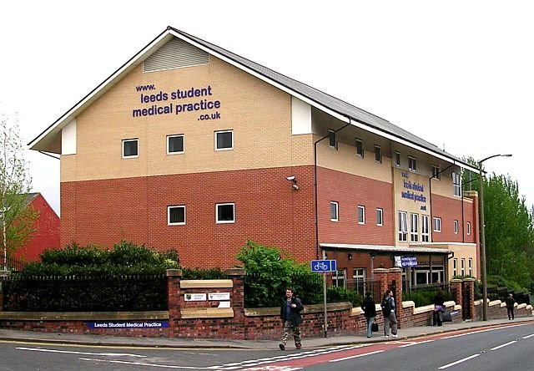
Leeds Student Medical Practice
GP (Doctor)
You're still unwell,
make an appointment with a GP.
Leeds Student Medical Practice works with the University of Leeds to support our students' needs. They offer:
Medical help
Support for LGBTQ+ students
Support with your mental health
Register with the Leeds Student Medical Practice as soon as you arrive in Leeds.
LSMP location
Leeds Student Medical Practice website

Slide 13
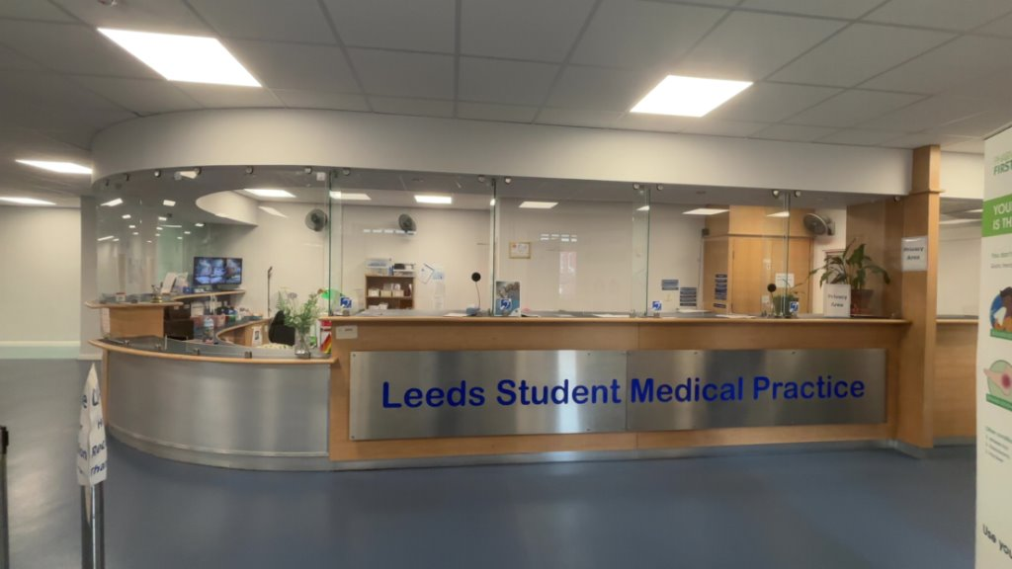
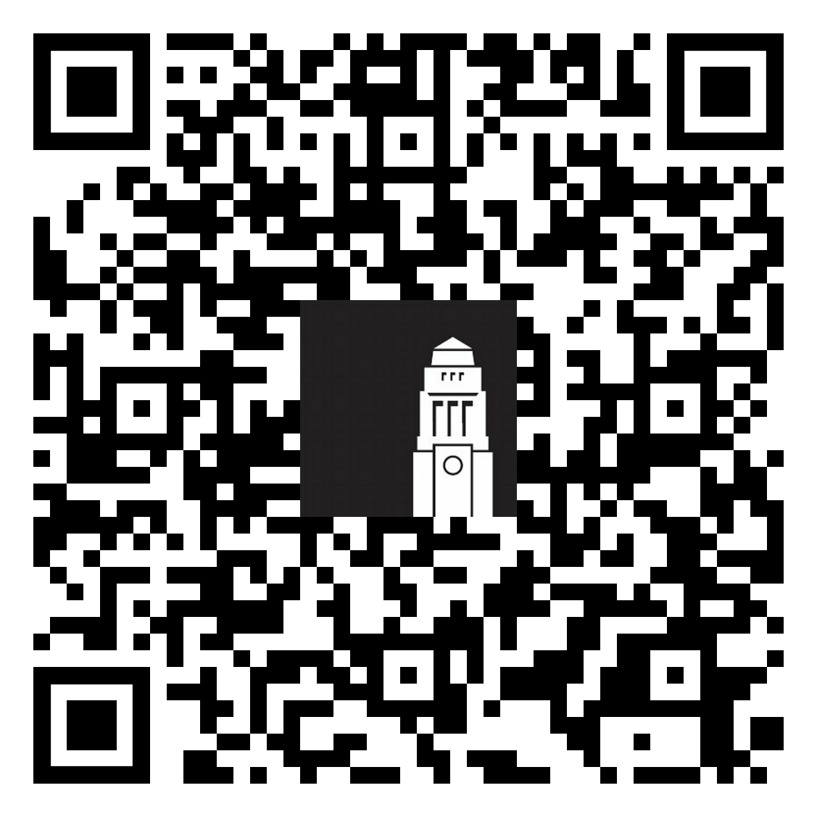
Register with
Leeds Student Medical Practice
GP (Doctor)
You're still unwell,
make an appointment with a GP.
Register with the Leeds Student Medical Practice
You'll need your accommodation address and date of when you’ve arrived in the UK
If you don't have some of the information asked in the form, select ‘prefer not to say’ or ‘I don’t know’ - you can update the details when you have them.
Scan the QR code to register as a patient

Slide 14
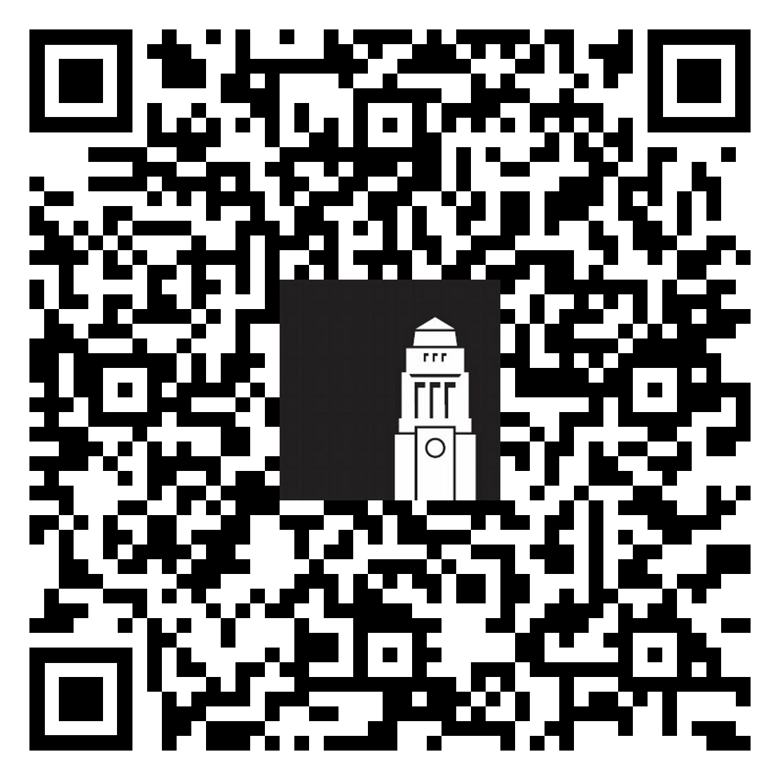
Meningitis vaccinations
Bring your vaccinations record with you.
All students must vaccinated against MenB – must have taken 2 doses taken 4 weeks apart.
If you can't get vaccinated before you leave your home country, speak to the Leeds Medical Practice on arrival.
Free vaccinations offered to under 25, first year Undergraduate students or students staying in halls of residence.
What is Meningitis and information on type of vaccine used in the UK

Slide 15
After you've registered
Your registration is finalised within 2 days.
If you’ve not received confirmation about your registration but you need to see a doctor, the practice can still book an appointment for you.
Sometimes the medical practice offer a health check when you arrive.
This is a brief appointment with a nurse or healthcare assistant to do some health checks and discuss your medical history, medications, and any ongoing conditions.
If you have a long-term condition and take ongoing medication, a nurse or healthcare assistant will discuss how to get your medication.
Scan the QR code to register as a patient

Slide 16
Seeing a doctor
Contact the Leeds Student Medical Practice:
By phone
Call the reception during opening hours (+44) 113 2954 488.
In person
Visit the reception desk.
Leeds Student Medical Practice, 4 Blenheim Court, Blenheim
Walk, Leeds, LS2 9AE
You can also request an appointment via the practice's online booking system - Patchs.
Speak to the practice on how to register for their online services.
Scan the QR code to register as a patient

Slide 17

During the appointment
Time
Appointment time 15 minutes, so try to be clear and focused.
Discussion
The GP will ask about your symptoms, lifestyle, medical history, and any medicines you take.
Examination
If needed, your GP might check things like your blood pressure, heart, throat, or joints. They’ll always explain first and ask permission.
Language help
If English isn’t your first language and you find it difficult, ask for a free NHS interpreter.

Slide 18
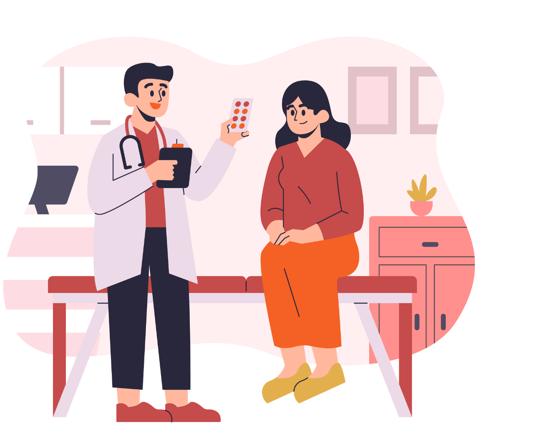
After the appointment
Depending on your situation, the General Practitioner could:
Give you advice or things you can do to stay healthy
Give you medication (you’ll collect it from a local pharmacy, usually
paying a standard fee)
Arrange tests (blood, urine, scans, etc.)
Arrange an appointment to check on how you feel
Refer you to a specialist doctor or hospital
Specialist hospital appointments
Are not always free. They depend on your visa type.
Might have longer waiting times and your GP cannot help speed your referral.

Slide 19
NHS walk-in services
NHS Walk-in services
If you cannot get to the GP and it’s not getting better, call 111.
NHS walk-in services are medical centres you can go to:
Out of hours (after 5pm)
At weekends
These are centres that you can visit if you haven't registered with a doctor.
There are several walk-in services in Leeds - call 111, they will tell you where to go.

Slide 20
Accident and Emergency (A&E)
A&E 999
If your life is in danger.
Losing blood, broken bones, difficulty breathing.
Unlike in some other countries, emergency services in the UK should only be used in a life-threatening situation:
You're losing blood
You've broken a bone
You've had a serious accident
You're struggling to breath
Call 999 if you do need to access emergencies services.
Call 111, do not go to A&E if you're not in immediate danger.
Leeds General Infirmary - Emergency department

Slide 21
What to do if you're ill
Always available:
NHS 111
Call this number if you're unsure about what to do, it's after 5pm or it's a weekend.
Step 1
Pharmacy
Skin conditions, ear and throat aches, stomach pain,
sprains and strains.
Step 2
GP (Doctor)
You're still unwell,
make an appointment with a GP.
If you can’t see your GP:
NHS Walk-in services
If you cannot get to the GP and it’s not getting better, call 111.
Only if emergency:
A&E - 999
Immediate help.
Losing blood, broken bones, difficulty breathing.

Slide 22

Healthcare and your visa

Slide 23
If you’re in the UK for a semester or less
Covered
To be paid for
General Practitioner's visits
Immediate A&E treatment
Specialist appointments, hospital stays
Dental treatment
All medications bought in the UK
It is important to have medical insurance to cover you for any treatment that you need to pay for.​ If you’re a student from the EU, you can still use a valid EHIC to access healthcare.
Healthcare and your immigration status

Slide 24
If you'll be in the UK for more than 6 months
Covered
To be paid for
The Immigration Health Surcharge entitles you to receive health services under the NHS.
Chevening or Commonwealth Scholars with an IHS reference number, which can be used as evidence of your exemption.
Your medications and dental treatment
Any private appointments you decide to have (if not advised by your doctor)
Healthcare and your immigration status

Slide 25

Dental care

Slide 26
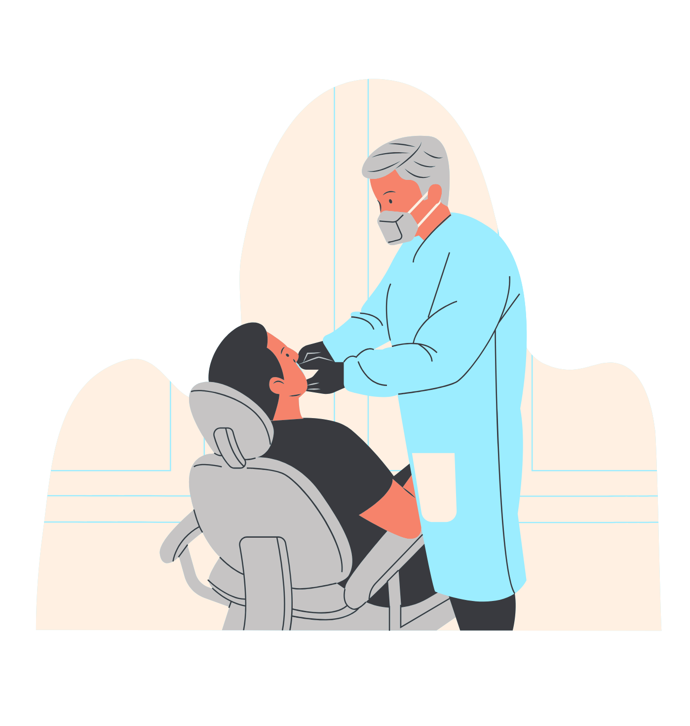
NHS Dental care (1)
You can apply for NHS dental care only if you have paid the Immigration Health Surcharge as part of your visa application.
NHS dental care is not free. Prices vary depending on the treatment you need (£27~£320)
check NHS fixed dental care costs.
The NHS offers visits for necessary treatment needed to keep your mouth, teeth, and gums healthy. This includes regular check-ups, fillings and tooth extractions.
Register with a doctor and a dentist

Slide 27
NHS Dental care (2)
Registering with a Dentist
You must register with a practice.
Search for an NHS dentist and register
Availability
Only some dentists are accepting new NHS patients so start looking for a dentist now.
Special exemptions
Dental care is free for children and pregnant women.
Register with a doctor and a dentist

Slide 28

Private dental care
Available to everyone.
Normally more expensive than NHS dental care and not free for children.
Costs set by individual dentists and can change from practice to practice.
Shorter waiting times for appointments.
All treatments, including cosmetic.
Register with a doctor and a dentist

Slide 29

Understanding wellbeing

Slide 30
Taking care of yourself
Emotional
5 steps to wellbeing:
Connect with other people
Be physically active
Learn new skills
Give to others
Take notice
Physical
Social

Slide 31
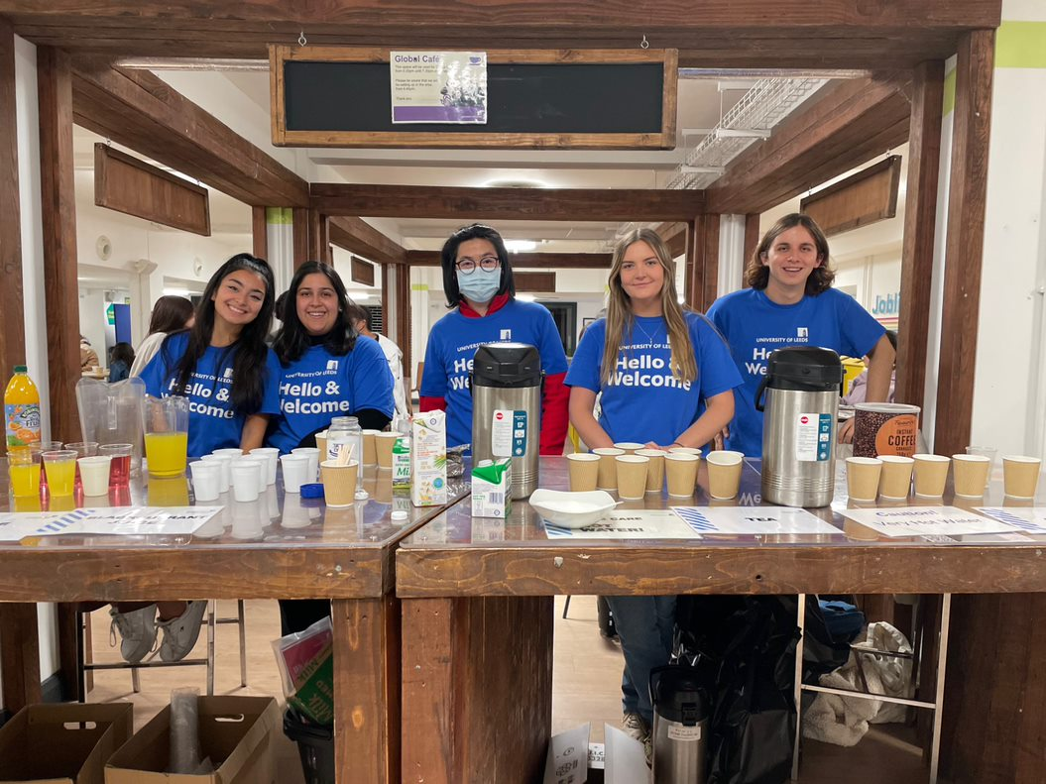
Connect with people
Things you can do:
Apply for the Buddy Scheme
Come to Global Café
Join a Leeds University Union society
Come along to Leeds Uni events
Ways to meet people

Slide 32


Be physically active
Things you can do:
Check what’s on offer our sports centre
The Edge
Join events offered by Active Campus
Explore Leeds and the beautiful countryside (Hike in the Yorkshire Dales or Ilkley Moor)

Slide 33
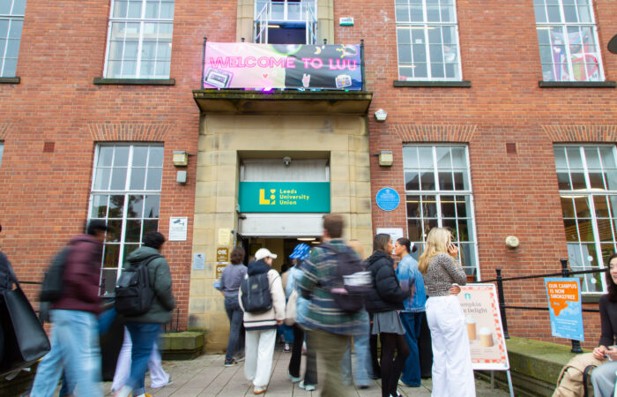

Learn something new
Things you can do:
Check the Give it a Go programme
Visit the LUU Welcome Fair to check what societies are on offer (21-27 September)
Take a tour of HELIX, the University’s learning space for students, staff, and the local community.

Slide 34

Give to others
Things you can do:
Sign up for the Jobs, careers and volunteering in the UK talk
Find out more about Volunteering opportunities
Volunteering Fair: Thursday 15 October 2026, Riley Smith Theatre

Slide 35
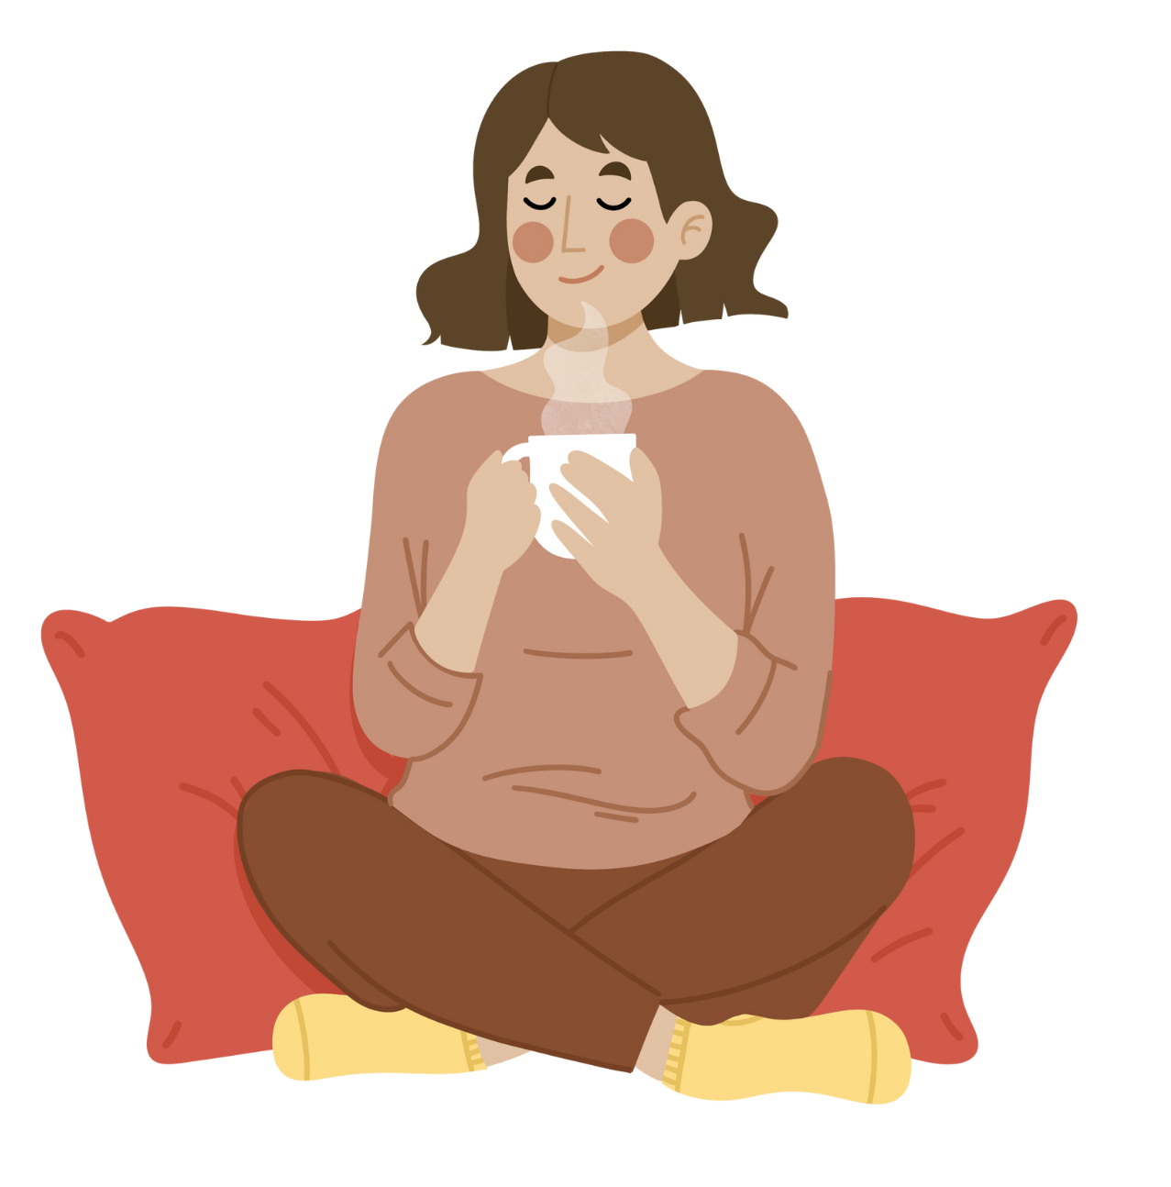
Take notice
Take time to stop and be aware of your surroundings and pay attention to your thoughts and feelings.
Things you can do:
Record your thoughts and feelings
Download our University mindfulness MP3 recordings
Attend a Student Counselling and Wellbeing workshop

Slide 36

Getting help

Slide 37
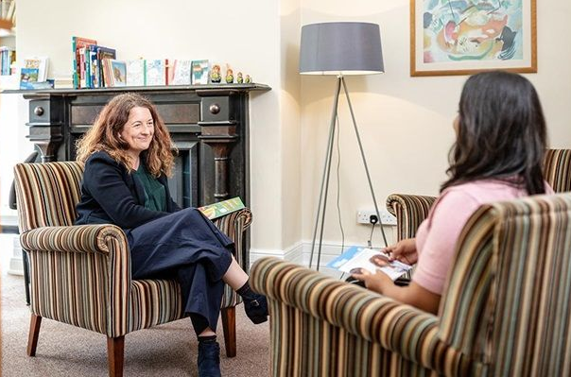
Student Counselling and Wellbeing
Free, confidential, specialist support from an experienced team of counsellors, mental health advisers and wellbeing practitioners in addition to online resources for you to access in your own time.
Stress
Homesickness
Academic problems
Culture shock
Life events
Counselling and Wellbeing support

Slide 38
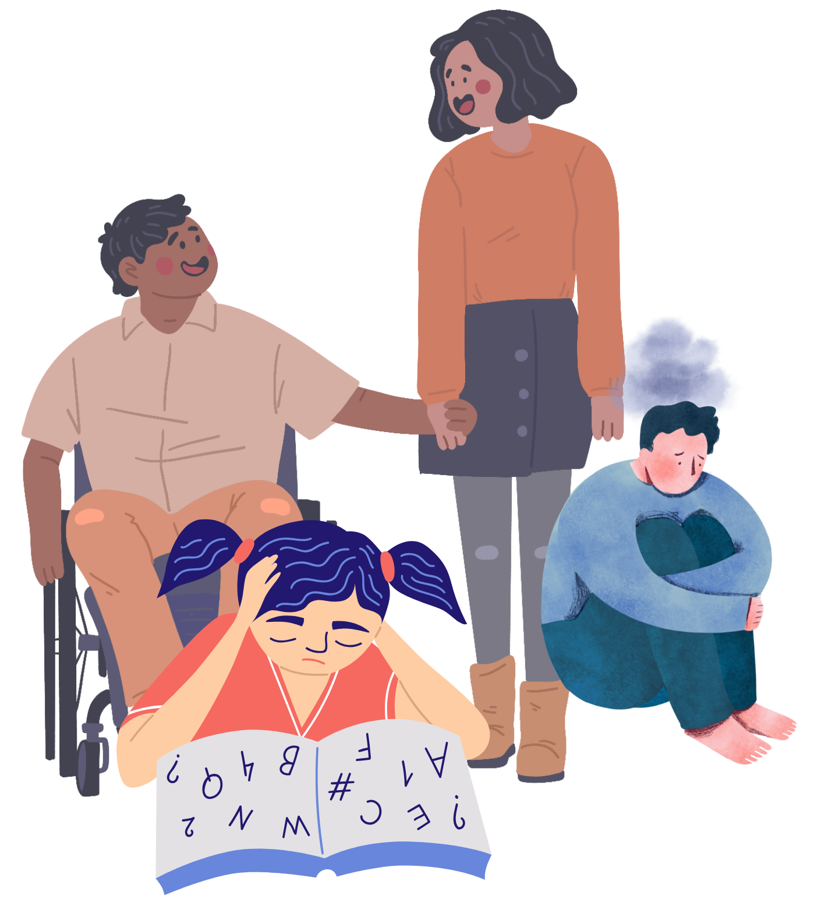
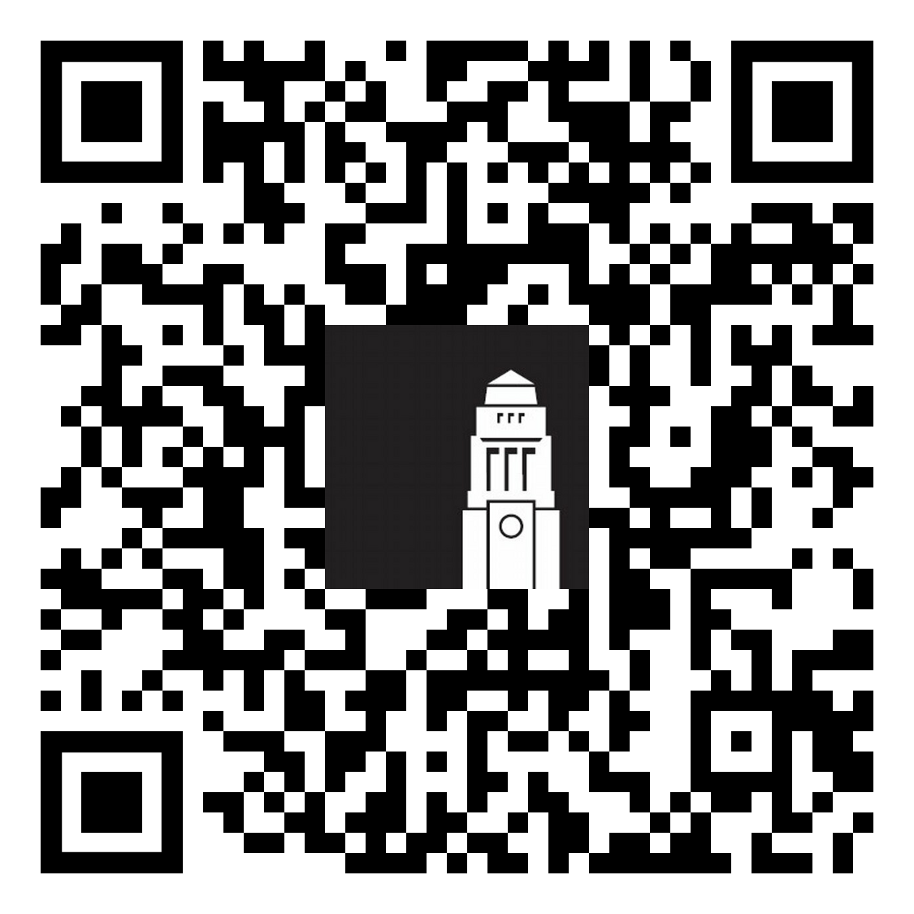
Disability support
The Leeds Student Medical practice also works closely with the University of Leeds to support our disabled students.
In the UK, the term "disability" covers conditions, illnesses and impairments that can affect your academic success. These can be:
Visible or invisible
Physical or related to mental health
Our Disability Services team ensures you have a successful academic experience in Leeds.
Register with Disability Services
Disabled Student Support

Slide 39

Disability Services
Advising your academic School on the support you may need in your learning.
Recommending academic adjustments for your course.
Giving you advice on a range of matters, from funding to assistive technology.
Providing you with ongoing support throughout your time at Leeds.
Contact the Disability Services team at Disability@leeds.ac.uk
Disabled Student Support - website

Slide 40

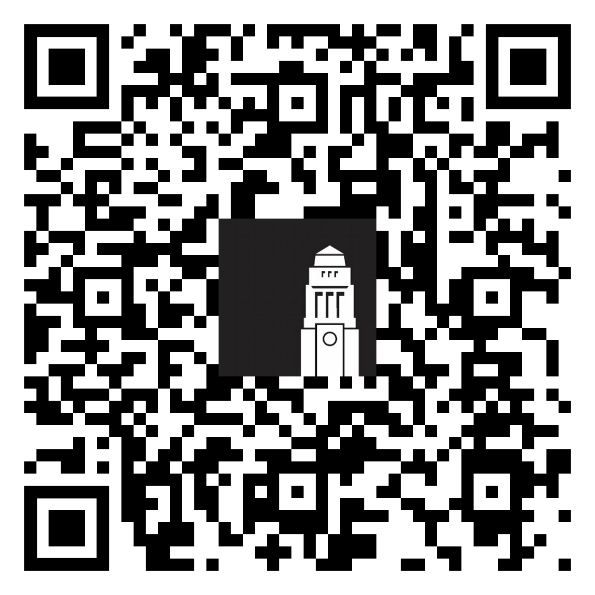
Faith-based support
Our Chaplaincy supports students of all faiths, and none.
Join faith-based societies in Leeds University Union
Book a Muslim faith campus tour
(available until 27 September)
Chaplaincy website

Slide 41
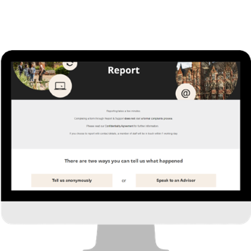

Harassment and Misconduct
Whatever you’re going through, you’re not alone. Violence, abuse, bullying, harassment, sexual misconduct, and discrimination are never okay.
If it happens to you or someone you know, the Harassment and Misconduct team can help however feels right to you, whether you want to explore support options, make a formal report, or just talk to someone.
We’re here for you every step of the way.
Complete the disclosure form to talk to a specialist advisor.
Email: reportandsupport@leeds.ac.uk

Slide 42
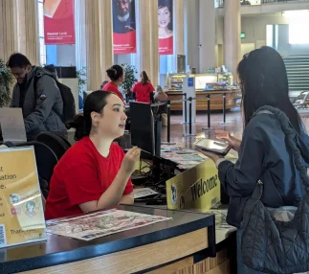
Student Information Service
Run by the Student Information Service, the Welcome Hub is your place to ask questions and get help.
The team can help with questions on online registration and identity checks, getting a SIM card, IT support, banking and more.
Before you arrive - get help by email or phone
When you’re in Leeds - visit the Welcome Hub in the Parkinson Building or another information point on campus.
Getting help - The Student Information Service

Slide 43

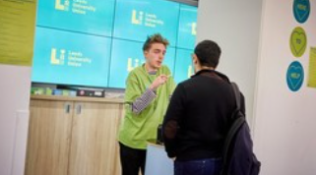
LUU Help & Support
Leeds University Union Help & Support Advisers can help with:
Wellbeing and your mental health
Budgeting and your finances
Living in Leeds, private-sector accommodation and staying safe
Exam support, appeal procedures and studying in Leeds
Student life
Meet in person Foyer of the Students' Union building
Email advice@luu.leeds.ac.uk
Phone +44 (0)113 3801 400
LUU Help & Support

Slide 44
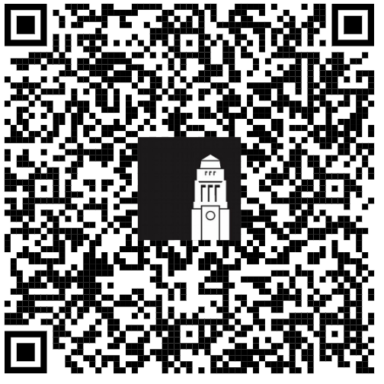
Thank you
How was this session?
Give us feedback on the Healthcare and Wellbeing webinar for a chance to win one of three £30 shopping vouchers.

