Slide 1
Tier 4 Extension Session
International Student Office
August 2018

Slide 2
International Student Office
Fraud warning from the International Student Office
We are aware that a number of international students at universities in the UK have been targeted by fraudsters, pretending to work for the UKVI, the police or another official authority in their home country. These fraudsters say there is a problem with their visa or tell them they are suspected of a crime such as money laundering. The fraudsters usually ask for payment and personal details. This criminal activity has focussed on certain nationalities, including Indian and Chinese students.
If a student receives a call asking for money or personal details, it is really important they end the call immediately.

Slide 3
International Student Office
Who needs to be here
Anyone who needs to extend their visa for their main course
What we will cover today
Why a perfect application is IMPORTANT
Why you need to apply before your visa expires
How we are going to help you
Supporting documents
How much money you will need to show
Making your application

Slide 4
International Student Office
Why is making a perfect application important?
If your application has one mistake or your supporting documents are incorrect, it will be refused
This could affect the possibility of you starting your course; making another Tier 4 application and remaining the UK.
Therefore it is essential that you complete the application form correctly and have all the necessary correct documents with you at the time of applying

Slide 5
International Student Office
Essential Documents
Passport
Two Passport Photographs
Bank Statements (if self-funded)
Parents Bank Statements, original birth certificate and letter from parents in English (if parents sponsoring)
Sponsor/Scholarship/Bursary letter (if financially sponsored)
Confirmation of Acceptance for Studies (CAS)
Qualifications used to obtain the offer

Slide 6
International Student Office
Important Note
If you are sending your application by post, you must photocopy every document that you are sending with it so if there are any problems we can check the copies
If you are applying in person at UK Visas & Immigration (UKV&I), we also recommend that you photocopy your documents before attending your appointment

Slide 7
International Student Office
Ways to apply
There are 3 options to choose from:
Standard (Postal) 8 weeks £475
Priority (Postal) 10 days £952
Premium (In person) Same day £1,085
Premium appointments are very limited at this time so we would recommend the Priority Service if you require your documents back before 8 weeks.

Slide 8
International Student Office
Photographs
Read the UKV&I photograph guidance:
https://www.gov.uk/photos-for-passports
Do not use old photographs taken in your home country, they should be different from the one on your current visa and MUST be taken in the UK
Your photographs should be no more than one month old at the time of application
Measure the photographs (overall size and head size)
Don’t smile, have a neutral expression
Make sure the background colour is either cream or grey
Write your name on the back of each photograph

Slide 9
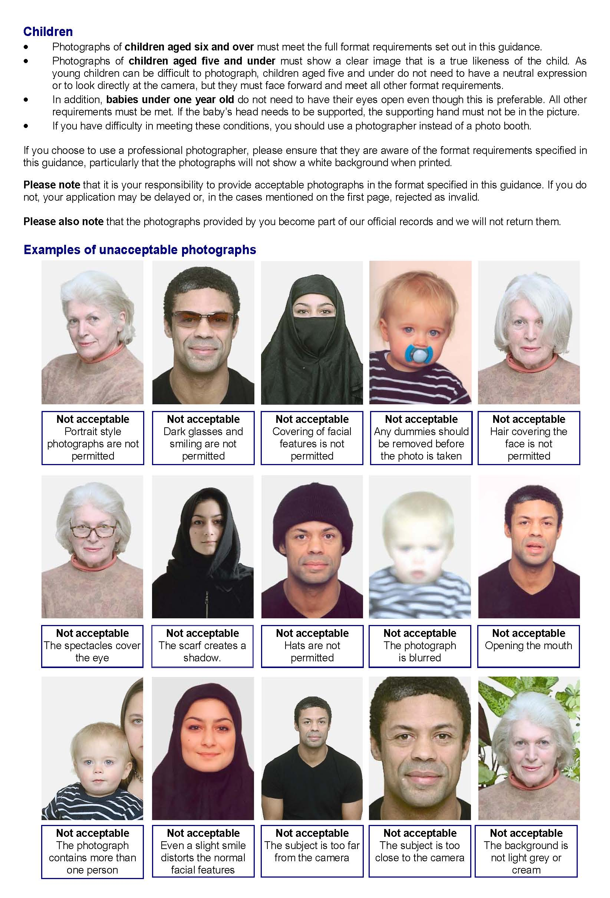

Slide 10
International Student Office
Bank Statements
You can use a UK or overseas bank statement
£9135 plus outstanding first year tuition fees
Money has to be in the account for consecutive 28 days at the time of making the application
Bank statements must not be older than 31 days at date of application (which is date you pay online for your application)
Bank statements must include your full name, bank logo, account number, date of the statement – original statements are recommended
Online statements must be stamped on each page
Useful to print out a currency conversion into GBP from www.oanda.com/currency/converter if using an overseas bank statement

Slide 11
International Student Office
Sponsor letter
Must be original (no photocopies/scans) and include:
Your name
Name and contact details of the official financial sponsor
Date of the letter (dated within the last 6 months)
Length of the sponsorship
Amount the sponsor is giving to the student or a statement that the student’s official financial sponsor will cover all of the fees and living costs

Slide 12
International Student Office
Previous Qualifications
Original, not a photocopy or scan (this will be returned to you)
The qualification you sent to Admissions to obtain your offer (usually your English test results and your academic qualification e.g. undergraduate degree, diploma etc.)
The qualifications are also listed on your CAS statement under “evidence used to obtain the offer”
You must check your qualification against the information on the CAS statement (name of qualification, place of issue, date of issue). If the information does not match, you must contact: tp_applications@adm.leeds.ac.uk
If the qualification is not in English, you must provide an official translation

Slide 13
International Student Office
Translations
The official translation must include:
The translators qualifications
The translator/translation company's contact details
Confirmation from the translator that it is an accurate translation of the original document with a signature
The date of the translation
If your translation does not tick all the boxes, you must obtain a new translation from a translating company in the UK:
http://translatemydoc.co.uk/
The translation can be from your home University provided that it has been stamped by the University

Slide 14
International Student Office
Immigration Health Surcharge (IHS) Fee
You will be required to pay a Immigration Health Surcharge Fee at the point of submitting your visa application.
This is a mandatory fee and applies to you and any dependants applying with you.
The fee is £150 per year per person. You have to pay the fee for the total length of the visa, not the length of the course.
If your course is 12 months you will pay £225 as your visa will be issued for 16 months.
You can calculate your IHS payment here:
https://www.immigration-health-surcharge.service.gov.uk/checker/type

Slide 15
International Student Office
Biometric Residence Permit (BRP)
Your new visa will be granted as a Biometric Residence Permit, also known as a BRP
Your new visa will not be a vignette (sticker) in your passport
If you have a BRP from a previous grant of leave in the UK, you will need to include it with your application
Make sure you keep your BRP safe
If you leave the UK you must take your BRP with you as you will require your BRP to re-enter the UK

Slide 16
International Student Office
Payment Options
Pay online using credit or debit card.
No other form of payment is acceptable i.e. cash, bankers draft, postal orders etc.

Slide 17
International Student Office
Police Registration Certificate
If this is applicable to you:
If current course is longer than 6 months and a national of one of the following countries:
Afghanistan, Algeria, Argentina, Armenia, Azerbaijan, Bahrain, Belarus, Bolivia, Brazil, China, Colombia, Cuba, Egypt, Georgia, Hong Kong, Iran, Iraq, Israel, Jordan, Kazakhstan, Kuwait, Kyrgyzstan, Lebanon, Libya, Moldova, Morocco, North Korea, Oman, Palestine, Peru, Qatar, Russia, Saudi Arabia, Sudan, Syria, Tajikistan, Tunisia, Turkey, Turkmenistan, United Arab Emirates, Ukraine, Uzbekistan, Yemen.
The certificate must have your up to date address (the address must be the same as the one you enter on the Tier 4 application form)

Slide 18
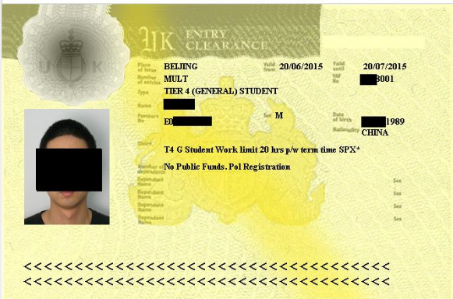
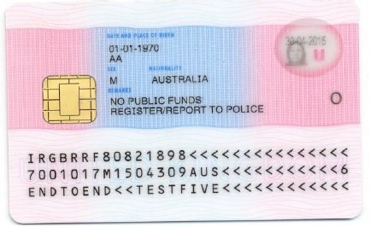
International Student Office

Slide 19
International Student Office
ATAS
Security clearance certificate issued by the FCO to study certain subjects
Check on your offer letter if your course requires ATAS clearance
If your course requires ATAS, you must apply for ATAS clearance immediately to avoid any delays. It can take up to 20 working days for an ATAS certificate to be issued (currently taking 30 working days)
http://www.fco.gov.uk/en/about-us/what-we-do/services-we-deliver/atas/apply-online
Once you receive the ATAS clearance certificate you must print it and include it with your Tier 4 application.
If you have not received your ATAS certificate after 20 working days please inform the International Student Office and we can chase this up for you.

Slide 20
International Student Office
Your CAS
The Admissions department will e-mail your CAS to you after you have successfully completed your pre-sessional course (around 14 September)
The CAS will not be on University letter headed paper and it does not need to be
We recommend that you print off and send a copy of your CAS with your Tier 4 application

Slide 21
International Student Office
Details on your CAS
Details you need from your CAS statement to complete the visa application form:
The Sponsor License Number: HG3NCOA4
Your CAS number
The course title
The start and end dates of your course
If your course requires ATAS clearance or not
Which qualification(s) you must submit with your application

Slide 22
International Student Office
Your CAS number
The CAS number on your CAS statement is your unique number
UKV&I can access your electronic CAS record online using this number
Any tuition fee payments and University accommodation payments up to £1,265 made will be updated and shown on the electronic CAS record (not the paper version you received) so UKV&I will see those online

Slide 23
International Student Office
How much money do you need to show?
£9,135 for 28 consecutive days in addition to any tuition fees that you have not paid
Therefore we strongly recommend:
Holding at least £9,135 into your bank account immediately and keep it in your account until your visa has been granted
Paying the full tuition fee before making the visa application

Slide 24
International Student Office
The application form
Create an online account and complete the Tier 4 Student Online Application here:
https://visas-immigration.service.gov.uk/product/tier-4-student
There is a useful guide to completing the online form on our website:
http://students.leeds.ac.uk/info/21506/your_visa/998/language_centre_visa_extensions_in_september

Slide 25
International Student Office
Bank Statement check
Does it cover a period of 28 days, with the closing balance/last transaction being no more than 1 month before making the application?
Does the minimum balance never drop below the required amount during those 28 days?
Does it include the bank’s logo?
Does it include your full name (not initials)?
Does it include the full account number?
If you use online, or ad-hoc, statements: Is every single page stamped by the bank?

Slide 26
International Student Office
Photograph Check
Have you measured the head size?
Does it meet the requirements of the photograph guidance (e.g. is it not too close to or to far away from the camera)?
Do you have a neutral expression (e.g. no smile)?
Is the background grey or cream?
Was the photograph taken within the last month?

Slide 27
International Student Office
FAQ’s
I live in private accommodation. Can I deduct the accommodation payments from the maintenance requirement?
No, only University of Leeds accommodation payments of up to £1,265 can be deducted.
I want to use my parents bank statements/my bank statements from abroad. Is this possible?
You can use bank statements from abroad, but if using your parents bank statements you will need to provide your original birth certificate and a letter from your parents, if they are not in English you will also need a translation.

Slide 28
International Student Office
FAQ’s
How long does it take until I receive my passport back?
It can take up to 8 weeks. This is a very busy time for UKV&I and it might take longer than usual. We advise you not to book any flights until you have your passport back.
What if I change address after making my application?
Update UKV&I via their website https://eforms.homeoffice.gov.uk/outreach/AddressUpdate.ofml

Slide 29
International Student Office
WHAT WE WILL DO:
Provide you with an appointment to have your application and documents checked.
You can book an appointment from Monday 10 September 2018.
The Appointment Booking Sheet will be available on Language Centre Reception, Level 3, Parkinson Building
The appointments will take place in the Richard Hughes Cluster Room 1.40 Clothworkers Link Building between 17 September to 28 September 2018 and
Please do not book multiple appointments and attend at the time you have booked
Post your application and documents to the UKVI (free of charge)

Slide 30
International Student Office
WHAT YOU MUST DO:
Open a UK bank account and deposit your tuition fees plus £9135 in your account before the 30 August 2018.
If using overseas account, need original bank statements posting to you. Must not be older than 31 days old when you make visa application.
If using parents bank account, need original birth certificate and letter from parents confirming they are funding your studies.
If sponsored obtain original up to date sponsor letter.
Obtain original degree certificate you used to obtain your offer.
If not in English provide a translation.
Obtain passport photographs from UK (photo booth inside Tesco, cost £5).
If applicable update police registration certificate.
Obtain ATAS certificate (if applicable).
Complete the online visa application form before you attend appointment

Slide 31
International Student Office
AFTER SUBMITTING YOUR VISA APPLICATION:
You will print off a Biometric Enrolment Letter, take this to the Post Office in St Johns Centre (opposite MacDonald's) and provide your fingerprints and photographs (Costs £19.20)
You will receive an email telling you to collect your documents (passport etc) and BRP from the Student Services Counter – allow up to 8 weeks for this. It may take longer for your documents to arrive at busy times.
Check your BRP – if there are any errors come to the International Student Office.

Slide 32
International Student Office
Support and Advice
http://students.leeds.ac.uk/#International-students
http://www.ukcisa.org.uk
E-mail: internationalstudents@leeds.ac.uk
UKCISA advice line: 020 7107 9922 open Monday-Friday 13.00-16.00

